Slide 1
Computer Systems
  Labs - summer 2025/26
    Tomáš Faltín, https://fan1x.github.io/

Slide 2
Lab 06
27/04/2026
18/05/2026

Slide 3
Lab Tests
2 hours long, 2+1 attempts, terms are in SIS
In the lab rooms, using local PCs (no laptops allowed)
  Access to Internet resources will be restricted
Completing (fixing) home assignments before the test is recommended
  You may re-use code from your home assignments in the test
Beware ALL unforgivable curses!
Practice
  AD&D dice example task (follow a link on the Grading page)
  Try the extra tasks introduced on the slides
  Demo test (in SIS)
Ask if anything is unclear

Slide 4
Homework Feedback
Be aware of deadline (Tuesday 21:59)
Request a review after fixing the problems
Test locally first (10 attempts only)

Slide 5
Homework Discussion
Take your colleague's code, discuss and code-review it together
☺ What do you like and why? What did you do differently?
☹ What do you dislike and why? Discuss a potential fix
What was the hardest?

Slide 6
Pointers
Create a space
for one int
type *p = <pointer expression>
  nullptr – pointer to nowhere (special value)
  Taken as address of existing value (&)
  Computed from another pointer (pointer arithmetic)
  Memory allocation function/operator
    Not needed on Arduino, use only static array allocation, e.g., int a[4]
int x = 42;
int *p1 = &x;
int *p2 = p1 + 5;
address-of operator
Not a reference
Declare pointer

Slide 7
Arrays
p1
p1
p3
int buffer[8];
Array ~ pointer at the beginning.
int *p1 = buffer;
Increment/decrement
int *p2 = ++p1;
Arithmetic
int *p3 = p1 + 3;
buffer[1] ~ *(buffer + 1)
Addresses
20
24
28
2c
30
34
38
3c
buffer
p2
Number of bytes deduced
from the type, i.e., sizeof(int)
Prefer brackets when
working with arrays

Slide 8
Strings
Array of chars, terminated by zero char ‘\0’
const char *msg = “Arduino”;
20
24
28
2c
30
34
38
3c
msg
41 | 72 | 64 | 75 | 69 | 6e | 6f | 0
Read-only
Ascii

Slide 9
Pitfalls
  Uninitialized pointers
  int *p;
  Reaching beyond arrays
  int buf[5];
  int *p = buf + 5;
  *p = 42;
  Strings in fix-sized buffers (like char buf[32])
  char msg[] = {'A','r','d','u','i','n','o','\0'};
  Possible, but dangerous (must not overflow!)
  Do not forget to make space for trailing zero!
char msg1[] = {
'A','r','d','u','i','n','o','\0’};
char msg2[] = "Arduino";
char msg2_copy[7];
int msg2_copy_size =
sizeof(msg2_copy)/sizeof(msg2_copy[0]);
for (int i = 0; i < msg2_copy_size; ++i) {
msg2_copy[i] = msg2[i];
}
printf("%s", msg2_copy);
May hold a random address
Use nullptr
Writing right after the array.
What data is there?
What is the output?

Slide 10
Task 1: Personal strlen
Create a C function that counts a given string size
Use pointers for implementation
Use, e.g., Coliru: https://coliru.stacked-crooked.com for testing

Slide 11
Task 2: Running Text
Create a running text message on LED display
  Download the prepared starter pack and open it
  Message is sent over via serial link
    Use SerialInputHandler class
  Display multiplexing works like in the last assignment
  Text scrolls (4 chars are visible at a time)
    Advance position by 1 to right every 300ms
    Loop the scrolling (once it scrolls our, start over again)
  Use pointers in your code!

Slide 12
Questions?
Ping me if anything unclear
Fill the survey!
Good luck ☺

Slide 13
Lab 05
13/04/2026
04/05/2026

Slide 14
Homework Feedback
Be aware of (new) deadline - Tuesday 21:59
Request a review after fixing the problems
Test locally first (10 attempts only)
Lab test demo

Slide 15
Time Multiplexing
Lab4: 7segment display
The counter shows a number 0-9999, a single digit at a time
Buttons 1 & 2: perform increment & decrement
Button 3: change the visible digit
Take your colleague's code, discuss and code-review it together
☺ What do you like and why? What did you do differently?
☹ What do you dislike and why? Discuss a potential fix

Slide 16
Beeper
Task 0: Beeper

Slide 17
Display Experiments (with your colleague's code)
Task 1: Show all numbers - naïve approach
Button 1 & 2: increment/decrement by 1
Display all 4 numbers in every loop()
Do you see any anomaly?
If not, try to put delay(2) at the end of the loop

Slide 18
Display Experiments (with your colleague's code)
Task 2: Show all numbers – multiplexing
Display a single digit at a time
1 loop ~ 1 digit
Each loop takes the same amount of time
Separate a display control from the rest of your code
Why?

Slide 19
Display Experiments (with your colleague's code)
Task 3: Improve appearance
Do not display leading zeros
Include a decimal dot
E.g., a function that sets its location
A good code decomposition should require minimal changes when adding a new feature
Glyph combination?
Use bit & (and)
Why & and not | (or)?

Slide 20
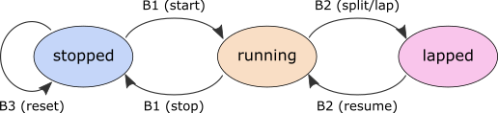
Display Experiments (with your own code)
Task 4 (Recodex): Create a stopwatch
The displayed precision is 100ms (i.e., 0.1s)
  But internal precision should be at least 1ms (use millis() for correct timing)
  Use the decimal dot to separate the last digit
  Always display at least 2 digits (zero is 0.0 – Czech locale notation)
  Button #1 starts/stops the stopwatch
  Button #2 splits the time (i.e., freezes the display, but the watch keeps running)
  Button #3 resets the stopwatch to 0 (only when stopped, no effect when counting)
  Be precise (correct) with the timing! (tested in ReCodEx)
State automaton

Slide 21
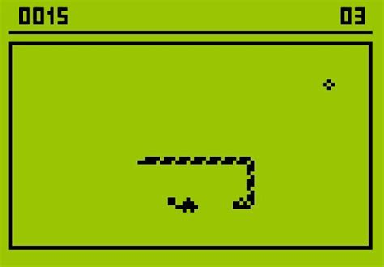
Other Display Experiments (with your own code)
Game: Snake
Game: Tetris
Graphical equalizer
….

Slide 22
UC5: Encapsulation
loop() {
if (alarmActive) {
if (alarmTime < now
&& (snoozedUntil == not_set || snoozedUntil < now)){
enable_sound_output();
} else {
disable_sound_output();
}
if (processButton(reset_btn_pin, resetBtnState)) {
alarmActive = false;
}
if (processButton(snooze_btn_pin, snoozeBtnState) &&
alarmTime < now &&
(snoozedUntil == not_set || snoozedUntil < now)) {
snoozedUntil = get_current_time() + snooze_delay;
}
}
if (processButton(set_btn_pin, setBtnState)) {
alarmActive = true;
alarmTime = get_input_time();
snoozedUntil = not_set;
}
}
Alarm’s (internal) state
bool alarmActive = false;
time_t alarmTime, snoozedUntil;
bool setBtnState, resetBtnState, snoozeBtnState;
bool processButton(int pin, bool &state) { … }
Button’s (internal) state
Button’s logic
Alarm’s logic
Notes:
Alarm’s logic all over the place

Slide 23
UC5: Encapsulation
☹ Global (Arduino ☹)
class AlarmClock {
private:
bool active;
time_t alarmTime;
time_t snoozedUntil;
public:
void setAlarm(time_t at) {
active = true;
alarmTime = at;
snoozedUntil = not_set;
}
bool isRinging() {
time_t now = get_current_time();
return active && alarmTime < now &&
(snoozedUntil == not_set || snoozedUntil < now);
}
void snooze() {
if (isRinging()) {
snoozedUntil = get_current_time() + snooze_delay;
}
}
void reset() { active = false; }
};
Button setBtn, resetBtn, snoozeBtn;
// ...
AlarmClock alarm;
void setup() { ... }
// ...
void loop() {
if (alarm.isRinging()) {
enable_sound_output();
} else {
disable_sound_output();
}
if (setBtn.isPressed())
alarm.setAlarm(get_input_time());
if (resetBtn.isPressed())
alarm.reset();
if (snoozeBtn.isPressed())
alarm.snooze();
}
(Private) internals
Instances ~ variables
(Public) API
Using API only
Semicolon

Slide 24
UC5: Encapsulation
Encapsulation (sufficient OOP design)
  Each class has a clear explicit purpose (e.g., Button, Display, …)
  A well-defined set of functions/methods allows the programmer to exploit this purpose
    But the internal implementation is hidden (maybe changed in the future)
Hints
  Interface first (imagine how it is used), implementation after
  Imagine the implementation changes over time (e.g., button behavior)
  Make member variables private (so you are not tempted to access them)
    Do not create simple getters/setters unless you really need them and re-think them twice (it may be a sign you are exporting behavior out of a class)

Slide 25
Lab 04
30/03/2026
20/04/2026

Slide 26
Homework Feedback
Be aware of deadline
Request a review after fixing the problems
Test locally first (10 attempts only)

Slide 27
Homework Feedback

Slide 28
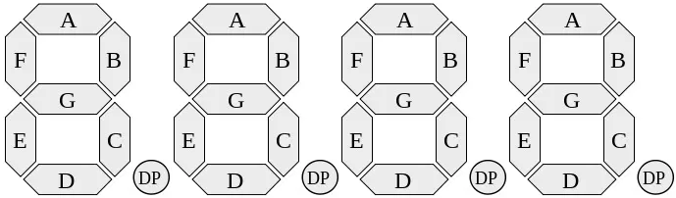
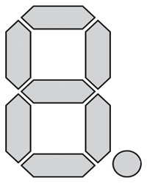
7Segment Display
Letter
Position
Segment
Controlling individual segments
Glyph
A “picture” in a char (a set of segments)
Glyph Encoding
bits in a single byte
Inversion logic! (1 ~ off, 0 ~ on)
'3.' ≈ 0b00110000 = 0x30 = 48
Glyph index
Encoded with bits
Uses only a half of the byte
Byte
3 |  |  |  | 0
0 | 0 | 1 | 1 | 0 | 0 | 0 | 0
7 | 6 | 5 | 4 | 3 | 2 | 1 | 0
DP | G | F | E | D | C | B | A
Bit flag
Index
Segment
½ Byte
4
0 | 1 | 0 | 0
3 | 2 | 1 | 0
Bit flag
Index
Notes:
https://en.wikipedia.org/wiki/Seven-segment_display

Slide 29
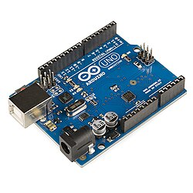
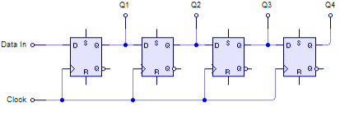
7Segment Display – Communication
Initialize! (pinMode)
Using a shift register
Use 3 pins: latch, clock, data
Write a glyph:
Close latch
Send a glyph
Send a glyph index
Open latch
digitalWrite(SEG7_LATCH_PIN, LOW);
shiftOut(SEG7_DATA_PIN, SEG7_CLOCK_PIN,
MSBFIRST, glyph);
shiftOut(SEG7_DATA_PIN, SEG7_CLOCK_PIN,
MSBFIRST, position);
digitalWrite(SEG7_LATCH_PIN, HIGH);
shiftOut(
data_pin,
clock_pin,
bitOrder,
value);
Notes:
Todo: put into a function

Slide 30
Shift Register
74HC959D Shift Registers
Serial input (sequence of bits), parallel output
Input is controlled by a clock signal
See https://en.wikipedia.org/wiki/Shift_register

Slide 31
Display a Digit
Task0: Write any number on any position
Task1: Write a function writing a digit on a given position
Task2: Change bit ordering from MSBFIRST to LSBFIRST and write numbers 1, 2, 3, 4
Task3: Use code that controls buttons and shows numbers from 0-9 only
Other digits stay blank
Use the function from Task1
Task4*: Create a snake animation that goes round the whole display
A single LED is on at any given time
Speed is given by a constant, e.g., 1s

Slide 32
Task5: Show All Digits (Simplified) - Recodex
Modify the counter to run modulo 10,000
  Formatted as a 4-digit number with leading zeros
  Make sure you handle the modular arithmetic correctly!
One digit (position) is shown at a time
  Rightmost digit (units) at the beginning
  Button 3 changes the digit/order in a cyclic fashion (1, 10, 100, 1000, 1, …)
Buttons 1 and 2 increment/decrement “the selected digit”
  I.e., button 1 performs +1, +10, +100, or +1000, based on which order is selected (displayed)
    Button 2 analogically (-1, -10, …)
Use a simple arithmetic/logical operations,
no pow, …
Notes:
Video: https://www.yout-ube.com/watch?v=F9afOP5Jq-8

Slide 33
Unforgivable Curse #4 – No Global Variables
Restricted access to global variables
  Global variables are bad, but we have no choice…
Rules
  Do not use global variables instead of local variables
  Do not use global variables just to pass values to/from functions
  If you could modify the value of a global variable in between loop() calls and it would not matter … then it should not be a global variable
To be on the safe side…
  Access global variables only from loop() and setup()
Constants can be used globally (to make it easier for you)

Slide 34
Writing Better Code…
Your code should handle 3 different things
  Button control (when a button triggers an action)
  Display control
  Application logic (handling the counter modifications, triggering display update…)
Make sure each part is duly encapsulated and reusable (esp. button and display)
  Use function(s)/method(s), structures/classes, …
For instance, it is not appropriate when…
  Button handling routine updates the counter directly
  Button handling triggers display update
  Display update tries to read a button state

Slide 35
Lab 03
16/03/2026
25/03/2026

Slide 36
Homework Feedback
Be aware of deadline
Request a review after fixing the problems
Test locally first (10 attempts only)

Slide 37
Homework Feedback
Avoid confusing naming
int minimum(const int temperatures[], int len) {
int min = 0;
for (int i = 0; i < len; i++) {
if (temperatures[i] != NO_VALUE && min > temperatures[i]) {
min = temperatures[i];
}
}
return min;
}
If I see my function only without the context, is the name descriptive?
→ Function should ideally be without any side-effects
Prefer parameters/return value over side-effects
Prefer descriptive name over a comment
Comment the side-effect
What does this function do?

Slide 38
Homework Feedback
Put into a function
Avoid using magic numbers
int cl = 0;
if (cl == 3 || cl == 0) {
d = -d;
}

Slide 39
Homework Feedback
The only change if
adding more LEDs
Put into a function
Avoid using magic numbers
int current_led = 0;
if (current_led == 3 || current_led == 0) {
direction = -direction;
}
…
if (delta >= 300)
…
constexpr int LedIndex[4] = {
LED1_PIN, LED2_PIN,
LED3_PIN, LED4_PIN
};
constexpr int LED_COUNT = 4;
constexpr int FIRST_LED_INDEX = 0;
constexpr int LAST_LED_INDEX = LED_COUNT - 1;
constexpr int INITIAL_LED = FIRST_LED_INDEX;
constexpr int STEP_INTERVAL_MS = 300;
constexpr int LedIndex[] = {
LED1_PIN, LED2_PIN,
LED3_PIN, LED4_PIN
};
Let the compiler fill in
the correct constant
→ Most numbers (other than 0, 1) should be constants

Slide 40
Homework Feedback
Do Not Repeat Yourself (DRY)
void one_on() {
all_off(); digitalWrite(LED1_PIN, ON);
}
void two_on() {
all_off();
digitalWrite(LED2_PIN, ON);
}
void three_on() {
all_off();
digitalWrite(LED3_PIN, ON);
}
void four_on() {
all_off();
digitalWrite(LED4_PIN, ON);
}
void show_active_led() {
if (active_Led == 0) one_on();
else if (active_Led == 1) two_on();
else if (active_Led == 2) three_on();
else four_on();
}
void turn_on(int led_id) {
digitalWrite(LEDS_PIN[led_id], ON);
}
void turn_off(int led_id) {
digitalWrite(LEDS_PIN[led_id], OFF);
}
void show_active_led() {
turn_off(active_Led - 1);
turn_on(active_Led);
}
→ Wrap visually similar things into functions
→ Would my code scale with minimal changes
4 LEDS → N LEDs, 3 buttons → N buttons
Minimal ~ a change of a constant, not C&P
Visually similar
What if we have
N LEDs?

Slide 41
Homework Feedback
Noneffective LED OFF
void clear_leds() {
for (int i = 0; i < n_leds; i++) {
digitalWrite(pins[i], OFF);
}
}
void show_active_led(int old_led, int active_led) {
turn_off(old_led);
turn_on(active_led);
}
→ Is your code efficient with a large N?

Slide 42
Homework Feedback
“Using int variable instead of bool”
void spad() {
if (!r) {
if (p == L) {
r = !r;
p -= 1;
} else {
p += 1;
}
} else {
if (p == F) {
r = !r;
p += 1;
} else {
p -= 1;
}
}
}

Slide 43
Homework Feedback
“Using int variable instead of bool”
void setPinAndDirection() {
if (!reversed) {
if (pin == LAST) {
reversed = !reversed;
pin -= 1;
} else {
pin += 1;
}
} else {
if (pin == FIRST) {
reversed = !reversed;
pin += 1;
} else {
pin -= 1;
}
}
}
void setPinAndDirection() {
if (pin == FIRST) {
direction = 1;
} else if (pin == LAST) {
direction = -1;
}
pin += direction
}
Visually similar

Slide 44
Homework Feedback
Useful approach - adding one more indirection
constexpr int LEDS[] = { LED1, LED2, LED3, LED4 };
constexpr int LED_PATTERN[] = { 0, 1, 2, 3, 2, 1 }; // Indexes to LEDS array
void turn_pattern_next(int pattern[], int pattern_length, int &curr_idx) {
turn_off(LED_PATTERN[curr_idx++ % pattern_length]);
turn_on(LED_PATTERN[curr_idx % pattern_length]);
}
→ Can I simplify my code by putting things into an array or/and a loop?
Doesn’t scale with number of LEDs
What is this?
What is this?
Notes:
E.g., virtual memory

Slide 45
Bit Encoder
Task 1: Bit-wise LED Encoder
Write a function that takes an integer and changes the LED states according to its lower 4 bits
  0 ~ LED is off, 1 ~ LED is on
  Useful to remember
  Bitwise operators: & (AND), | (OR), ~ (negation)
  Bit shifts <<, >>
  Test it (try to display some constant values)
5 = 0101b =
11 = 1011b =
21 = 10101b =

Slide 46
Continuous Counting
Task 2: Continuous Counting
Create a counter that continuously increments itself (modulo 16)
  With reasonable interval (e.g., 1s)
  Use the same approach as in Lab02 (avoid delay()or other attempts to block the loop())
Display the value of the counter on LEDs
  Using the function from Task 1

Slide 47
Buttons
Setup
pinMode(button1_pin, INPUT)
  Actually, this should be the default, but do it anyway (makes it clearer)
Get button state
digitalRead(button1_pin)
  Inverse (pullup) logic (false ~ button is pressed)
Need to be checked periodically in the main loop
  Note (no need to address this): buttons not perfect (creates a short oscillation effect - as if the button is pressed and released in quick succession a few times).

Slide 48
Buttons Controlling Counter
Task 3: Increment when the button is pressed
Update the code so the counter is incremented only when button #1 is in a pressed state (is being held down)
The speed of the counter updates should remain the same
Small improvement
The counter is incremented once at the exact moment the button is pressed (changes its state from up to down) and then it continues in regular intervals
  The beginning of the interval starts when the button goes down

Slide 49
Buttons Controlling Counter
Task 4:
Create an alternate behavior for the button
But don’t throw your code away yet
Stop/remove the continuous increment of the counter
The counter should increment only when button #1 is pressed (once)
  I.e., when the button state changes from not pressed to pressed
  Keep a copy of the last known state of the button in the global variable to find out when the state is changing

Slide 50
Buttons Controlling Counter
Task 5: Decrement
Make the second button work similarly to the first one,
but it will decrement the counter
Note: How do you decrement in modulo arithmetic nicely?
    x = (x + 15) % 16
Side task
Make the third button add +5 to the counter
Do you see the pattern (all three buttons are doing almost the same)?
  If your code seems redundant, simplify it!

Slide 51
Smart Buttons (ReCodex)
Task 6: Making buttons smarter
Buttons will still increment/decrement the counter when pressed
If the button is held for a while it starts to increment/decrement the counter continuously
  There should be 2 delay constants – how long before the continuous update starts and how fast it proceeds
  (e.g., it starts after 1s and increments every 300ms)
  Do not use delay()!
Remember there is more than 1 button
  You need to time the operations of each button independently
Think about reusability!
  Button handling might be required in future assignments

Slide 52
Debugging
Debugging embedded devices is tough
We can use the serial link for dumping (printing) debug info
  void setup() {
  Serial.begin(9600);
  }
  void loop() {
  // ...
  Serial.println("Hail the computer...");
  Serial.println(analogValue, HEX);
  }

Slide 53
Unforgivable Curse #3 - DRY
Make the buttons implementation re-usable (remember DRY)
Might prove handy for subsequent assignments
Hints
Do not copy-paste your code
  …unless you do it only once and perform major changes in the copy
  …you just need to keep a copy so you can experiment/debug the original
Use functions for the same logical pieces
Use loops
  Possibly in combination with (constant) arrays
Some cases cannot be avoided (without knowing more complex C++ features)
  At least try to minimize the duplicated parts

Slide 54
More Practice
Extension 1: Alternating behavior
  Make the third button switch between the three implemented strategies of updating the counter (i.e., of the behavior of the first two buttons)
    Represented by tasks 3, 4, and 6
Extension 2: Larger counter
  Allow the counter to grow from 0 to 256
  LEDs will alternate to show the lower 4 bits and higher 4 bits of the counter in an interval (if no button is pressed)
    E.g., alternating every 1 second or when button #3 is pressed
Extension 3: Create a piano

Slide 55
Lab 02
02/03/2026+09/03/2026

Slide 56
Homework Feedback
No Plagiarisms
Read University Ethical Guideline
Okay to cooperate/discuss and then write it on your own
Searching min wrongly
Initiate to MAX_INT or other INVALID value
Or use a bool
int last_valid_temperature = 0;
int minimal_temperature = 0;

Slide 57
Homework Feedback
DRY: put repeating code into a function
for (int u = 0; u < -temperature; ++u) {
printf("*");
}
…
for (int u = 0; u < min-temperature; ++u) {
printf("*");
}

Slide 58
Homework Feedback
Split the logic into functions
Don’t put everything into the main

Slide 59
Homework Feedback
Non-descriptive naming
int lowest(int count) { ... }

Slide 60
Homework Feedback
Non-effective use of strings
std::string result = "";
for (int i = 0; i < buffer; i++){
result += ' ‘;
}
std::cout << result;

Slide 61
Homework Feedback
Questions?

Slide 62
Arduino
Open-source HW and SW project
Arduino board
Base board with sets of digital and analog pins
Expansion board (shield)
Connected by pins providing various functionality
Arduino IDE (not Arduino Web Editor!)
https://www.arduino.cc/en/main/software
Notes:
The IDE is very simple and designed for amateurs. You just write the code and hit the upload button. The code will automatically compile and upload to your device.
Hint: If you have trouble connecting your IDE to your Arduino (upload fails), check that you have the right COM port selected (Tools > Port).

Slide 63
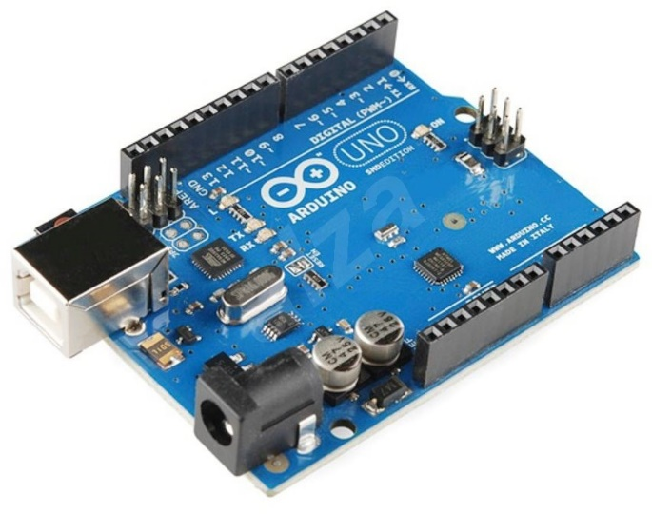
Arduino Uno
CPU ATmega328P
14 digital I/O pins
Of which 6 can be used as PWM outputs
6 analog inputs
Clock speed 16 MHz
FLASH memory 32 KB
SRAM 2 KB
EEPROM 1 KB
USB
DC power

Slide 64
Arduino IDE
Sketch
An application
Library
Shared interface and implementation
Two important functions
void setup() { ... }
  Called once at the start of a sketch
void loop() { ... }
  Called repeatedly ~1000-times per sec
The main() is supplied by the framework itself
// Arduino main.cpp
int main(void){
init();
...
setup();
for (;;) {
loop();
if (serialEventRun)
serialEventRun();
}
return 0;
}
Notes:
Remember how variable scope (visibility) works in C. Local variables (within block/function) are created at the beginning of the block and terminated at the end. I.e., local variables within the loop() function will not hold their value between two subsequent loops.
For maintaining global state we need global variables. (In most languages, using global variables should be avoided and is considered bad practice; however, in Arduino project, we have little choice so global variables are considered OK for variables that need to hold values with duration that needs to span over multiple loops).
Note: `for(;;)` is extremely ugly code. If you really need to create infinite loop (be careful when you does), use `while (true)` instead.

Slide 65
Executing Sketch on Arduino
Compilation and Execution
  The sketch is compiled by a compiler in Arduino IDE for the target CPU
  The resulting binary code is uploaded via USB/serial to an Arduino board and the board is reset
  EEPROM on the board contains a boot loader, which is executed after the board reset
  If there is some USB/serial payload after the reset, it is read by the boot loader, stored in the FLASH memory on the board, and executed
  If there is no payload, the boot loader executes the already stored sketch in the FLASH memory
Host
Sketch .c
Compile
Binary code
USB/serial
Arduino
Bootloader
Write memory
FLASH

Slide 66
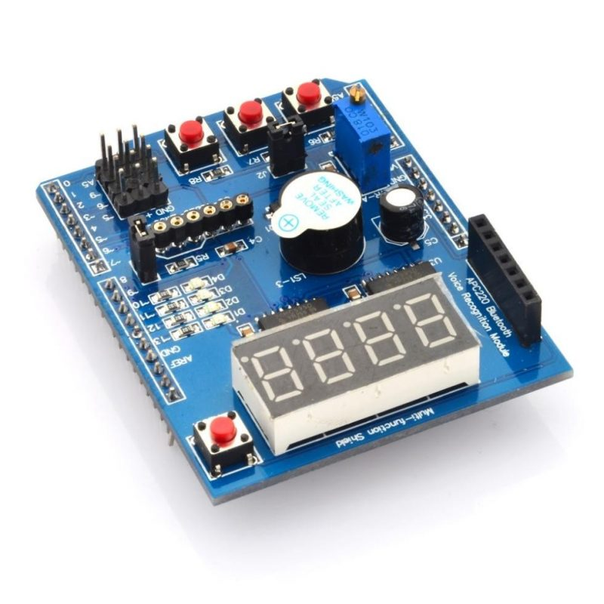
Funshield
Simple “interactive” shield
  3 buttons
  4 LEDs
  4-digit display
  1 buzzer – will not be used, too noisy
  1 potentiometer – will not be used, too small
  More info – follow the URL in the “Links” tab
Funshield library
  Download it from the lecture web (Labs)
  Sketch > Include Library > Add .ZIP library… (once)
  Sketch > Include Library > Funshield (every project)

Slide 67
Work: Blink a LED
Initialize a LED pin
  pinMode(pin, OUTPUT/INPUT)
  Pin constants are in funshield.h
  Use constants instead of literal numbers!
Set LED pin state
  digitalWrite(pin, HIGH/LOW)
  Actually LOW value means the LED is on (see ON/OFF in funshield)
Make 1st LED blink
  The main loop is too fast, use delay(ms)
Notes:
See https://www.arduino.cc/reference/en/language/functions/time/delay/
Once again: NEVER EVER use literal numbers (like 13) directly in code. Who knows what 13 really represents? Furthermore, if we were to give you another shield with similar functions but different wiring (where the LEDs are connected to different pins), you would not have wanted to rewrite most of your code (just use different library with different constant values).
I.e., use constants like led1_pin.
If you fail this task, check out Arduino IDE examples.

Slide 68
Work: Blinking without Blocking
Avoid using delay() – replace with timing
unsigned long millis()
  number of milliseconds passed from the start
You can use it to monitor the passage of time
  Save actual ms time
  Perform a check in every loop on how much time has passed, once it exceeds the desired threshold (delay)…
  More than 1 ms may pass between two loops or the same value may be returned by two subsequent calls to millis() – no telling for sure (depends on the amount of work being done inside loop())
How long does it take for the counter to overflow?
  And how can we deal with it (if we measure only the diff between consecutive loops)?
Put into a function
Notes:
https://www.arduino.cc/reference/en/language/functions/time/millis/
Alternatively https://www.arduino.cc/reference/en/language/functions/time/micros/ , but be careful. This is actually too fine grained for us and microsecond counter overflows every 70 minutes or so.

Slide 69
Work: Beyond Blinking
Work: Blink all LEDs together
  Do not forget to initialize all four LEDs in the setup
  Instead of just one LED, turn them all ON/OFF (based on your timing from the previous step)
Keep your code DRY
  DRY = Do not Repeat Yourselves
  Do not copy/paste code
  When the same code is executed multiple times use for-loops (and arrays when necessary)
    Remember previous labs!
Notes:
Keeping your code DRY is not just a fashion, it is considered a normal programming practice. It will be required in the final home assignment and failure to comply with this requirement may lead to failure of the course!

Slide 70
Beyond Blinking
Work: Create animated pattern
  Blink LEDs sequentially (snake pattern)
    First to last, exactly 1 LED is always on
  Alternatively, create a different pattern (e.g., ping-pong)
Work Extension: Create a longer snake
  E.g. for length 3, the pattern, and the sequence for LEDs turned on will be:
  ____ ___o __oo _ooo ooo_ oo__ o___ ____
Work Extension: Anti-aliased snake using PWM (Pulse-Width Modulation)
  Last LED is dimming whilst the following LED is lightening up…
Notes:
Simple snake and PWM anti-aliased ping-pong are presented in the video: https://youtu.be/AoDzcXPOFC0
For PWM see https://en.wikipedia.org/wiki/Pulse-width_modulation
Use short duty cycle (< 1ms), use loop counter or micros() function for timing that. First try to dim/lighten up smoothly one LED, then try to implement anti-aliased snake.

Slide 71
Submitting in ReCodEx
Moccarduino: Arduino (and Funshield) API-based emulator
  Emulates API IDE at the function level, not the device itself
  Designed for offline batch testing (like in ReCodEx)
  Some output variations are tricky to test, stick to the specification!
Minor differences in compilation and execution
  We keep a list (on the GitHub readme page)
Use the funshield.h library!
  Do not create arbitrary constants, and do not rely on low-level features
If your code works on Arduino and you are 100% sure it is correct, but it does not pass in ReCodEx, contact us

Slide 72
Rule 1: Code Decomposition
Structure your code well, divide it into functions
  When a block of code is used multiple times
  When a name needs to be assigned to a block of code
  A piece of code is too long and hard to read
  You wish to encapsulate local variables/arguments to avoid naming collisions
Indicators that you are not doing it right…
  The code is much longer and there is no apparent benefit
  Created function(s) have way too many arguments (or use global variables extensively)
  You have a hard time coming up with the name for a function
A good function has only one purpose and is self-contained
  Pure functions – no side effects, dependent only on argument

Slide 73
Rule 2: Use Constants
Use constants instead of value literals
  A constant bears a name (more readable)
  It is easier to change the value (if necessary)
    Especially, when used multiple times in code
Do not over-do it
  Do not create constants for obvious values without meaning
    constexpr int zero = 0;
  If you do not have a name and the value will never change
    float fahrenheit_to_celsius(float f) {
    return (f - 32.0f) * 5.0f / 9.0f;
    }

Slide 74
Questions?

Slide 75
Lab 1
16/02/2026

Slide 76
Communication
Be proactive
Web
https://fan1x.github.io/teaching/2526-pocsys
https://www.ksi.mff.cuni.cz/teaching/nswi170-web/
Mattermost
nswi170-compsys-faltin
Mail
tomas.faltin@matfyz.cuni.cz

Slide 77
Labs
Motivation
Hands on hardware and computer systems
See a different language, other than Python
Lectures
C language basics
Operating systems, compilers, …
Labs (1/14 days)
Programming in C/C++
Programming Arduino
Labs and lectures are independent but complement each other

Slide 78
Labs Credit
Homeworks
Recodex: https://recodex.mff.cuni.cz
Submitted 100% correct solution in time
1 week ~ solution + 1 week ~ reviews
1+N points (where N=1..6)
Homeworks build on top of each other
Labs exam
A final lab credit exam
A variation on homeworks
Credit: Correct homeworks + >= 13 points + lab exam

Slide 79
Programming Support
Language - C/C++
Close to HW, statically typed, compiled,
Editors
coliru.stacked-crooked.com (online web editor+compiler)
https://godbolt.org (online web editor+compiler)
VSCode, VS Studio, … (editors)
GCC, Clang, … (compilers)
Next week
Arduino IDE - www.arduino.cc/en/main/software
Master your editor – compilation + debugging + …

Slide 80
Playtime ☺

Slide 81
Hello World
#include <stdio.h>
void greet() {
printf("Hello world\n");
}
int main() {
greet();
}
Includes the library containing the printf
A return value type
Semicolon
Program’s entry point – the first function to be called

Slide 82
Exercise 1
*
***
*****
*******
*********
***********
Hello World
Draw a rectangle of size MxN
Draw a tree of size N
(3) + allow decoration (e.g., every N)
(4) + allow step variation (e.g., every N)
Use online IDEs (or locally configured IDE)
https://coliru.stacked-crooked.com
https://godbolt.org
*
***
*****
O ******* O
*********
***********
#include <stdio.h>
void greet() {
printf("Hello world\n");
}
int main(){
greet();
}
*
***
*****
***
*****
*******
*********

Slide 83
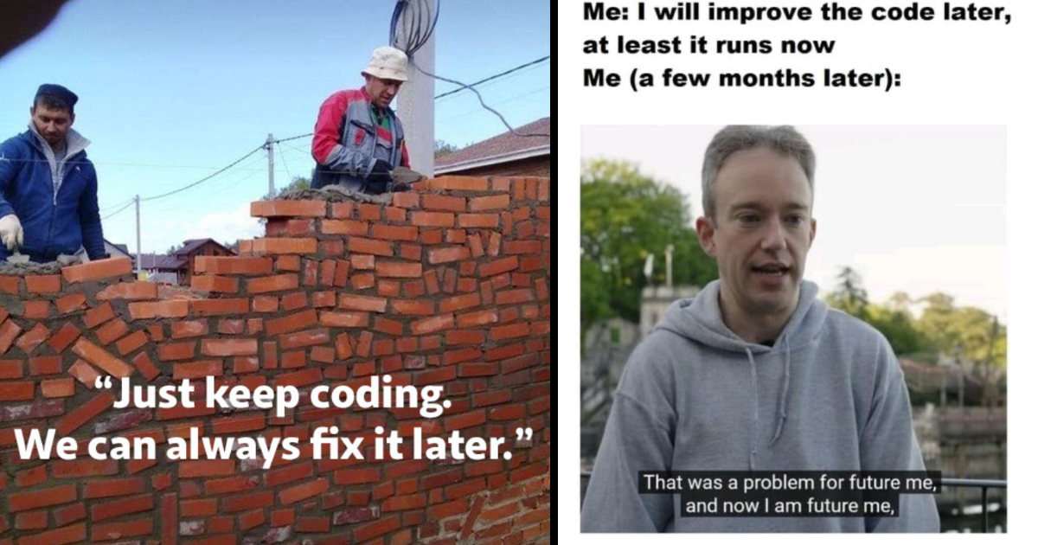
Code Guidelines
Assume we are in a big team working on a big project
→ Working program is not enough
→ Code should be maintainable (=readable)
Six unforgivable courses
https://teaching.ms.mff.cuni.cz/nswi170-web/pages/labs/coding/
NPRG043: Best practices in programming
NPRG024: Design patterns

Slide 84
Rule 0: Consistency
Use English naming
☹ cas, tlacitko, currCas
☺ time, button, currentButton
Consistency with your/team’s code
ledState vs. Led_state vs. LEDState
Use descriptive names
☹ data, stuff, var1
☺ buttonState, sensor_value
No abbreviations
☹ mv, tmpx, dly
(☺ idx, i (in for loops))
Self-check
English
Same naming style
My colleague immediately understands my code

Slide 85
Rule 0: Consistency - Example
Any problems with the code?
constexpr int ButtonAr[3] = {button1_pin ,button2_pin ,button3_pin };
constexpr int PocetButt = sizeof(ButtonAr) / sizeof(ButtonAr[0]);

Slide 86
Mysterious Function 1 - Arrays
#include <stdio.h>
int fn1(int array[], int length) {
int res = 0;
for(int i = 0; i < length; ++i) {
res += array[i];
}
return res;
}
int main()
{
int array[] = {0, 1, 2, 3, 4, 5, 6, 7, 8, 9, 10};
int res = fn1(array, 10);
printf("Result: %d", res);
}
Any problems with the code?
Array of Integers
Size of the array
Semicolon
Size is deduced automatically

Slide 87
Mysterious Function 1 - Arrays
#include <stdio.h>
int fn1(int array[], int length) {
int res = 0;
for(int i = 0; i < length; ++i) {
res += array[i];
}
return res;
}
int main()
{
int array[] = {0, 1, 2, 3, 4, 5, 6, 7, 8, 9, 10};
int res = fn1(array, sizeof(array)/sizeof(array[0]));
printf("Result: %d", res);
}

Slide 88
Hello Tomas
#include <stdio.h>
void greet(const char name[]) {
printf("Hello %s\n", name);
}
int main(){
greet("Tomas");
}
Replaces %s with the given String - name

Slide 89
Mysterious Function 2 - Arrays
int fn3(int array[], int length) {
int j = 0;
int k = 0;
for(int i = 0; i < length; ++i) {
if (array[i] % 2 == 0) {
++j;
} else {
++k;
}
}
if (j > k) {
return j;
} else if (k > j) {
return -k;
} else {
return 0;
}
}

Slide 90
Mysterious Function 2 – Refactored*
int count_and_compare_odd_even(int array[], int length) {
int even_count = 0;
int odd_count = 0;
for(int i = 0; i < length; ++i) {
if (array[i] % 2 == 0) {
++even_count;
} else {
++odd_count;
}
}
if (even_count > odd_count) {
return even_count;
} else if (odd_count > even_count) {
return -odd_count;
} else {
return 0;
}
}
Any problems with the code?
Notes:
Function does multiple things

Slide 91
Exercises 2
******
*******
*******
********
**********
***********
*******
**
*
Print an average of an array
Draw a graph of positive values in an array
Draw negative values in an array
Negative values + indentation
Some values can be invalid
→ Celmomether (in Recodex)
Problem decomposition: Solve the problem iteratively
|******
|*******
|*******
|*****
|***
|*
*|
**|
***|

Slide 92
Homeworks
Homework in ReCodEx
https://recodex.mff.cuni.cz
(join our lab exercise - `SIS integration/Join groups/…`
→ Deadline: Next Tuesday 3:59
Arduino
Get one in library at Malá Strana
Install Arduino IDE: www.arduino.cc

Slide 93
Discussion

