Slide 1
Practical Course in Computer Systems
Use 7-segment LED display
Jakub Yaghob

Slide 2
Additional Arduino Tips
Bit functions
  bit(n) = 1 << n
  bitRead(x, n) = (x & (1 << n)) >> n
  bitClear(x, n) = x & ~(1 << n)
  bitSet(x, n) = x | (1 << n)
  bitWrite(x, n, b) = bitClear or bitSet based on b

Slide 3
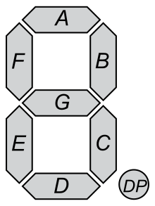
7-segment Display
Prepare bitmasks for all digits
  Remember 1 ~ LED off, 0 ~ LED on
Segments encoded
in byte
DP
G
F
E
D
C
B
A

Slide 4
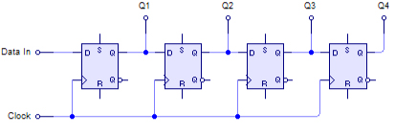
Shift Register
74HC959D Shift Registers
  Serial in (sequence of bits), parallel output
  Input is controlled by a clock signal

Slide 5
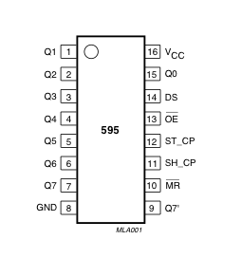
Shift Register
Shift Registers Controlling Display
Bits 0-3 indicate which digits are active
(LSB is the leftmost digit)
7 segment mask
Arduino feed
(data + clock)
digit selector
7seg mask

Slide 6
Using Shift Registers
Controlling the output latch
  digitalWrite(latch_pin, LOW) – close
  digitalWrite(latch_pin, HIGH) – open
    If the latch is closed, output pins do not change
Sending the data
  shiftOut(data_pin, clock_pin, bitOrder, value)
    bitOrder = MSBFIRST or LSBFIRST
    value = byte (8 bits) to be send bit-by-bit
Do not forget setting the pins to output

Slide 7
Putting it together
One function for writing a glyph to a position
void writeGlyphBitmask(byte glyph, byte posmask) {
digitalWrite(latch_pin, LOW);
shiftOut(data_pin, clock_pin, MSBFIRST, glyph);
shiftOut(data_pin, clock_pin, MSBFIRST, posmask);
digitalWrite(latch_pin, HIGH);
}

Slide 8
Single-digit Counter
Task 1
  Get the code from last labs
    Increment/decrement a value using buttons
  Make sure the counter is updated modulo 10
  Update your display function to show the current number on 7-segment display
    Use rightmost digit of the display only

Slide 9
Changing Digit Position
Task 2
  Counter has the range 0-9999
  Only one digit is displayed
  Select the digit by B3
    For displaying the digit and for controlling the digit
  Increment selected digit by B1, decrement selected digit by B2
    Inc/dec make carry and are wrapped to the range

Slide 10
Already Done?
Waiting Animation
  Create a “snake” animation that goes round the whole display
    Only one LED is on at any given time
    The snake should move using constant velocity and complete the cycle in exactly 1s
  Prepare 7seg masks for letters
    Some letters need to be lowercased, some uppercased
    Use it to spell out “hello world” message

