Slide 1
NSWI170: Lab 02
Arduino Introduction
Martin Kruliš

Slide 2
Arduino
Open-source HW and SW project
HW
  Arduino board
    Base board with sets of digital and analog pins
  Expansion board (shield)
    Connected by pins providing various functionality
SW
  Arduino IDE (not Arduino Web Editor!)
  https://www.arduino.cc/en/main/software
Notes:
The IDE is very simple and designed for amateurs. You just write the code and hit the upload button. The code will automatically compile and upload to your device.
Hint: If you have trouble connecting your IDE to your Arduino (upload fails), check that you have the right COM port selected (Tools > Port).

Slide 3
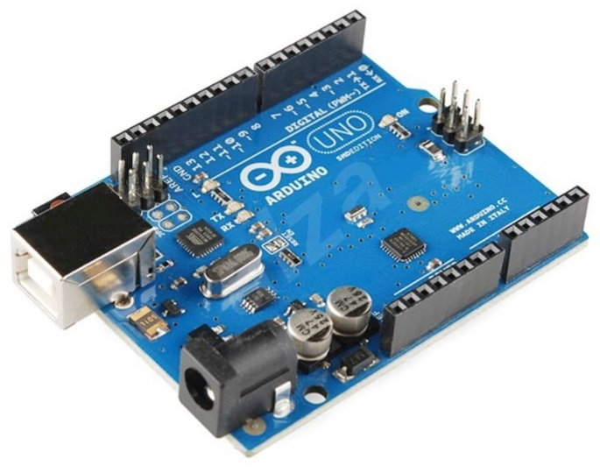
Arduino UNO
Entry level board
  CPU ATmega328P
  14 digital I/O pins
    Of which 6 can be used as PWM outputs
  6 analog inputs
  Clock speed 16 MHz
  FLASH memory 32 KB
  SRAM 2 KB
  EEPROM 1 KB
  USB
  DC power

Slide 4
Arduino IDE
Sketch
  An application
Library
  Shared interface and implementation
Two important functions
  void setup() { ... }
    Called once at the start of a sketch
  void loop() { ... }
    Called repeatedly ~1000-times per sec
  The main() is supplied by the framework itself
Notes:
Remember how variable scope (visibility) works in C. Local variables (within block/function) are created at the beginning of the block and terminated at the end. I.e., local variables within the loop() function will not hold their value between two subsequent loops.
For maintaining global state we need global variables. (In most languages, using global variables should be avoided and is considered bad practice; however, in Arduino project, we have little choice so global variables are considered OK for variables that need to hold values with duration that needs to span over multiple loops).

Slide 5
Arduino IDE
Arduino main.cpp (part)
  int main(void)
  {
  init();
  ...
  setup();
  for (;;) {
  loop();
  if (serialEventRun) serialEventRun();
  }
  return 0;
  }
Called once before loop
Called in infinite loop, should not block
Notes:
Note: `for(;;)` is extremely ugly code. If you really need to create infinite loop (be careful when you does), use `while (true)` instead.

Slide 6
Executing Sketch on Arduino
Compilation and Execution
  The sketch is compiled by a compiler in Arduino IDE for the target CPU
  Resulting binary code is uploaded via USB/serial to an Arduino board and the board is reset
  EEPROM on the board contains boot loader, which is executed after board reset
  If there is some USB/serial payload after the reset, it is read by boot loader, stored to the FLASH memory on the board, and executed
  If there is no payload, boot loader executes already stored sketch in the FLASH memory
Host
Sketch .c
Compile
Binary code
USB/serial
Arduino
Bootloader
Write memory
FLASH

Slide 7
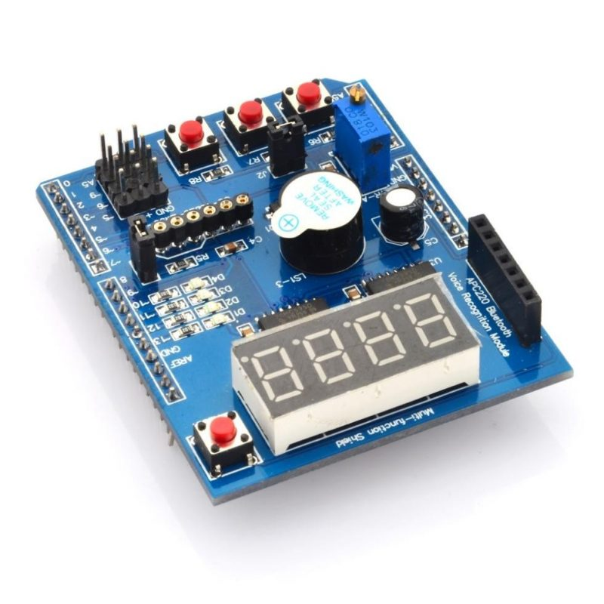
Funshield
Simple “interactive” shield
  3 buttons
  4 LEDs
  4-digit display
  1 buzzer – will not be used, too noisy
  1 potentiometer – will not be used, too small
  More info – follow the URL in the “Links” tab
Funshield library
  Download it from the lecture web (Labs)
  Sketch > Include Library > Add .ZIP library… (once)
  Sketch > Include Library > Funshield (every project)

Slide 8
Blink a LED
Initialize a LED pin
  pinMode(pin, OUTPUT/INPUT)
  Pin constants are in funshield.h
  Use constants instead of literal numbers !!!
Set LED pin state
  digitalWrite(pin, HIGH/LOW)
  Actually LOW value means LED is on (see ON/OFF)
Make 1st LED blink
  Main loop is too fast, use
    delay(ms)
Funshiled lib constants
Some shields may have them inverted (check it out and update them if need be)
Notes:
See https://www.arduino.cc/reference/en/language/functions/time/delay/
Once again: NEVER EVER use literal numbers (like 13) directly in code. Who knows what 13 really represents? Furthermore, if we were to give you another shield with similar functions but different wiring (where the LEDs are connected to different pins), you would not have wanted to rewrite most of your code (just use different library with different constant values).
I.e., use constants like led1_pin.
If you fail this task, check out Arduino IDE examples.

Slide 9
Blinking without Blocking
Avoid using delay() – replace with timing
  millis() – number of ms from start
  Returns unsigned long value!
  You can use it to monitor passage of time
    Save actual ms time
    Check in every loop, how much time has actually passed, once it exceeds desired threshold (delay)…
    More than 1 ms may pass between two loops or the same value may be returned by two subsequent calls to millis() – no telling for sure (depends on the amount of work being done inside loop())
Notes:
https://www.arduino.cc/reference/en/language/functions/time/millis/
Alternatively https://www.arduino.cc/reference/en/language/functions/time/micros/ , but be careful. This is actually too fine grained for us and microsecond counter overflows every 70 minutes or so.

Slide 10
Beyond Blinking
Blink all LEDs together
  Do not forget to initialize all four LEDs in setup
  Instead of just one LED, turn them all ON/OFF (based on your timing from previous step)
Keep your code DRY
  DRY = Do not Repeat Yourselves
  Do not copy/paste code
  When the same code is executed multiple times use for-loops (and arrays when necessary)
    Remember previous labs!
Notes:
Keeping your code DRY is not just a fashion, it is considered a normal programming practice. It will be required in the final home assignment and failure to comply with this requirement may lead to failure of the course!

Slide 11
Beyond Blinking
This is today’s final assignment, details are in ReCodEx
Create animated pattern
  Blink LEDs sequentially (snake pattern)
    First to last, exactly 1 LED is always on
  Alternatively, create a different pattern (ping-pong)
Bonus1: Create longer snake
  E.g. for length 3, the pattern, the sequence for LEDs turned on will be: -, 1, 12, 123, 234, 34, 4, -
Bonus2: Anti-aliased snake using PWM
(Pulse-Width Modulation)
  Last LED is dimming whilst the following LED is lightening up…
Notes:
Simple snake and PWM anti-aliased ping-pong are presented in the video: https://youtu.be/AoDzcXPOFC0
For PWM see https://en.wikipedia.org/wiki/Pulse-width_modulation
Use short duty cycle (< 1ms), use loop counter or micros() function for timing that. First try to dim/lighten up smoothly one LED, then try to implement anti-aliased snake.

Slide 12

Discussion

