Slide 1
NSWI170: Lab 01
C/C++ Language
Martin Kruliš

Slide 2
C/C++ Language
Quick Revision
  Statically typed
    int x = 1;
  Slightly different syntax than Python
    int main() {
    for (int i = 0; i < 50; ++i) {
    if (is_prime(i)) { // let’s print primes...
    printf("%d\n", i);
    }
    }
    return 0;
    }
; after every statement
Blocks created by {}, not by indentation!

Slide 3
Practice
T1: Hello World
  https://repl.it/
  printf("string");
  Print out “Hello world”
T2: Create your first function
  Which takes an integer and prints as many * on a line
  void function_name(int n) { /* body */ }
T3: Print a triangle of height 5
  Using previously defined function
T4: Print a triangle of height 42
*
**
***
****
*****

Slide 4
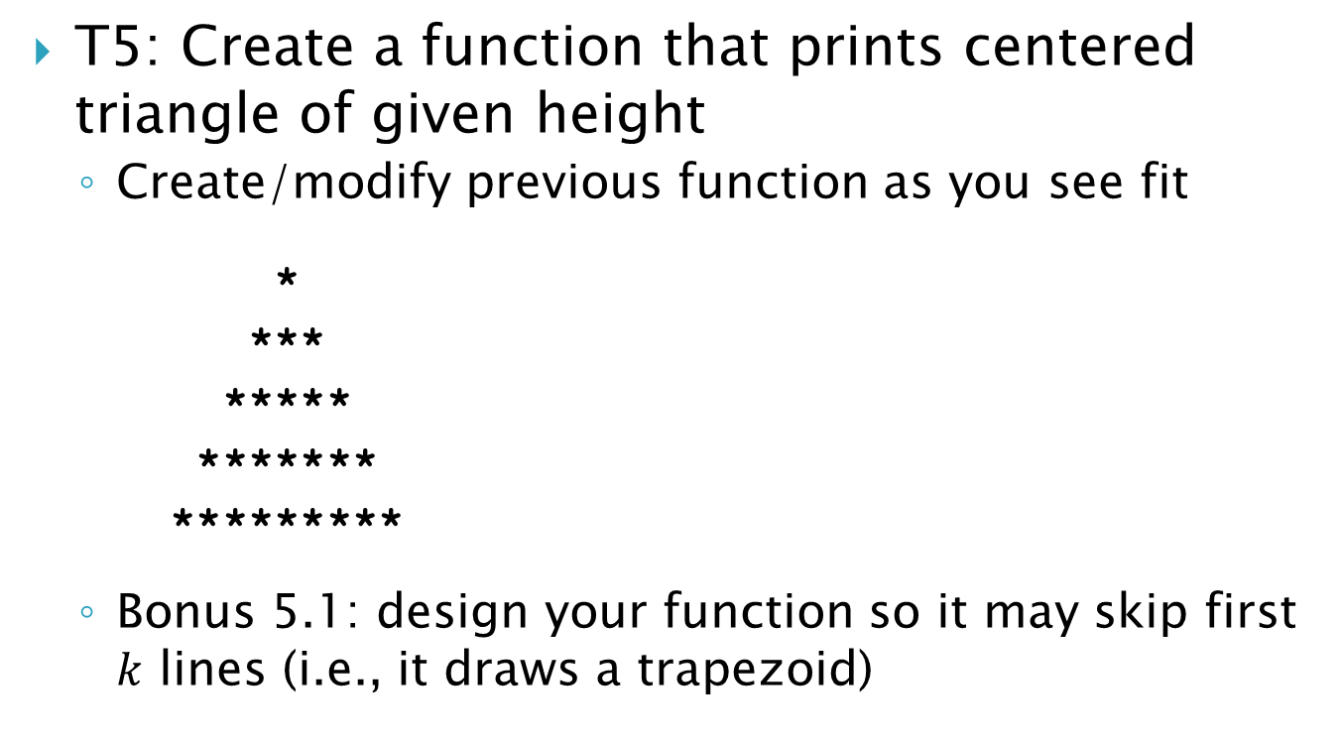
Practice
T5: Create a function that prints centered triangle of given height
  Create/modify previous function as you see fit
    *
    ***
    *****
    *******
    *********
  Bonus 5.1: design your function so it may skip first $k$ lines (i.e., it draws a trapezoid)

Slide 5
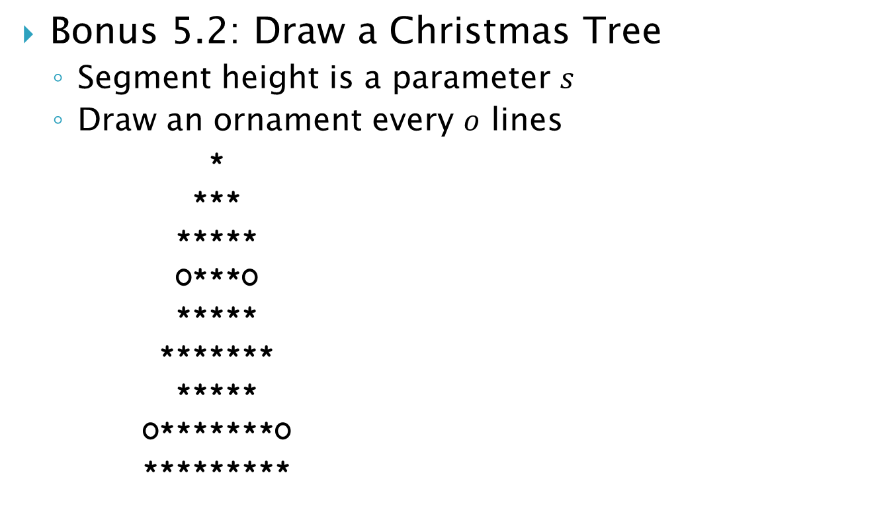
Practice
Bonus 5.2: Draw a Christmas Tree
  Segment height is a parameter $s$
  Draw an ornament every $o$ lines
      *
      ***
      *****
      O***O
      *****
      *******
      *****
      O*******O
      *********

Slide 6
Arrays
C Array
  Sequence of values (of one type!)
  Fields accessible by numeric index (zero based)
    int x[42];
    int y[] { 1, 2, 3 };
    int z[2][3] { { 1, 2, 3 }, { 10, 20, 30 } };
    y[1] = z[0][2];
  Passing arrays as function arguments
    int avg(int a[], int count) {
    …
    }
Array of arbitrary length
So we need to pass down the size as well

Slide 7
Practice
T6: Create a function that displays graph
  Data (integers) in array (e.g., measured values from a thermometer taking samples over period of time)
  Each value is printed out as number of * on a line
  Test it:
    int temps[] { 3, 4, 4, 5, 6, 8, 11, 11, 10, 5, 2, 0 };
  A trick how to determine the size of the array
    int tempsCount = sizeof(temps) / sizeof(temps[0]);
    Works only for arrays of known size
      int avg(int a[], int count) {
      // sizeof(a) will NOT work here as expected
      }

Slide 8
Practice
T7: Write a function that computes moving average of the temperatures
  Given a slide window size as a parameter
  Averages are saved into a new array
    Create array of the same size as input, some fields may remain unused
  Then use function from T6 to display them
3 | 4 | 4 | 5 | 6 | 8 | 11 | 11 | 10 | 5 | 2 | 0
Σ
4 | 4 | 5 | 6 | 8 | 10 | 11 | 7 | 6 | 2

Slide 9
Final Assignment
Vertical graph with positive and negative values
  Similar to T6, but the negative values needs special handling
  Zero values are represented by
  one column, graph is padded
  by spaces where necessary
  Furthermore, the values come
  from an unreliable thermometer (some may be missing) – replace them with last known value
  constexpr int no_value = -999;
  int temps[] { 10, 9, no_value, 7, no_value, no_value, 1 };
*****
***
*
**
****
4
0
-3
{ 10, 9, 8, 7, 5, 3, 1 }

Slide 10
In Conclusion
Complete the final task
  Available in ReCodEx as Celmomether/Ceplomeris
  Submit your code in ReCodEx (will be reviewed)
  Observe the deadline (no resurrections)
    If you have problem with deadline, you need to speak up before the deadline!
Arduino
  Borrow/buy an Arduino set before next labs!
  Install Arduino IDE
  Possibly try it out, but we will get there…

Slide 11

Discussion

