Slide 1
Computer Systems
Parallel programming and synchronization
Jakub Yaghob

Slide 2
Parallel and concurrent computing
Parallel computing
  Calculations or executions of processes are carried out simultaneously
  Bit-level, instruction-level, data, and task parallelism
  Parallelism without concurrency – bit-level parallelism
  Problem broken into several similar subtasks, results combined
Concurrent computing
  Computations are executed simultaneously
  Concurrent without parallelism – multitasking on a single CPU
  Processes do not work on related tasks
Forces
  One address space
  Threads
  Multiprocessing
  Scheduling

Slide 3
Race condition
Race condition
  Result of a computation depends on the sequence or timing of units of scheduling
class List {
public:
void PushFront(Node *n) {
n->next = root;
root = n;
}
private:
Node *root;
};

Slide 4
Race condition
Common var
List lst;
Thread 1
lst.PushFront(A);
Thread 2
lst.PushFront(B);
lst
X
Y
A
lst
X
Y
B
B
lst
X
Y
A
B
lst
X
Y
A

Slide 5
Critical section
The problem
  Concurrent access to a shared resource can lead to the race condition or even to an undefined behavior
Solution
  Parts of the program, where the shared resource is accessed, need to be protected to avoid concurrent access
Critical section
  Protected section of the program
Mutual exclusion
  A critical section can be executed simultaneously by at most one unit of scheduling

Slide 6
Synchronization
Process synchronization
  Multiple units of scheduling do some form of a handshake at a certain point to make an agreement to a certain sequence of action
Data synchronization
  Keeping multiple copies of data in coherence with each other
  Maintain data integrity
  Usually implemented by process synchronization
Problems with synchronization
  Deadlock, starvation, …

Slide 7
Synchronization primitives
Synchronization primitives
  Implement process synchronization
  Active
    Instructions are executed during waiting for an access
      Busy-waiting
  Passive/blocking
    Unit of scheduling blocked until the access is allowed
HW
  Atomic instructions
    Test-and-set (TSL), compare-and-swap (CAS)

Slide 8
Synchronization primitives
Spin-lock
  Busy-waiting using TSL/CAS
  Short latency, right for short waiting times
Semaphore
  Protected counter and a queue of waiting US
  Atomic operations UP and DOWN
void down() {
if(counter>0) --counter;
else {
queue.push(myUS);
myUS.block();
}
}
void up() {
if(counter==0 &&
!queue.empty())
{
US = queue.popany();
US.unblock().
}
else ++counter;
}

Slide 9
Synchronization primitives
Mutex
  Implements mutual exclusion
  Atomic operations LOCK and UNLOCK
Barrier
  Multiple units of scheduling meet in the same time on the same barrier
Programming language
  Monitor
    Methods in an object executed with mutual exclusion
    Possibility to wait on a certain condition
  Java
    Keyword synchronized

Slide 10
Deadlock
Deadlock
  A state of a group of units of scheduling and resources, where every member of the group waits for an action, which can be performed by other member in the group
Necessary conditions for deadlock (Coffman)
  Mutual exclusion
    At least one resource in exclusive mode
  Hold and wait
    US holding a resource requests for another one
  No preemption
    Resources cannot be reclaimed without harm
  Circular wait
    There is a circle in a deadlock modelling graph
T1
R1
R2
T2

Slide 11
Deadlock – example
Shared mutexes
Mutex m1, m2;
Thread 1
m1.lock();
m2.lock();
m2.unlock();
m1.unlock();
Thread 2
m2.lock();
m1.lock();
m1.unlock();
m2.unlock();

Slide 12
Classic synchronization problems
Classic synchronization problems
  Set of well-known synchronization problems
  Demonstrate a problem using an allegory
  Avoid deadlock, starvation, and other problems
Bounded-buffer (producer-consumer)
Dining philosophers
Readers and writers
Sleeping barber

Slide 13
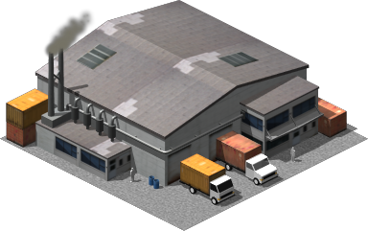
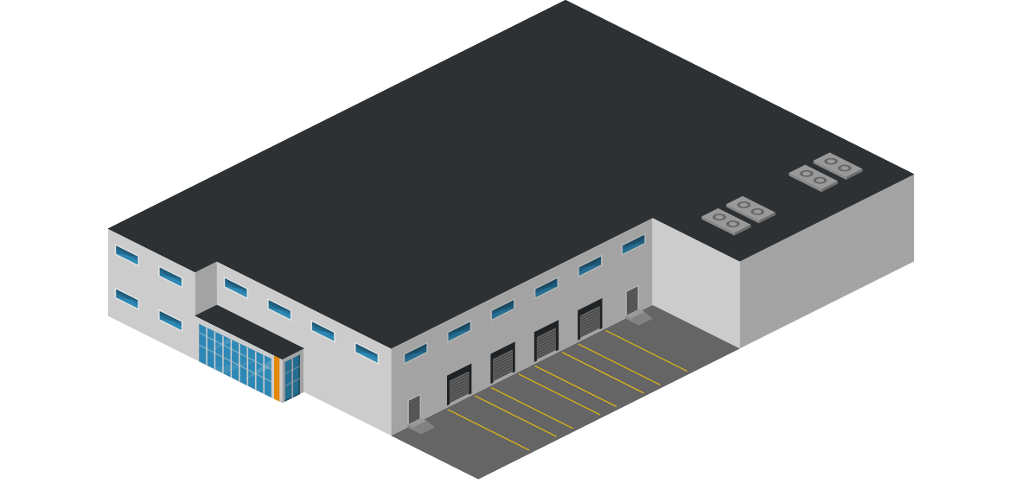

Producer-consumer
Problem
  Producer produces a product and he places it to the warehouse with a limited capacity. If the warehouse is full, producer will stop production of products.
  Consumer takes a product from the warehouse. If there is no item available, consumer will wait for an item.
  If the warehouse is empty and producer produces the first product and there is a waiting consumer, producer will wake up consumer
  If the warehouse is full and consumer takes the first product and there is stopped producer, consumer will wake up producer

Slide 14
Dining philosophers
Problem
  N philosophers sitting around a circular table
  Each philosopher has a plate of Chinese food in front of him
  There is one chopstick between each dish, two chopsticks are needed to eat
  The life of a philosopher consists of thinking and eating
P1
P5
P2
P4
P3

Slide 15
Readers and writers
Problem
  Common data structure
  Readers are able only to read data
  Writers change data or a data structure
  Many readers read simultaneously data
  Only one writer can change data/data structure
  Reader must wait, if there is a working writer
  Writer must wait, if there are working readers

Slide 16


Sleeping barber
Problem
  Barber shop with one barber, one barber chair, and N waiting chairs
  When there is no customer, barber goes to sleep in the barber chair
  Barber must be woken when a customer comes in
  When barber is cutting hair, new incoming customers are waiting in chairs or leaving the shop, if there is no empty chair

