Slide 1
Computer Systems
Memory
Jakub Yaghob

Slide 2
Memory
Definition
  Each memory organized into memory cells – bits
  Bits are grouped into words of fixed length
    1, 2, 4, 8, 16, 32, 64, and 128 bits
  Each word can be accessed by a binary address
    N bits
    We can store 2^{N} words in the memory
  Today, the 8-bit word is used exclusively
    Byte

Slide 3
Memory – address space
0
1
2
address
1234
2^{N}-2
2^{N}-1

Slide 4
Memory – physical view
2D array
  Row x column
  Select, access, deselect row
  Timing
    CAS (tCL) – Column Access Strobe
    tRCD – Row Address to Column Address Delay
    tRP – Row Precharge
    RAS (tRAS) – Row Active Time
Row decoder
Column decoder
C
Row (14 bits)
Bank (3 bits)
Column(11 bits)
Byte in bus (3 bits)

Slide 5
Data representation – integer numbers
Unsigned numbers
  Simple binary representation of a number
  Usual sizes
    1, 2, 4, 8 bytes
  Represented range
    [0; 2^{N}-1]
Signed numbers
  Two’s complement
  Bitwise negation + 1
  One 0
  Compatible with unsigned arithmetic
  Asymmetric range
    [-2^{N-1};2^{N-1}-1]

Slide 6
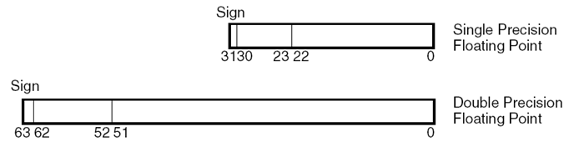
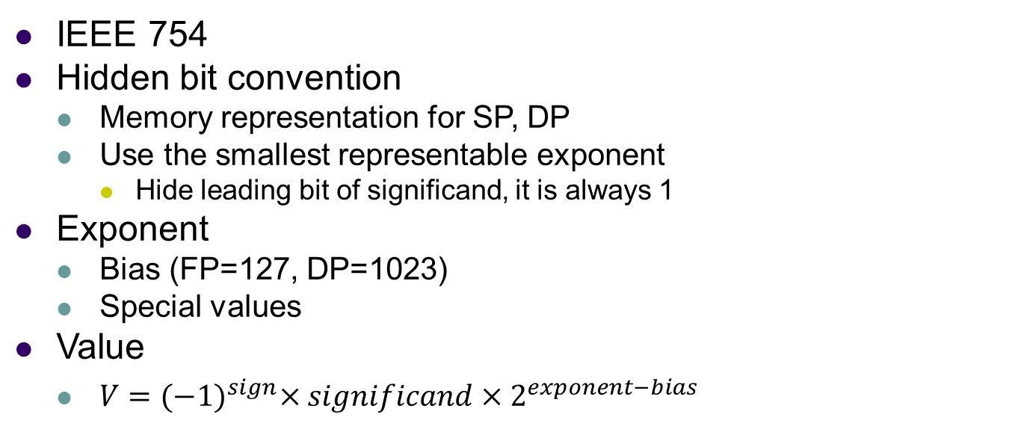
Data representation – floating point numbers
IEEE 754
Hidden bit convention
  Memory representation for SP, DP
  Use the smallest representable exponent
    Hide leading bit of significand, it is always 1
Exponent
  Bias (FP=127, DP=1023)
  Special values
Value
  $V={(−1)}^{sign}×significand×2^{exponent−bias}$

Slide 7
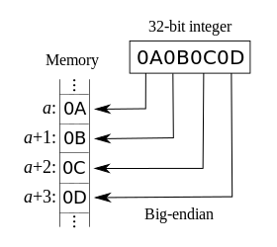
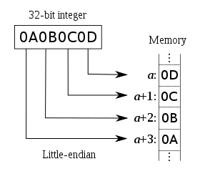
Data representation - endianess
How to store multi-byte numbers?
Big endian
  MSB first, LSB last
  PowerPC
Little endian
  LSB first, MSB last
  Intel
Example
  Store 32-bit number 0x0A0B0C0D

Slide 8
Data alignment – inner padding
Modern CPUs require data in memory aligned to their size
  E.g. integer (4B) must have address aligned to 4
A
c
1B
A
c
1B
struct dem {
char c;
double d;
int i;
};
A+1
d
8B
7B
A+8
d
A+9
i
8B
4B
A+13
A+16
i
4B
A+20

Slide 9
Data alignment – outer padding
dem arr[2];
A
c
1B
A
c
1B
7B
7B
A+8
d
arr[0]
A+8
d
arr[0]
8B
8B
A+16
i
4B
A+16
i
4B
A+20
c
1B
4B
7B
A+24
c
1B
arr[1]
7B
%8?
A+28
d
8B
A+32
d
8B
arr[1]
A+36
i
4B
A+40
A+40
i
4B
4B
A+48

Slide 10
Memory allocation
Task
  Locate a block of unused memory of sufficient size
  Allocate portions from a large pool of memory
    Heap, memory arena/pool
Lifecycle
  Allocate a block
    Different strategies, allocators
  Use the block
  Free the block
    Explicitly, garbage collector

Slide 11
Fragmentation
Internal
  Allocated more memory than needed in a block
External
  Free memory separated into small blocks and interspersed by allocated memory
requested
allocated

Slide 12
Dynamic memory allocation
Contiguous allocation of variable size
Free blocks evidence
  Linked list
  Bitmap
    Each bit represents a block of a fixed size
0
0
0
0
0
1
1
0
0
0
1
1
1
1
1
1
1
1
1
1
1
1
0
0
1
1
1
0
0
0
0

Slide 13
Allocation algorithms
First fit
  Start from the beginning
  Find the first free space big enough to accommodate required block size
  Pros: fast, simple; Cons: can divide larger blocks
Next fit
  Like the first fit, but starts from the last position
  Pros: fast, doesn’t make fragmentation on the start of the heap
Best fit
  Start from the beginning, find the smallest space big enough
  Pros: keeps large blocks; Cons: slower, creates many tiny blocks
Worst fit
  Start from the beginning, find the largest space
  Cons: divides large blocks

Slide 14
Buddy memory allocation
Blocks of 2^{N} size
  Address aligned to 2^{N}
Find the smallest 2^{N} block fitting the required size
  “List” of free blocks lists with fixed sizes 2^{N}
If there are no small blocks, create them dividing larger blocks
  Buddies
    Find the buddy address by XORing my address with the block size
Merge blocks back when both buddies are free
Significant internal fragmentation

Slide 15
Buddy memory allocation
Req 200B
64
A:1024,S:256
128
256
A:1280,S:256
512
A:1024,S:512
1k
2k
4k
8k
16k
A:16384,S:16k

Slide 16
Computer memory hierarchy
Size
reg
Speed
Price
Power on
cache
RAM
persistent RAM
Power off
SSD, flash disks
HDD
tapes

Slide 17
Cache
HW or even SW
  A structure holding data
  Future requests for that data can be served faster
  Generic cache operation
    Make a request for data
    Are data placed in the cache?
    If they are, return them, otherwise do a slow calculation/access
Cache in CPU
  Hides memory latency
  Based on locality of reference
  CPU cache operation
    Make a request for data in the memory
    Are data placed in the cache? Look in all levels of cache in the CPU from the fastest L1 to the slowest LLC
    If they are, return them to the execution unit in a CPU core, otherwise do a full memory access

Slide 18
Cache terminology
Cache line/entry
  Caches are organized in lines
    Usual size is 64B
Cache hit
  Request served from the cache
  Success rate around 97%
Cache miss
  Data not found in a cache hierarchy, do a full memory access
  Load data from the memory to a cache line
    Select either a free cache line or select a victim cache line
    Store modified cache lines back to the memory
Cache line state
  MESI

Slide 19
Associative memory
Associative memory
  Very fast
  Content based addressing
  Used in CPU caches
RAM
21
64
Cache
line
number
key
value
138
114
114
21
138
64

Slide 20
NUMA
Multiprocessors
  SMP – Symmetric multiprocessing
  NUMA – Non-uniform memory access
Address space
RAM1
CPU1
CPU2
RAM1
RAM3
RAM2
System bus
CPU1
CPU3
RAM3
RAM
CPU2
CPU4
RAM4
RAM2
RAM4

