Slide 1
Computer Systems
CPU
Jakub Yaghob

Slide 2
Von Neumann architecture
Simple, slower
CPU
Memory
I/O

Slide 3
Harvard architecture
Microcontrollers
Multiple address spaces
Instruction
Memory
CPU
Data
Memory
I/O

Slide 4
Real PC architecture
External Graphics
Card
Sandy Bridge
PCI express ×16
2133-1066 MHz
DDRIII
Channel 1
Memory controller
Cache
GFX
System
Agent
Mem BUS
Core
DDRIII
Channel 2
Core
Display link
4×DMI
Line out
Audio Codec
Line in
South Bridge (PCH)
D-sub, HDMI, DVI, Display port
S/PDIF out
S/PDIF in
exp
slots
BIOS
PCI express ×1
Super I/O
LPC
Lan
Adap
USB
SATA
SATA
Parallel Port
Floppy
Drive
PS/2
keybrd/
mouse
mouse
DVD
Drive
Hard
Disk
Serial Port
LAN

Slide 5
CPU
Architecture
  HW
  ISA
"Simple" machine
  Executes instructions
    Instruction – simple command

Slide 6
Instructions - motivation
How can we execute the following code?
  if(a<3) b = 4; else c = a << 2;
  for(int i=0;i<5;++i) a[i] = i;
  int f(int p) { return p+1; }
  void g() { auto r = f(42); }

Slide 7
Instruction classes
Load instructions
Store instructions
Move instruction
Arithmetic and logic instructions
Jumps
  Unconditional x conditional
  Direct x indirect x relative
Call, return
…

Slide 8
Registers
Types
  General, integer, floating point, address, branch, flags, predicate, application, system, vector, …
Naming
  Direct x stack
Aliasing

Slide 9
Registers – example 32-bit x86
EAX | AX | AH | AL |  | CS
EBX | BX | BH | BL |  | DS
ECX | CX | CH | CL |  | ES
EDX | DX | DH | DL |  | SS
ESI |  | SI |  |  | FS
EDI |  | DI |  |  | GS
EBP |  | BP |  |  | EFLAGS |  | FLAGS
ESP |  | SP |  |  | EIP |  | IP

Slide 10
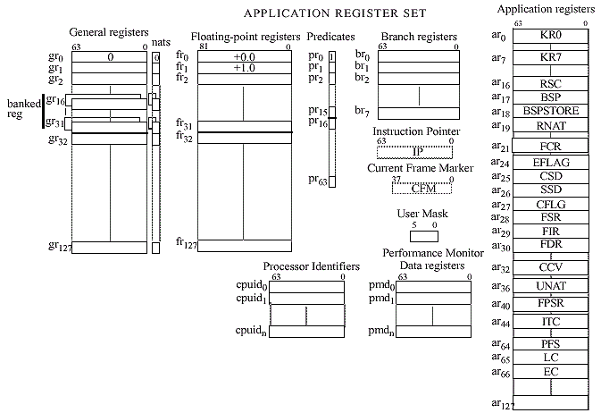
Registers – example IA-64

Slide 11
MIPS – simple assembler
Execution environment
  32-bit registers r0-r31
    r0 is always 0, writes are ignored
    r31 is a link register for the jal instruction
  No stack
  No flags
  PC register

Slide 12
MIPS – register aliases
Register | Name | Purpose | Preserve
$r0 | $zero | 0 | N/A
$r1 | $at | Assembler temporary | No
$r2-$r3 | $v0-$v1 | Return value | No
$r4-$r7 | $a0-$a3 | Function arguments | No
$r8-$r15 | $t0-$t7 | Temporaries | No
$r16-$r23 | $s0-$s7 | Saved temporaries | Yes
$r24-$r25 | $t8-$t9 | Temporaries | No
$r26-$r27 | $k0-$k1 | Kernel registers – DO NOT USE | N/A
$r28 | $gp | Global pointer | Yes
$r29 | $sp | Stack pointer | Yes
$r30 | $fp | Frame pointer | Yes
$r31 | $ra | Return address | Yes

Slide 13
MIPS – instructions
Arithmetic
  add $rd,$rs,$rt
    R[rd] = R[rs]+R[rt]
  addi $rd,$rs,imm16
    R[rd] = R[rs]+signext(imm16)
  sub $rd,$rs,$rt
  subi $rd,$rs,imm16

Slide 14
ISA comparison
MIPS
x86
ADD $t1,$t1,$t0
ADDI $t1,$t1,1
ADD $t2,$t0,$t1
ADD eax,ebx
ADD eax,1
MOV eax,ebx
ADD eax,ecx

Slide 15
MIPS – instructions
Logic operations
  and/or/xor/nor $rd,$rs,$rt
  andi/ori/xori $rd,$rs,imm16
    R[rd] = R[rs] and/or/xor zeroext(imm16)
  No not instruction, use nor $rd,$rs,$rs
Shifts
  sll/slr $rd,$rs,shamt
    R[rd] = R[rs] << / >> shamt
  sra $rd,$rs,shamt

Slide 16
ISA comparison
MIPS
x86
NOR $t1,$t2
SLL $t1,$t1,3
MOV eax,ebx
NOT eax
SHL eax,3

Slide 17
MIPS – instructions
Memory access
  lw $rd,imm16($rs)
    R[rd] = M[R[rs] + signext32(imm16)]
  sw $rt,imm16($rs)
    M[R[rs] + signext32(imm16)] = R[rt]
  lb $rd,imm16($rs)
    R[rd] = signext32(M[R[rs] + signext32(imm16)])
  lbu $rd,imm16($rs)
    R[rd] = zeroext32(M[R[rs] + signext32(imm16)])
  sb $rt,imm16($rs)
    M[R[rs] + signext32(imm16)] = R[rt]
Moves
  li $rd,imm32
    R[rd] = imm32
  move $rd,$rs
    R[rd] = R[rs]

Slide 18
ISA comparison
MIPS
x86
LW $t1,1234($t0)
SW $t1,1234($t0)
LB $t1,1234($t0)
LI $t1,5678
MOVE $t1,$t0
MOV eax,[ebx+1234]
MOV [ebx+1234],eax
MOV al,[ebx+1234]
MOV eax,5678
MOV eax,ebx

Slide 19
MIPS – instructions
Jumps
  j addr
    PC = addr
  jr $rs
    PC = R[rs]
  jal addr
    R[31] = PC+4; PC = addr

Slide 20

ISA comparison
MIPS
x86
J label
JR $ra
JAL fnc
JMP label1
JMP [ebx]
CALL fnc

Slide 21
MIPS – instructions
Conditional jumps
  beq $rs,$rt,addr
    If R[rs]=R[rt] then PC=addr else PC=PC+4
  bne $rs,$rt,addr
Testing
  slt $rd,$rs,$rt
    If R[rs]<R[rt] then R[rd] = 1 else R[rd] = 0
  sltu $rd,$rs,$rt
    Unsigned version
  slti $rd,$rs,imm16
    If R[rs]<signext(imm16) then R[rd] = 1 else R[rd] = 0
  sltiu $rd,$rs,imm16
    If R[rs]<zeroext(imm16) then R[rd] = 1 else R[rd] = 0

Slide 22
ISA comparison
MIPS
x86
BEQ $t0,$t1,label
SLT $t2,$t1,$t0
BNE $t2,$zero,label
SLTI $t2,$t1,5
BNE $t2,$zero,label
CMP eax,ebx
JZ label
CMP eax,ebx
JL label
CMP eax,5
JL label

Slide 23
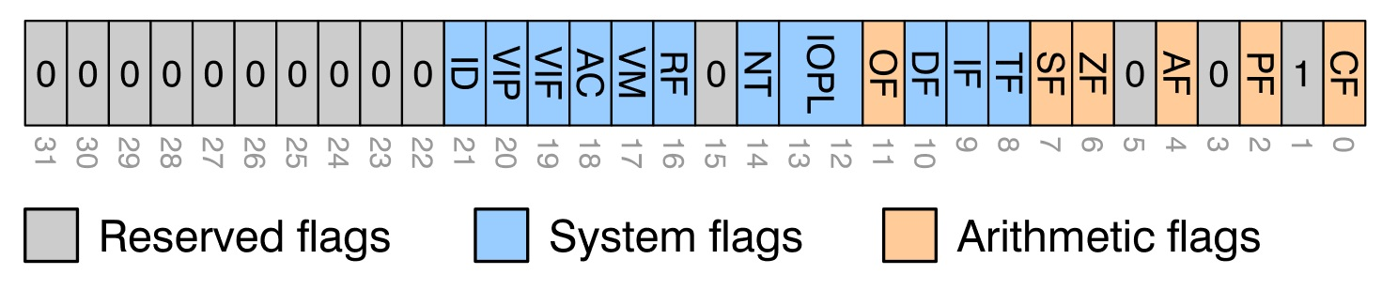
Flags
Only used by some ISA
Control execution
Check status of the last instruction
Usual flags
  Z – zero flag
  S – sign flag
  C – carry flag

Slide 24
CPU
Architecture
  Memory controller
  Cache hierarchy
  Core
  Registers
    Types
  Logical processor
    Hyper threading
  Instructions

Slide 25
Instruction
Simple command to the CPU
Encoding
Assembler
Operands
Instruction flow
  PC
Stack?
  SP

Slide 26
ISA
Instruction set architecture
  Abstract model of CPU
Classification
  CISC – Complex Instruction Set Computer
  RISC – Reduced Instruction Set Computer
  VLIW – Very Long Instruction Word
  EPIC – Explicitly Parallel Instruction Computer
Orthogonality
  Accumulator
Load-Execute-Store

Slide 27
CPU – simplified scheme
Package
CORE 0
CORE 1
CORE 2
CORE 3
T0
T4
T1
T5
T2
T6
T3
T7
EU
EU
EU
EU
L1I
L1I
L1I
L1I
L1D
L1D
L1D
L1D
L2
L2
L2
L2
L3/LLC

Slide 28
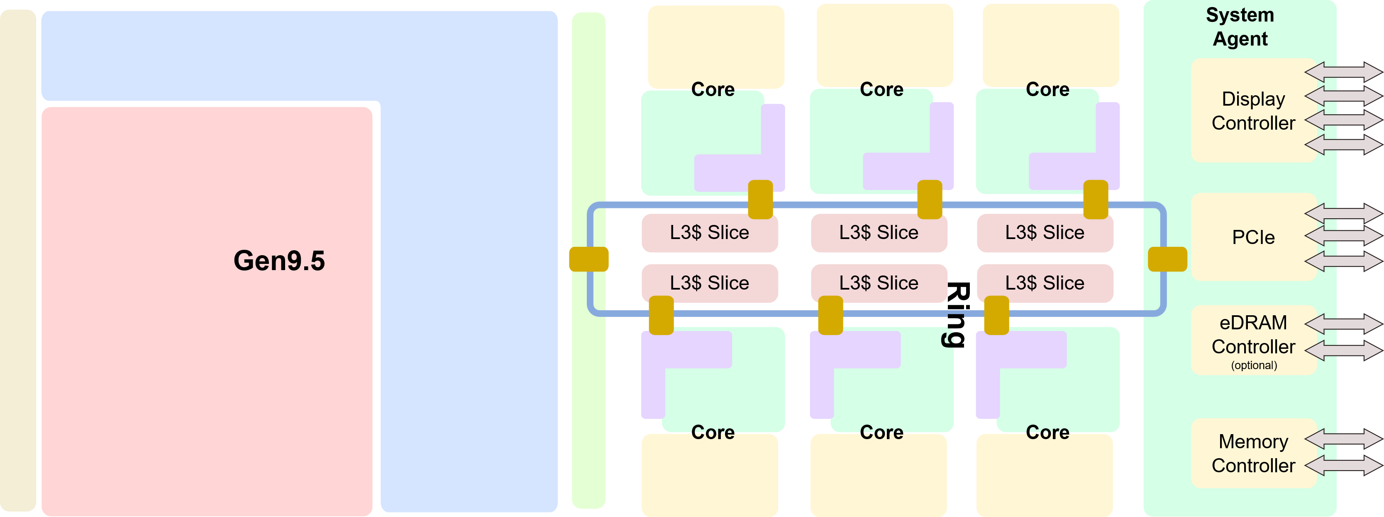
Real CPU scheme – package
Intel Coffee Lake

Slide 29
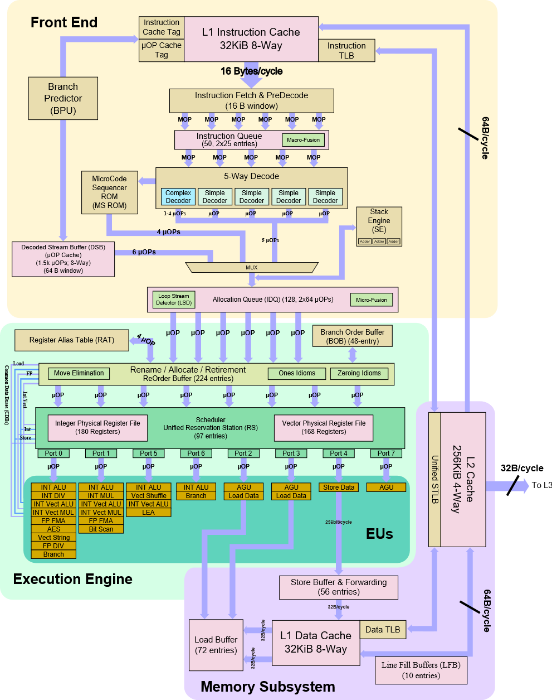
Real CPU scheme – core

Slide 30
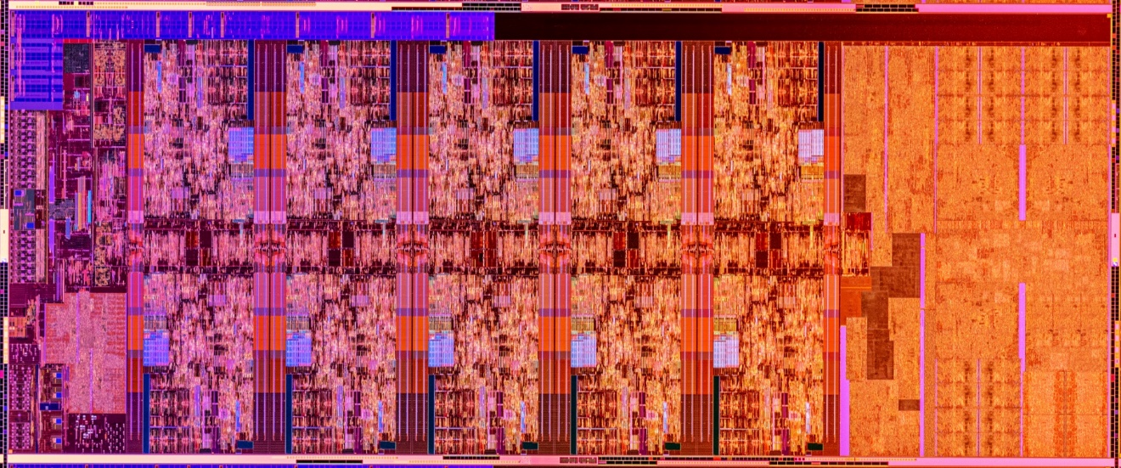
Real CPU die

Slide 31
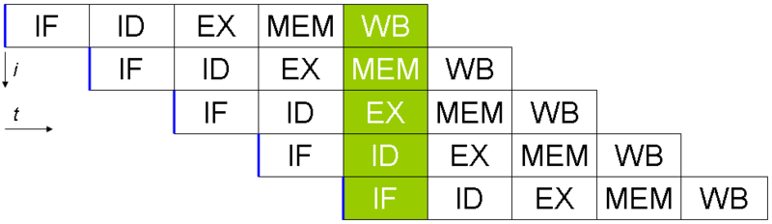
CPU architecture – pipeline
Current CPU
  14-19 stages

Slide 32
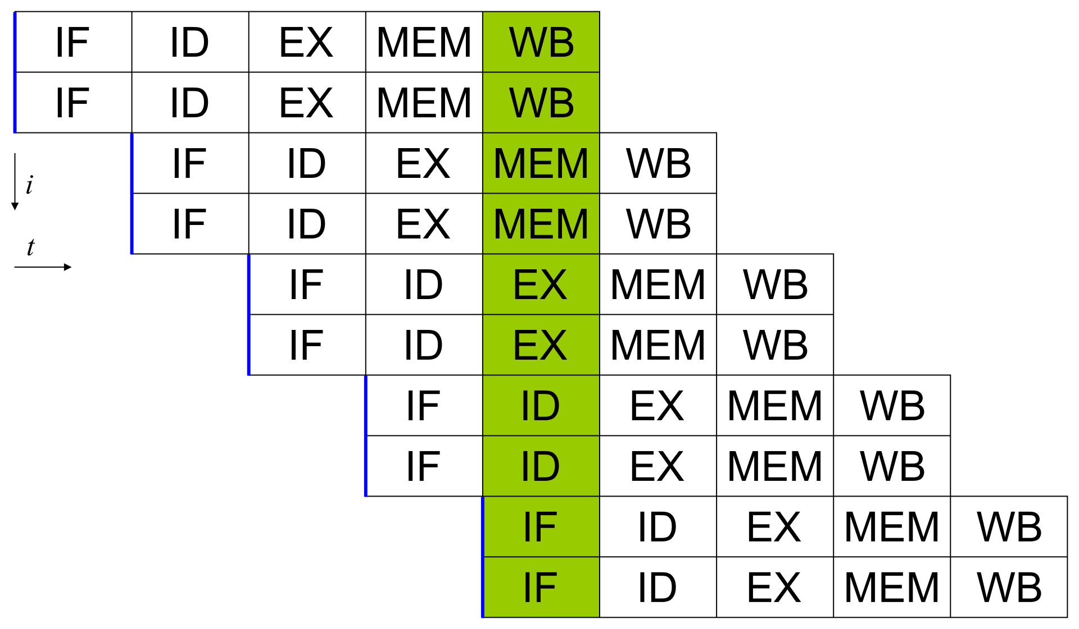
CPU architecture – superscalar processor
Current CPU
  5-way, asymmetric

Slide 33
CPU architecture – out-of-order execution
Decoder
µOPs
Reservation station (pool)
Port 0
Port 1
Port 5
Port 6
Port 2
Port 3
Port 4
Port 7
I/V ALU
I/V ALU
I/V ALU
I ALU
AGU
AGU
AGU
AGU
I/V MUL
I/V MUL
Vec Shuff
I Logic
Load
Load
Store
I/V Logic
I/V Logic
F ADD
Branch
String
Bit scan
Comp Int
F FMA
F FMA
AES
SQRT
I/F DIV
Reorder buffer
Branch

