Slide 1
Virtualization and Cloud Computing
Virtualization
David Bednárek, Jakub Yaghob, Filip Zavoral

Slide 2
Resources
Using freely available VMware courseware
  https://www.vmware.com/learning.html

Slide 3
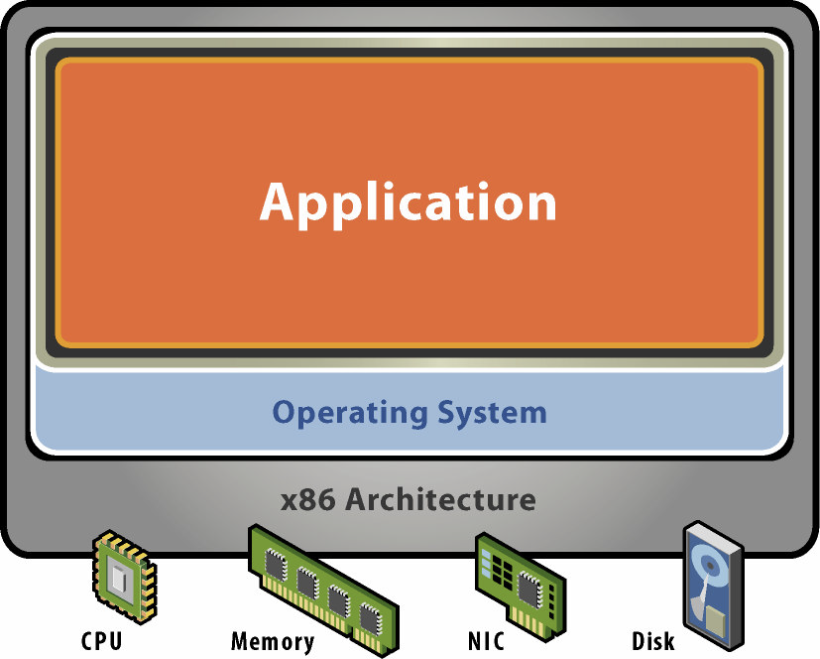
Physical machine
Physical HW
  CPU, RAM, disks, I/O
  Underutilized HW
SW
  Single active OS
  OS controls HW

Slide 4
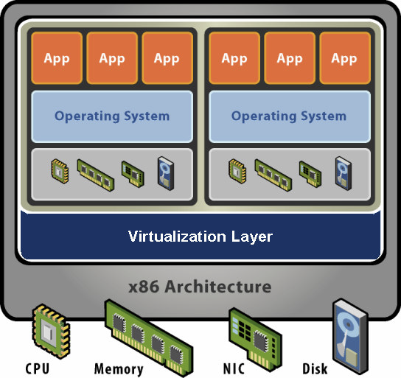
Virtual machine
HW-level abstraction
  Virtual HW: CPU, RAM, disks, I/O
Virtualization SW
  Decouples HW and OS
  Multiplexes physical HW across multiple guest VMs
  Strong isolation between VMs
  Manages physical resources, improves utilization

Slide 5
Virtual machine – isolation
Secure multiplexing
  Multiple VMs on a single physical host
  CPU HW isolates VMs (MMU)
Strong guarantees
  SW bugs, crashes within one VM cannot affect other VMs
Performance isolation
  Partition system resources

Slide 6
Virtual machine – encapsulation
Entire VM is a file
  OS, applications, data
  Memory and device state
Snapshots and clones
  Capture VM state on the fly and restore to point-in-time
  System provisioning, backup, mirroring
Easy content distribution
  Preconfigured apps
  Virtual appliances

Slide 7
Virtual machine – compatibility
HW-independent
  Physical HW hidden by virtualization layer
  Standard virtual HW exposed to VM
Create once, run everywhere
  No configuration issues
  Migrate VMs between hosts
Legacy VMs
  Run ancient OS on new platform

Slide 8
Resource controls
Shares
  Specify relative importance
  Entitlement directly proportional to shares
  Abstract relative units, only ratios matter
Reservation
  Minimum guarantee, even when system overloaded
  Concrete absolute units
  Admission control: sum of reservations ≤ capacity
Limit
  Upper bound of consumption, even if underloaded
  Concrete absolute units

Slide 9
Resource controls – demo
Proportional-share scheduling
  Simple virtual-time algorithm
    Virtual time = usage / share
    Schedule VM with smallest virtual time
  Example: 3 VM A, B, C with 3:2:1 share ratio
A
2
4
4
6
8
8
8
10
10
B
3
3
6
6
6
9
9
9
12
C
6
6
6
6
6
6
12
12
12

Slide 10
Distributed systems
Features
  Choose initial host when VM powers on
  Migrate running VM across physical hosts
  Dynamic load balancing
  Distributed power management
  Distributed I/O management
  Support cloud computing, multi-tenancy

Slide 11
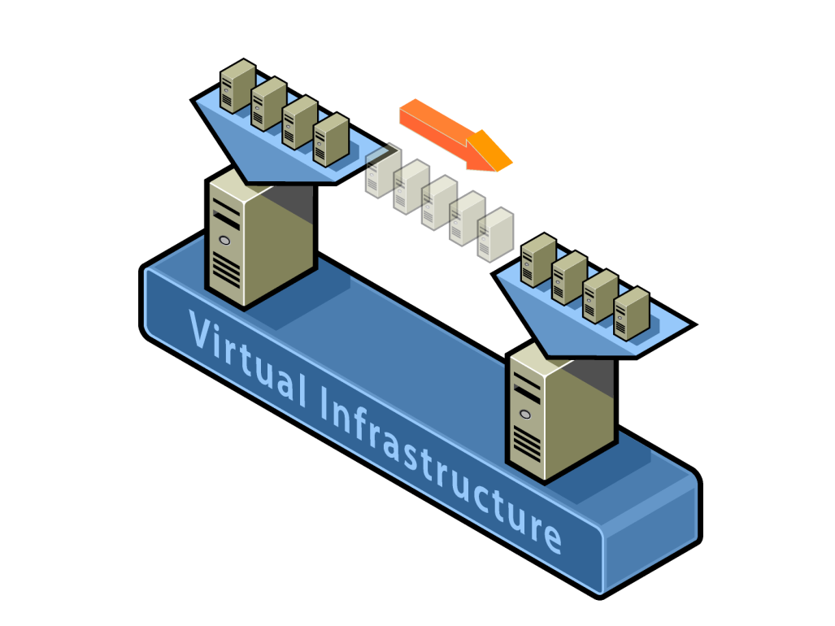
Live VM migration
Hot migrate across hosts
  Transparent to guest OS, apps
  Minimal downtime (≤1s)
Requirements
  Shared storage
  Same subnet
  Compatible CPUs (EVC)

Slide 12
Load balancing
4GHz
4GHz
VM1
VM2
VM3
VM4
3GHz
2GHz
1GHz
1GHz
Host normalized
entitlement = 1.25 (5/4)
Host normalized
entitlement = 0.5 (2/4)

Slide 13
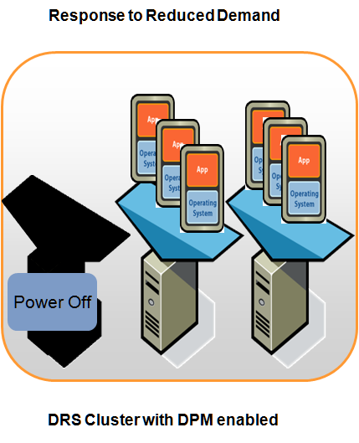
Distributed power management
Consolidate VMs onto fewer hosts and power off hosts when demand is low
Power hosts back on when needed to meet workload demands or to satisfy constraints
Works in concert with DRS

Slide 14
Distributed high availability
Features
  Specify resources to reserve to restart VMs upon failures of their hosts in a cluster
    Number of host failures to tolerate
    Percentage of cluster capacity
    Specify hosts to set aside for failover
  Failover reservation strict or best-effort
  Decentralized host failure detection and quick VM restart
    Cluster hosts send each other heartbeats; when a host fails to do so for some period, failover response action is launched
  Works in concert with DRS and DPM
    Resources for each VM to failover on 1 powered on host
    DRS/DPM/HA proactively maintain appropriate spare resources

Slide 15
Fault tolerance
High speed availability
  Modern CPUs can replicate stream of instructions
  Cluster creates secondary VM and moves it to another host, they share resources on SAN
  Primary VM works as usual, secondary VM makes only reads
  When host for primary VM fails, secondary VM becomes primary and continues without interruption
  Small lag (≈ 5ms)

Slide 16
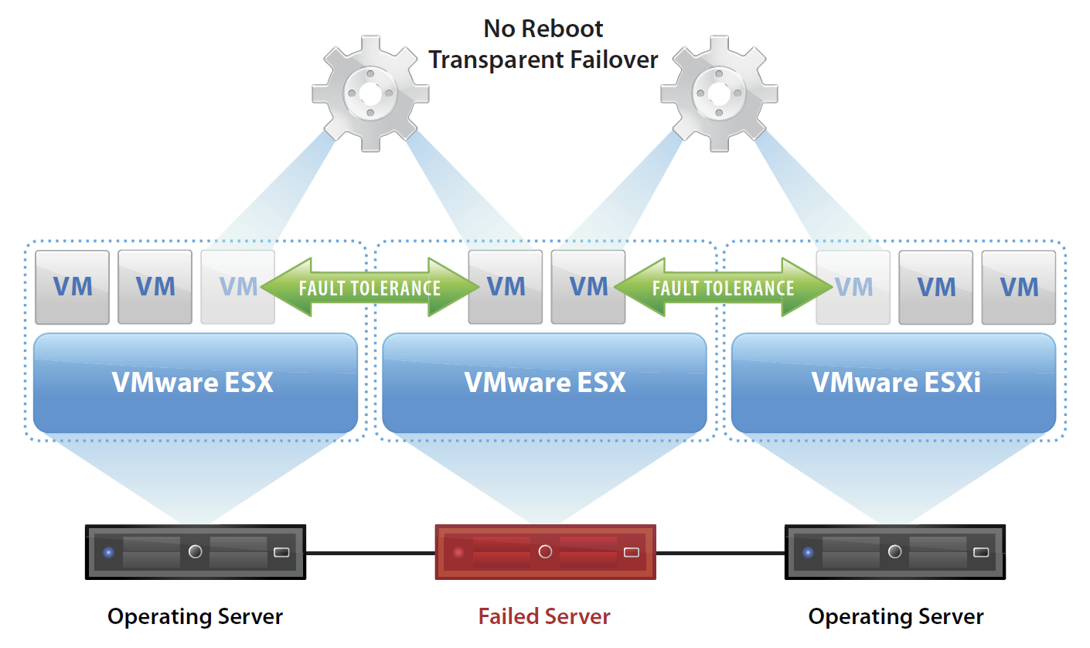
Fault tolerance – demo

