Slide 1
Virtualization and Cloud Computing
Data center hardware
David Bednárek, Jakub Yaghob, Filip Zavoral

Slide 2
Resources
Books
  H. Geng: Data Center Handbook, ISBN: 978-1118436639, Willey, 2014
  B.A. Ayomaya: Data Center for Beginners: A beginner's guide towards understanding Data Center Design, ASIN: B01NC24WNL, Amazon, 2017

Slide 3
Motivation for data centers
Standardization/consolidation
  Reduce the number of DCs of an organization
  Reduce the number of HW, SW platforms
  Standardized computing, networking and management platforms
Virtualization
  Consolidate multiple DC equipment
  Lower capital and operational expenses
Automating
  Automating tasks for provisioning, configuration, patching, release management, compliance
Securing
  Physical, network, data, user security

Slide 4
Data center requirements
Business continuity
  Availability
ANSI/TIA-942 standard
  Tier 1
    Single non-redundant distribution path
    Non-redundant capacity with availability 99.671% (1729 min/year)
  Tier 2
    Redundant capacity with availability 99.741% (1361 min/year)
  Tier 3
    Multiple independent distribution paths
    All IT components dual-powered
    Concurrently maintainable site infrastructure with availability 99.982% (95 min/year)
  Tier 4
    All cooling equipment dual-powered
    Fault-tolerant site infrastructure with electrical power storage with availability 99.995% (26 min/year)

Slide 5
Problems of data centers – design
Mechanical engineering infrastructure design
  Mechanical systems involved in maintaining interior environment
  HVAC (heating, ventilation, air conditioning)
  Humidification and dehumidification, pressurization
  Saving space and costs while maintaining availability
Electrical engineering infrastructure design
  Distribution, switching, bypass, UPS
  Modular, scalable
Technology infrastructure design
  Cabling for data communication, computer management, keyboard/mouse/video
Availability expectations
  Higher availability needs bring higher capital and operational costs
Site selection
  Availability of power grids, networking services, transportation lines, emergency services
  Climatic conditions

Slide 6
Problems of data centers – design
Modularity and flexibility
  Grow and change over time
Environmental control
  Temperature 16-24 °C, humidity 40-55%
Electrical power
  UPS, battery banks, diesel generators
  Fully duplicated
  Power cabling
Low-voltage cable routing
  Cable trays
Fire protection
  Active, passive
  Smoke detectors, sprinklers, fire suppression gaseous systems
Security
  Physical security

Slide 7
Problems of data centers – energy use
Energy efficiency
  Power usage effectiveness
  State of the art DC have PUE ≈ 1.2
Power and cooling analysis
  Power is the largest recurring cost
  Hot spots, over-cooled areas
Thermal zone mapping
  Positioning of DC equipment

Slide 8
Problems of data centers – other aspects
Network infrastructure
  Routers and switches
  Two or more upstream service providers
  Firewalls, VPN gateways, IDS
DC infrastructure management
  RT monitoring, management
Applications
  DB, file servers, application servers, backup

Slide 9
Data center technologies – racks
Standardized frame or enclosure for mounting DC equipment
Standard width 19 inches
  There are some other widths, but they are less common
Depth
  Many depths, depends on an equipment and the space in DC
  E.g. 500, 600, 800, 900, 1200 mm
Height
  In multiples of U (=unit), 1U=1.75 inches
  Common rack height is 42U
  All equipment has its height in multiples of U
Rails
  Rails fastened to the rack
  Sliding or fixed rails
  Easy equipment management
Optional features
  Cable management
  Power distribution
  Cooling

Slide 10
Data center technologies – liquid cooling
Liquid cooling
  Much more efficient than air cooling
  Reduces electricity costs, noise
  Enables high rack densities (~100kW per rack)
  Liquid
    Some liquids are dielectric
    Degrades in time – renew after a year, repeatable cost
Cold plates – Direct Liquid Cooling
  Placed directly on the hottest components (CPU/GPU)
  Connected to liquid input/output on server chassis
CDU
  Coolant Distribution Unit
  Usually for one rack
  Distributes liquid among servers inside the rack
  Connects and adapts to the DC liquid distribution
Not standardized
  Many cold plates vendors
  Server vendors use different connectors for inlet/outlet hoses
  Not all server vendors support liquid cooling
  Vendor specific CDU placed in a rack along with vendor’s servers

Slide 11
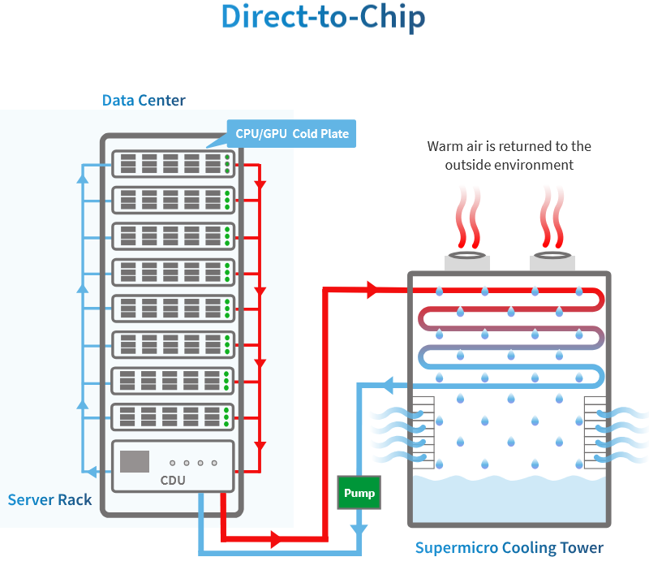
Data center technologies – liquid cooling
Notes:
The picture has been taken from Supermicro web site

Slide 12
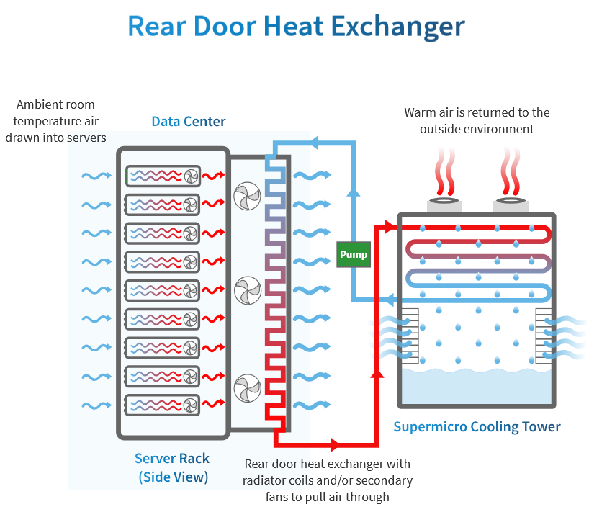
Data center technologies – liquid cooling
Notes:
The picture has been taken from Supermicro web site

Slide 13

Data centers – examples

Slide 14

Data centers – examples

Slide 15
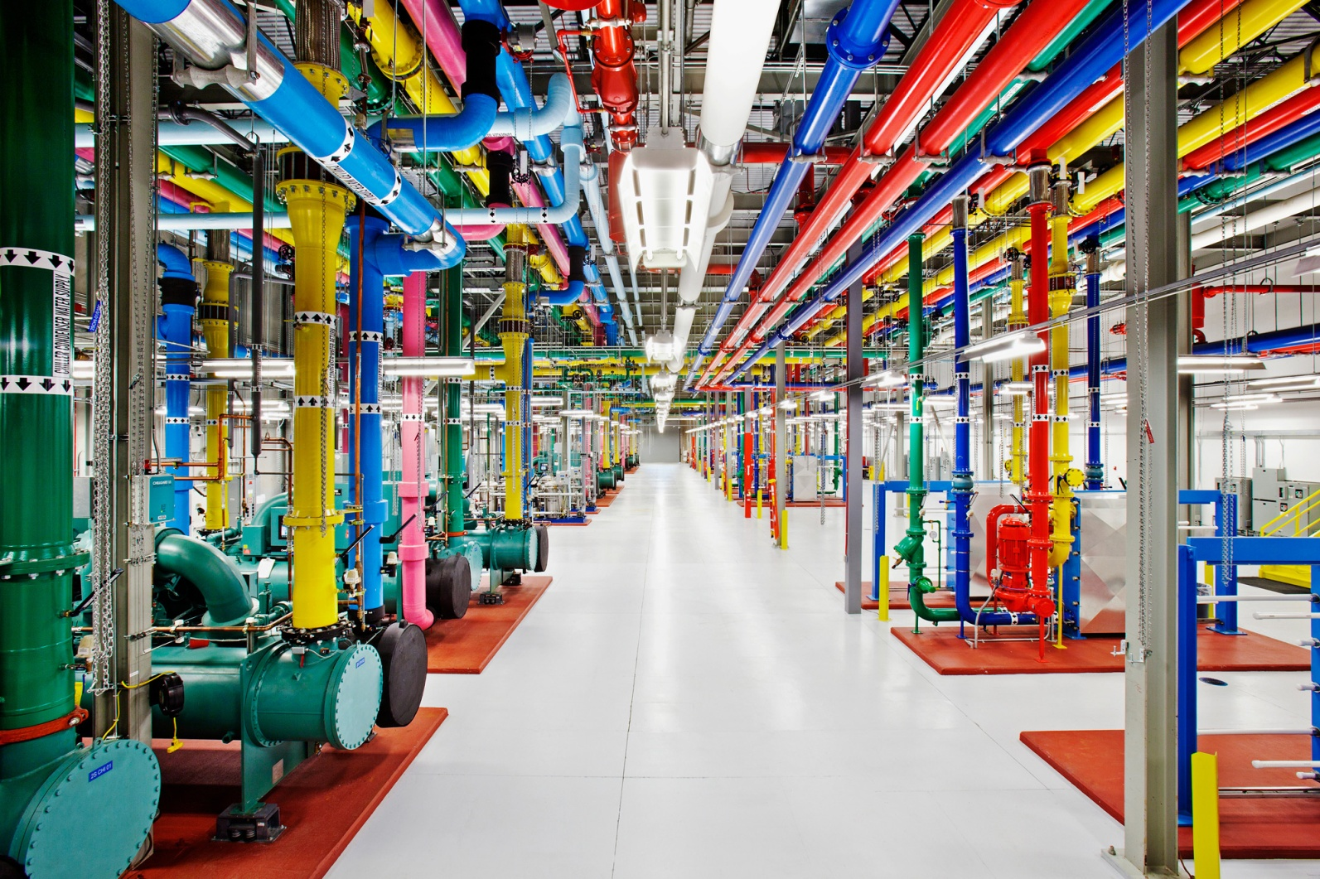
Data centers – examples

Slide 16
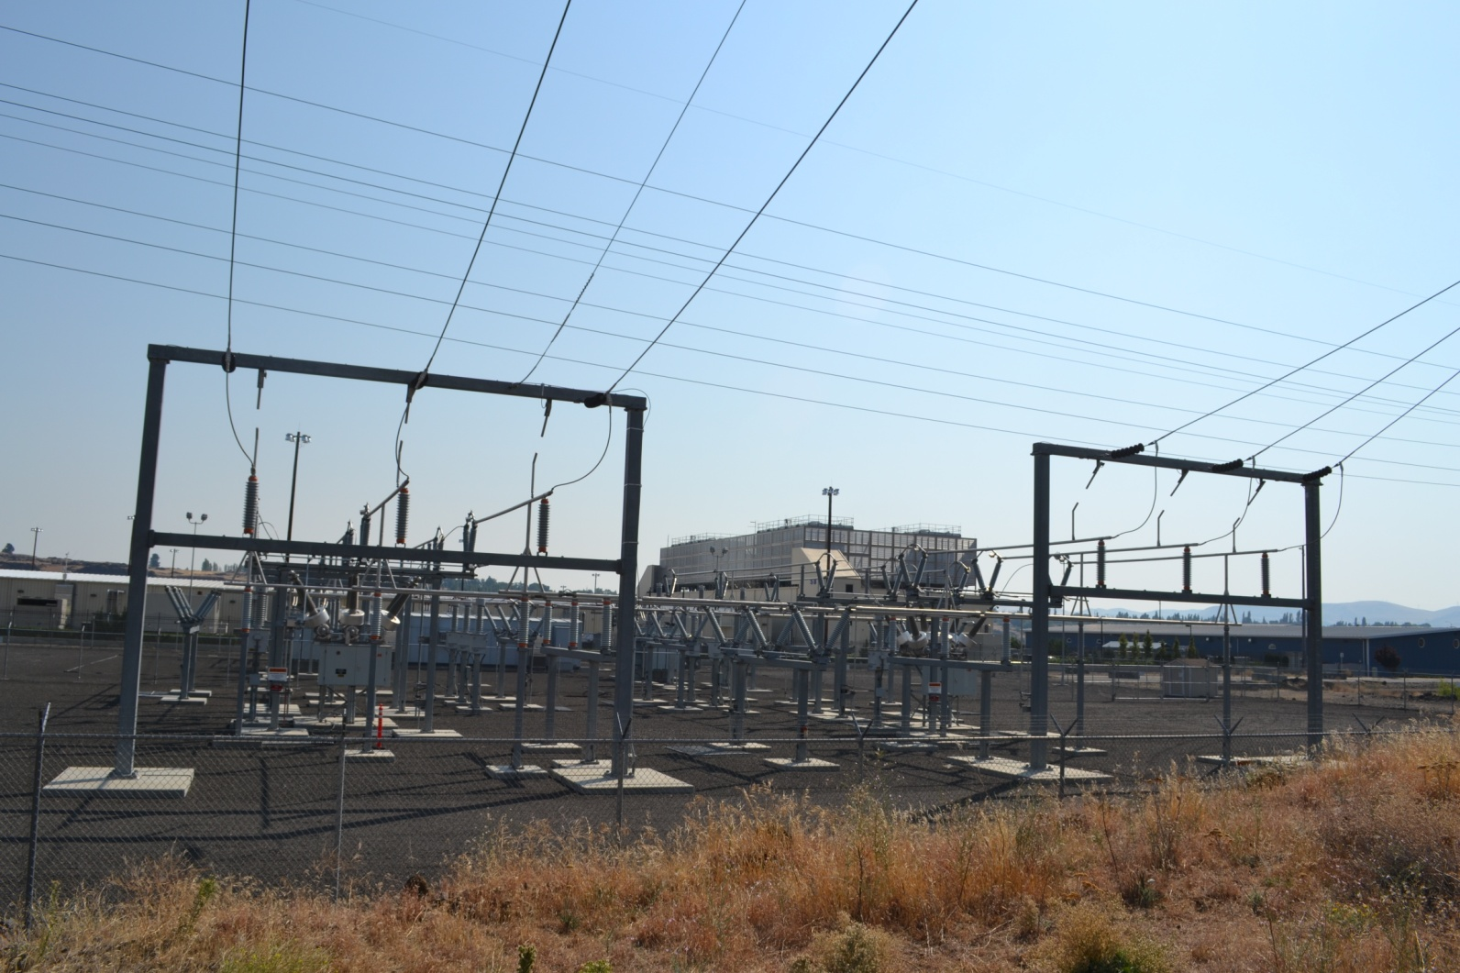
Data centers – examples

Slide 17
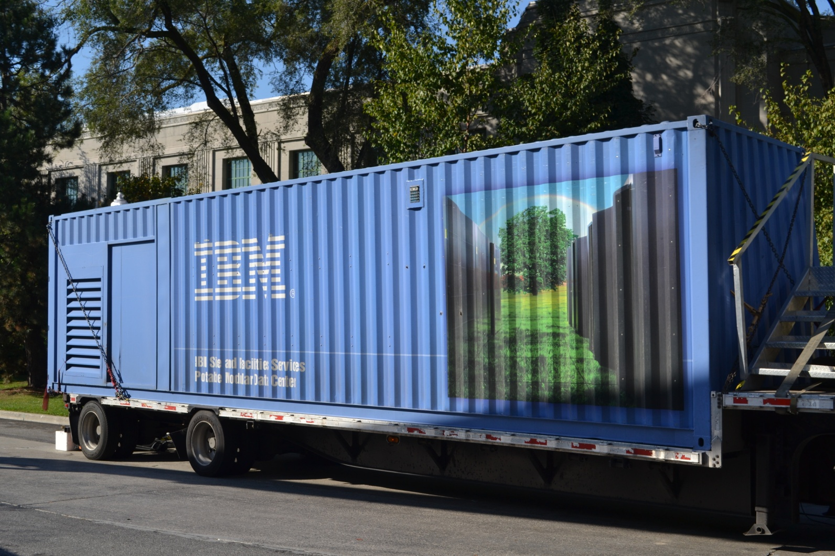
Portable data center

Slide 18
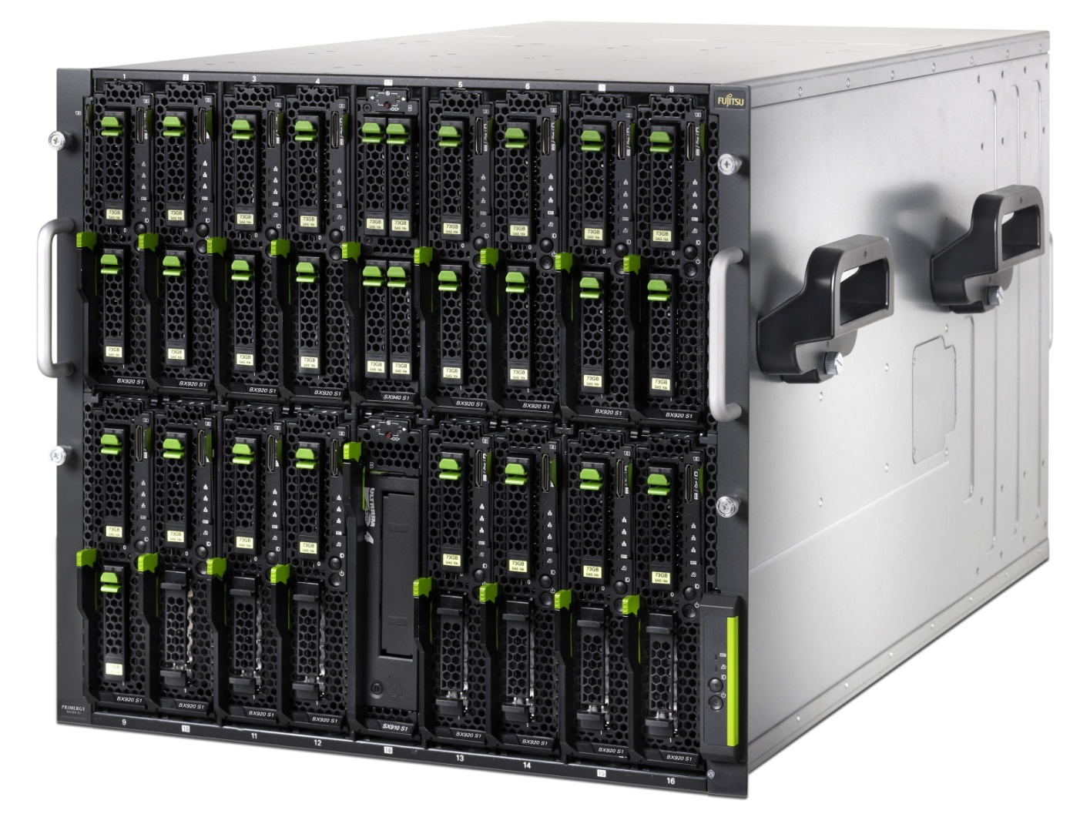
Data centers – blade servers

Slide 19
Blade servers
Modular design optimized to minimize the use of physical space and energy
  Chassis
    Power, cooling, management
    Networking
      Mezzanine cards
      Switches
  Blade
    Stripped server
    Storage

Slide 20
Data centers – converged infrastructure

Slide 21
Converged infrastructure
Converged infrastructure
  Group multiple components into a single optimized package
  Components
    Servers
    Data storage
    Networking
  Management SW
    Sharing and assigning resource pools

Slide 22
Storage area network – SAN
Block level data storage over dedicated network
Server 1
Server 2
Switch A
Switch B
Controller
a
Controller
b
Disk
array γ

Slide 23
SAN
Server 1
Server 2
Server n
Switch A
Switch B
Controller
a
Controller
b
Controller
a
Controller
b
Controller
a
Controller
b
Disk
array α
Disk
array β
Disk
array γ

Slide 24
Multipathing
Server 1
ID 1.1
ID 1.2
Switch A
Switch B
ID a.1
ID a.2
ID b.1
ID b.2
Controller
a
Controller
b
Disk
array γ
Multiple paths to one disk array volume
  1.1:a.1, 1.1:b.1, 1.2:a.2, 1.2:b.2
  4 disks for OS
Disk array assigns UUID to each volume
  Multipath SW in OS compares UUID and creates one multipath disk for each unique UUID
Multipath strategies
  Fixed, MRU, Round Robin
  Active-Active

Slide 25
SAN protocols
iSCSI
  Mapping SCSI over TCP/IP
  Ethernet speeds (1, 10 Gbps)
iSER
  iSCSI Extension over RDMA
  InfiniBand
FC
  Fibre channel
  High speed technology for storage networking
FCoE
  Encapsulating FC over Ethernet 10

Slide 26
Fibre channel
High speed
  4, 8, 16, 32, (64) Gbps
  Throughput 400, 800, 1600, 3200, (6400) MBps
Characteristics
  In-order, lossless
Security
  Zoning
Topologies
  Point to point
  Arbitrated loop
  Switched fabric
Ports
  FCID (like MAC)
  Type
    N – node port
    NL – node loop port
    F – fabric port
    FL – fabric loop port
    E – expansion (between two switches)
    G – generic (works as E or F)
    U – universal (any port)
Host
Storage
N
N
NL
Storage
NL
NL
Host
NL
NL
NL
Storage
Host
Host
N
N
F
F
Switch
Switch
Switch
E
E
F
F
N
N
Storage
Storage

Slide 27
iSCSI
Host
Host
Initiator
  Client
  HW, SW
Target
  Storage resource
LUN
  Logical unit number
Security
  CHAP
  VLAN
  LUN masking
Network booting
Initiator α
Initiator β
TCP/IP network
Disk array
Target
α: A=0, B=1
A
B
C
β: B=0, C=1

Slide 28
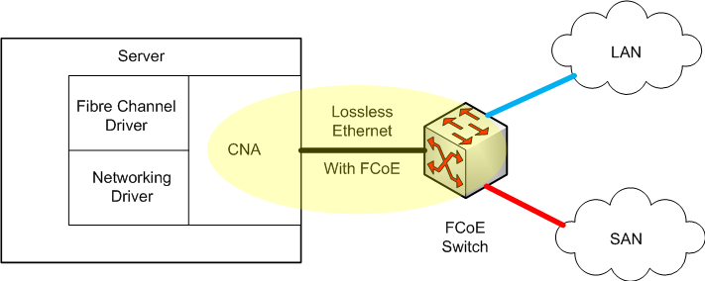
FCoE
Replaces FC0 and FC1 layers of FC
  Retaining native FC constructs
  Integration with existing FC
Required extensions
  Encapsulation of native FC frames into Ethernet frames
  Lossless Ethernet
  Mapping FCID and MAC
Converged network adapter
  FC HBA+NIC
Consolidation
  Reduce number of network cards
  Reduce number of cables and switches
  Reduce power and cooling costs

Slide 29
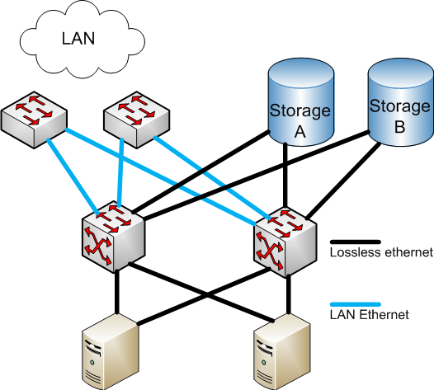
FCoE

Slide 30
Disk arrays
Disk storage system with multiple disk drives
Components
  Disk array controllers
  Cache
    RAM, disk
  Disk enclosures
  Power supply
Provides
  Availability, resiliency, maintainability
  Redundancy, hot swap, RAID
Categories
  NAS, SAN, hybrid

Slide 31
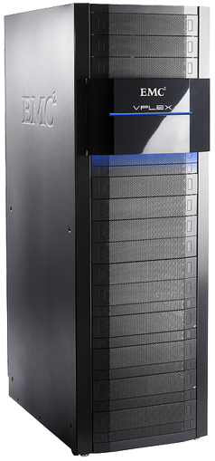
Enterprise disk arrays
Additional features
  Automatic failover
  Snapshots
  Deduplication
  Replication
  Tiering
  Front end, back end
  Virtual volume
  Spare disks
  Provisioning

Slide 32
Indirect block table
1
2
0
2
3
Easily make
  Snapshot
  Deduplication
  Virtual volume
1
5
4
2
0
3
5
5
4
1
0
1
2
3
4
N
N
0
M
Virtual volume
IBT
Disk blocks

Slide 33
RAID levels
Redundant array of independent disks
  Originally redundant array of inexpensive disks
Why?
  Availability
    MTBF (Mean Time Between Failure)
      Nowadays ≈500 000 hours for consumer disks, ≈2 500 000 hours for enterprise disks
    MTTR (Mean Time To Repair)
  Performance
Other issues
  Using disks with the same size

Slide 34
RAID – JBOD
Just Bunch Of Disks
Minimum of drives: 1
Space efficiency: 1
Fault tolerance: 0
Array failure rate: 1-(1-r)^{n}
Read benefit: 1
Write benefit: 1

Slide 35
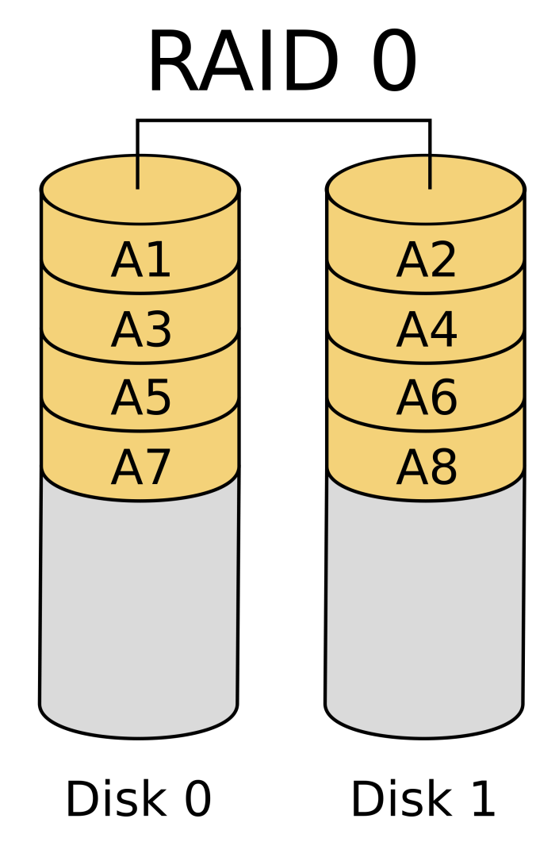
RAID – RAID0
Striping
Minimum of drives: 2
Space efficiency: 1
Fault tolerance: 0
Array failure rate: 1-(1-r)^{n}
Read benefit: n
Write benefit: n

Slide 36
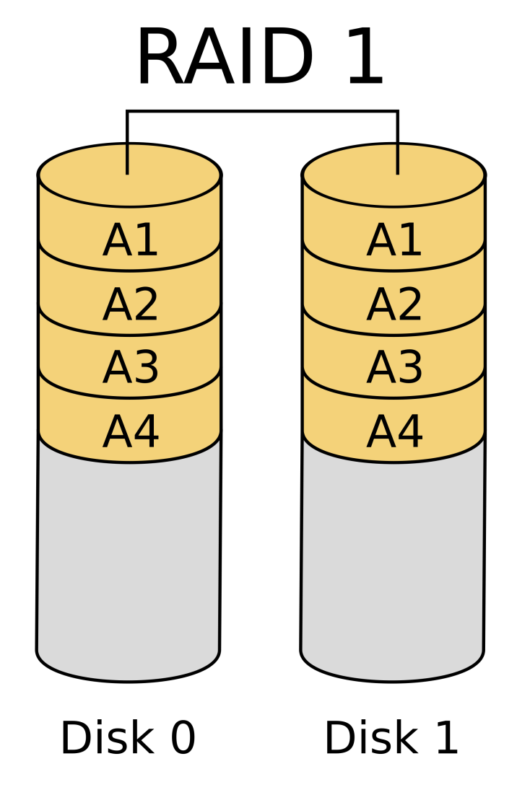
RAID – RAID1
Mirroring
Minimum of drives: 2
Space efficiency: 1/n
Fault tolerance: n-1
Array failure rate: r^{n}
Read benefit: n
Write benefit: 1

Slide 37
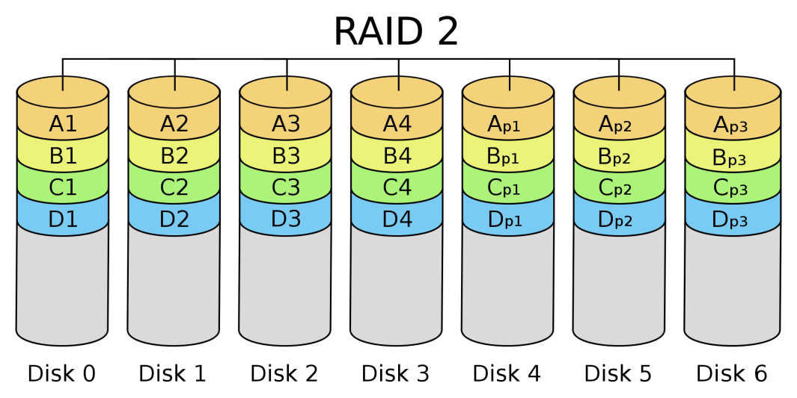
RAID – RAID2
Bit striping with dedicated Hamming code parity
Minimum of drives: 3
Space efficiency: 1-1/n . log₂(n-1)
Fault tolerance: 1
Array failure rate: variable
Read benefit: variable
Write benefit: variable

Slide 38
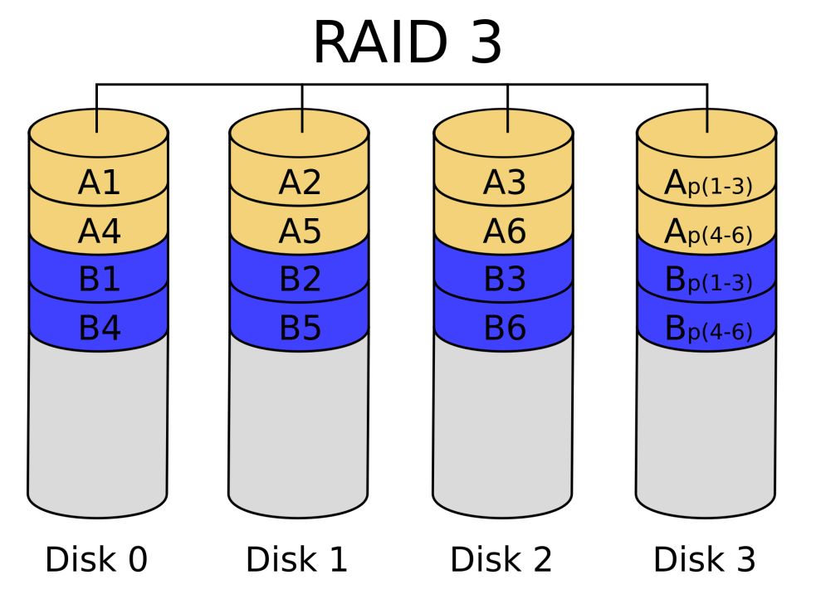
RAID – RAID3
Byte striping with dedicated parity
Minimum of drives: 3
Space efficiency: 1-1/n
Fault tolerance: 1
Array failure rate: n(n-1)r²
Read benefit: n-1
Write benefit: n-1

Slide 39
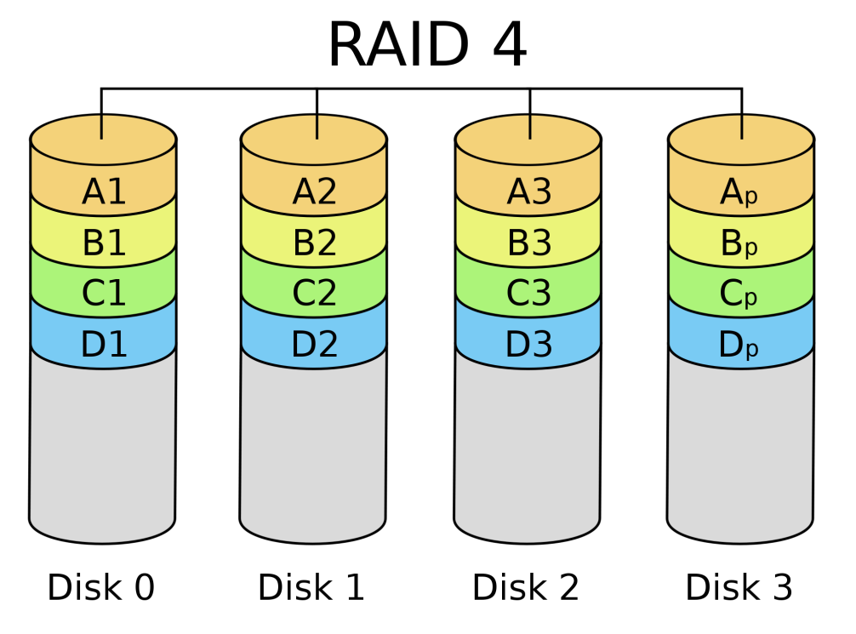
RAID – RAID4
Block striping with dedicated parity
Minimum of drives: 3
Space efficiency: 1-1/n
Fault tolerance: 1
Array failure rate: n(n-1)r²
Read benefit: n-1
Write benefit: n-1

Slide 40
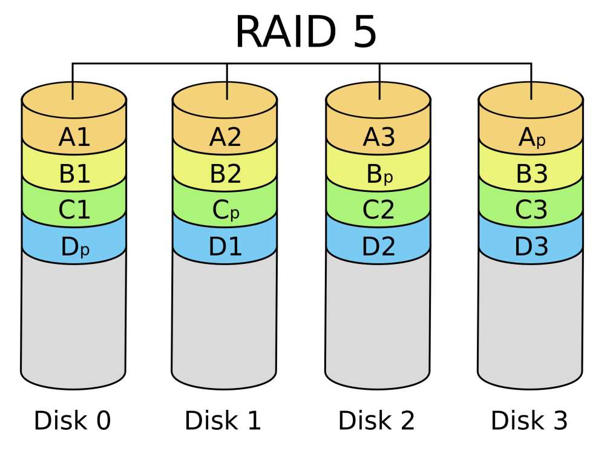
RAID – RAID5
Block striping with distributed parity
  P = A₁ XOR A₂ XOR A₃ … A_{n}
Minimum of drives: 3
Space efficiency: 1-1/n
Fault tolerance: 1
Array failure rate: n(n-1)r²
Read benefit: n-1
Write benefit: ?

Slide 41
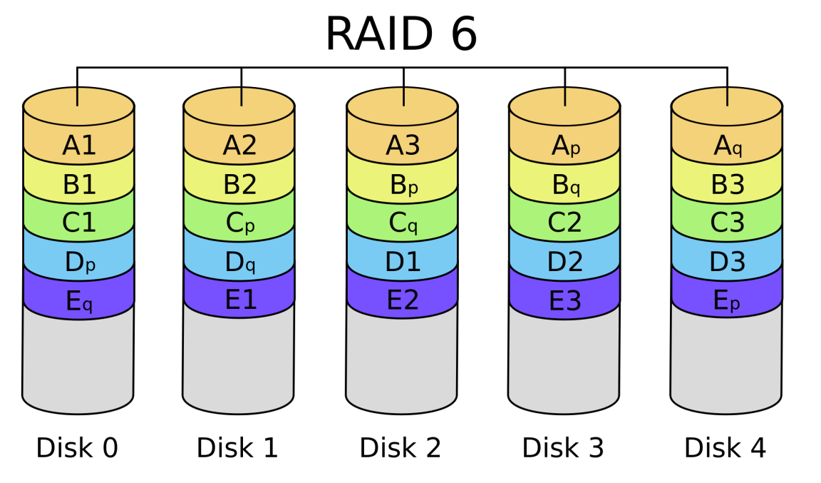
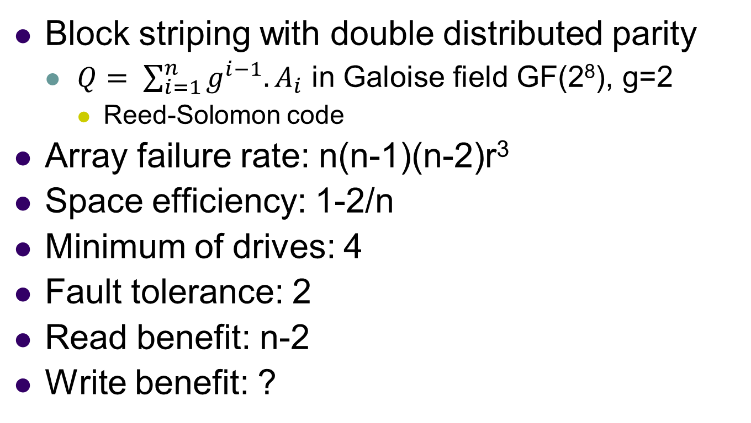
RAID – RAID6
Block striping with double distributed parity
  $Q= \sum_{i=1}^{n}{g^{i−1}.A_{i}}$ in Galoise field GF(2⁸), g=2
    Reed-Solomon code
Array failure rate: n(n-1)(n-2)r³
Space efficiency: 1-2/n
Minimum of drives: 4
Fault tolerance: 2
Read benefit: n-2
Write benefit: ?
Notes:
https://mirrors.edge.kernel.org/pub/linux/kernel/people/hpa/raid6.pdf

Slide 42
RAID – nested (hybrid) RAID
RAID 0+1
  Striped sets in mirrored set
  Min drives: 4, even number of drives
RAID 1+0 (RAID 10)
  Mirrored sets in a striped set
  Min drives: 4, even number of drives
  Fault tolerance: each mirror can loose a disk
RAID 5+0 (RAID50)
  Block striping with distributed parity in a striped set
  Min drives: 6
  Fault tolerance: one disk in each RAID5 block

Slide 43
Tiering
Different tiers with different price, size, performance
Tier 0
  Ultra high performance
  DRAM or flash
  $20-50/GB
  1M+ IOPS
  <500 μs latency
Tier 1
  High performance enterprise app
  15k + 10k SAS
  $5-10/GB
  100k+ IOPS
  <1 ms latency
Tier 2
  Mid-market storage
  SATA
  <$3/GB
  10K+ IOPS
  <10 ms latency

Slide 44
Scale-out distributed filesystems
Scale-out vs. scale-up
  Scale-up – adding resources (storage) to an existing equipment
  Scale-out – purchasing another equipment
Distributed filesystems
  Lustre, BeeGFS
  Use "normal" servers as a storage servers
  Interconnect with any high-speed technology
  Good scaling, used in HPC

Slide 45
Simple Lustre setup
Images from Lustre FS documentation

Slide 46
Scaled-out Lustre setup

