Slide 1
Compiler principles
Processor architectures
David Bednárek

Slide 2
Registers
The fastest memory
Precious resource
  x86 has 7 of 32-bits integer registers
  x86_64 has 15 of 64-bit integer registers
  IA-64 has 128 of 64-bits integer registers
Different register types for different data types
  Integer, floating point, address, vector
Different access modes
  Direct
  Stack (x87 FPU)

Slide 3
Instruction set
RISC (Reduced-Instruction-Set Computer)
  Small number of simple instructions
    e.g. no division
    popular in 1980..2000
CISC (Complex-Instruction-Set Computer)
  Complex instructions, wide repertoire
    since 2000, many CISC CPUs internally use RISC microinstructions
Load-Execute-Store
  Register-only operands in arithmetic instructions
    Part of the RISC strategy
Orthogonality
  All registers of the appropriate kind may participate in an instruction
  x86 has non-orthogonal instruction set

Slide 4
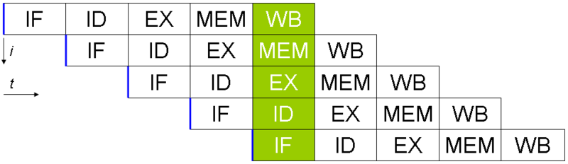
Pipelining
Next instruction fetch and decode started before the previous instruction was finished
Each stage and each instruction has a latency
  Problem with operand dependency (RAW)
Appeared around 1970 in expensive computers
  Intel: Since 80486 (1989)

Slide 5
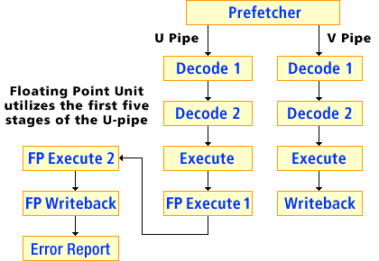
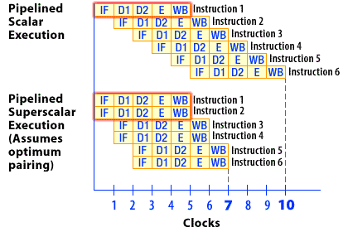
Superscalar processor
More than one pipeline
  Adjacent instruction may be executed in parallel
  Example: Intel Pentium (1993)

Slide 6
Out-of-Order Execution
Instruction fetch
Instruction dispatch to an instruction queue
The instruction waits until its input operands are available
The instruction is issued to its execution unit
The results are queued
When all older instructions written their results to the register file, the instruction writes its result
  Elements in experimental computers since 1965
  IBM: POWER1 (1990)
  Intel: elements in Pentium Pro (1995), full OOO in Core (2006)
  ARM: since A9 (2007)

Slide 7
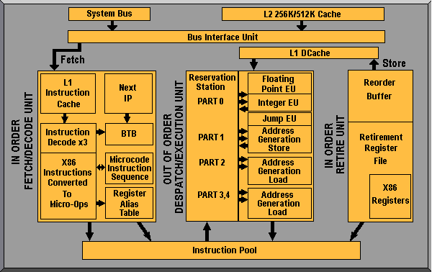
Out-of-Order Execution – AMD

Slide 8
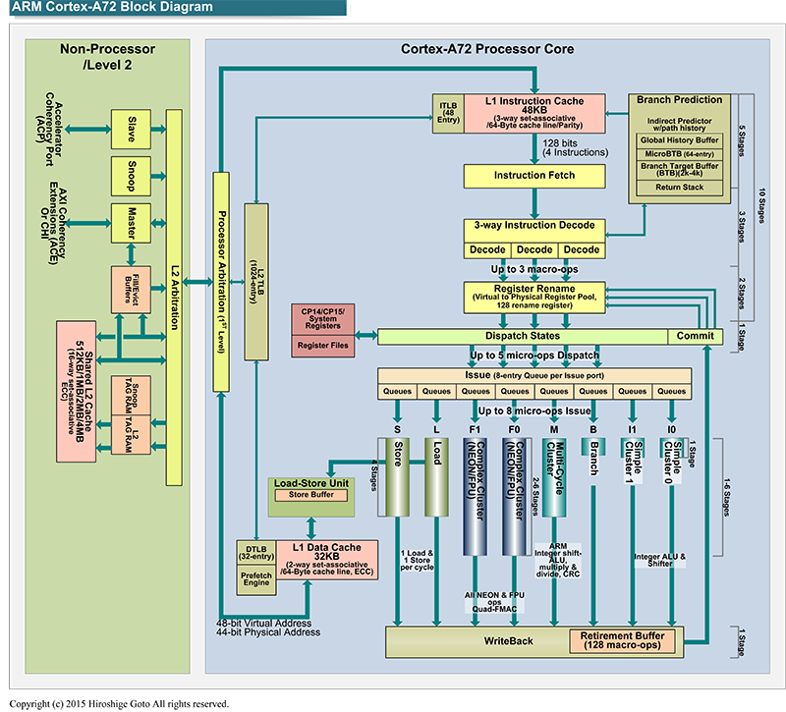
Out-of-Order Execution – ARM Cortex-A72

Slide 9
Branch prediction
Deep pipelines have a problem with not taken conditional jumps
Dynamic branch prediction
  BTB
  CPU uses history (patterns of some length) for branch prediction
  Static prediction used when no history is available
Static branch prediction
  No hint
    Forward jump is not taken, backward jump is taken
  Hint
    A compiler computes branch probability and generates appropriate branch hint
Delay slot

Slide 10
Speculative execution
Execution of a code in advance which is not necessarily used later
Motivation:
  Deep pipelines are stalled by dependences
  Significant disproportion between CPU and memory speed
Code speculation
  Not waiting for confirmation of previous instructions (exceptions)
Data speculation
  Ignore potential Read-After-Write conflicts due to aliasing
Memory-write operations usually postponed
  Until confirmed - they cannot be undone
  Often executed in-order
  Explicit barrier instructions may be needed in parallel code

Slide 11
SIMD instructions
Vector registers + vector instructions
  Integer and float data types as elements
Vectorization is usually performed early in the compiler
  Need to recognize vectorizable patterns in loops etc.
  As opposed to scheduling
The effect of vectorization is difficult to estimate
  Significant speedup for long-running loops
  High proportion of fixed costs for short loops
  Profile or hints from programmers often needed
Vectorization always changes the order of operations
  Including memory access
  Detailed alias analysis required
    Or an explicit non-aliasing warranty from the programmer (restrict)

Slide 12
VLIW
Very-Large Instruction Word
  Popular in 2000, now almost abandoned, replaced by OOO
  Intel: IA-64 (2001)
Concurrency encoded directly in instructions
  Complex instruction encoding
  Explicit indication of dependencies

Slide 13
SoC (System on Chip) + Microcontrollers
Small memory space
  Optimization for size of code and data
    One-bit variables
Separated memory spaces
  Code and several data address spaces
  Different access
Simple pipeline, no superscalarity

Slide 14
Code generation
Memory allocation
Instruction selection
Register allocation
Instruction scheduling
Output
  Output file format
  Objects
    Code, data, relocations, external and public symbols, debug information

Slide 15
Memory allocation
Code
  Basic-block ordering and alignment
Static data
  Global data, floating-point and string literals etc.
Stack
  Local and temporary variables and function parameters
  Some of them may reside in CPU registers
Data alignment
  Inside structures (responsibility of the compiler)
  Static data (compiler, linker, loader)
  Local variables wrt. stack frames (compiler)
  Stack frames wrt. stack (calling convention)
  Stack position (loader, library init)
  Dynamic allocation (responsibility of the library)

Slide 16
Instruction selection
1:N
  One intermediate code instruction corresponds with N target instructions
  Simple, the generated code is considerably suboptimal
M:N
  M intermediate code instructions correspond with N target instructions
  NP-complete problem of selection
  Heuristics
More possibilities of code generation
  CISC, SIMD, VLIW
Non-orthogonal instruction set problem

Slide 17
Register allocation
Select candidates for register placement
  Local variables (including temporaries)
  Not aliased (no pointer points to them)
  Scalars (corresponding to register types)
    Non-aliased structs may be decomposed
Determine live range of each variable
Construct a collision graph
  Nodes = variables
  Edges signalize non-empty intersection of live ranges
Algorithm: Graph coloring
  Colors = registers
  Complications: Non-orthogonal instruction sets, subregisters, calling conventions

Slide 18
Instruction scheduling
Rearrange a sequence of instructions,
minimizing total time
  Construct oriented graph of data dependency
    Nodes: instructions
    Edges: RAW, WAW, WAR and control dependencies
    Any topological order is a correct schedule
  Use a model of the CPU to predict timing
    Significantly simpler than the real CPU
    Instruction latency + available pipelines
  Versions:
    Single Basic Block: Too small area to have significant impact
    Trace Scheduling: Procedure covered by sequences of basic blocks
    Software pipelining: Special version for simple loops
      The dependency graph is no longer acyclic!

