Slide 1
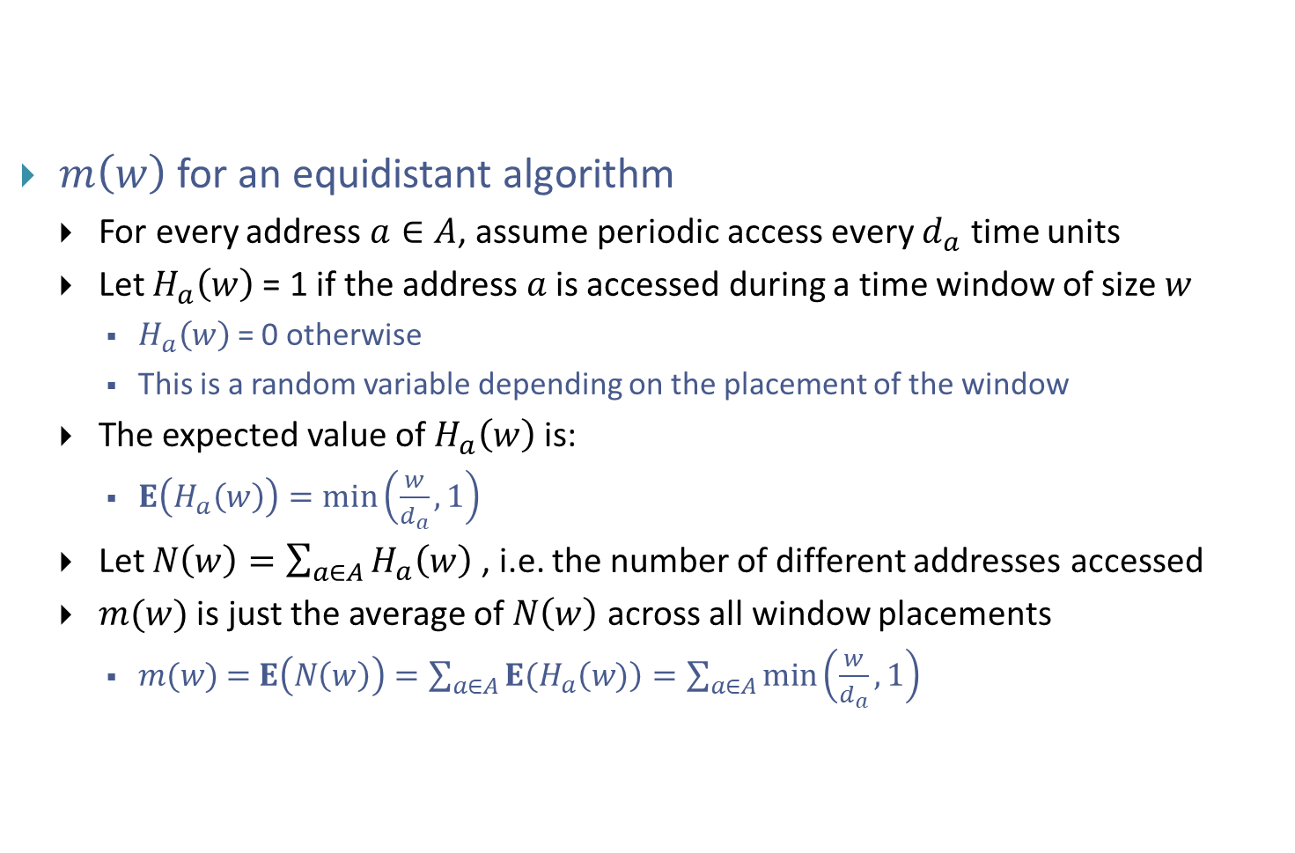
Estimating m(w)
$m\left(w\right)$ for an equidistant algorithm
  For every address $a∈A$, assume periodic access every $d_{a}$ time units
  Let $H_{a}\left(w\right)$= 1 if the address $a$is accessed during a time window of size $w$
    $H_{a}\left(w\right)$= 0 otherwise
    This is a random variable depending on the placement of the window
  The expected value of $H_{a}\left(w\right)$is:
    $E\left(H_{a}\left(w\right)\right)=min\left(\frac{w}{d_{a}},1\right)$
  Let $N\left(w\right)=\sum_{a∈A}{H_{a}\left(w\right)}$ , i.e. the number of different addresses accessed
  $m(w)$ is just the average of $N\left(w\right)$ across all window placements
    $m(w) \text{=} E\left(N\left(w\right)\right)=\sum_{a∈A}{E(H_{a}\left(w)\right)}=\sum_{a∈A}{\min\left(\frac{w}{d_{a}},1\right)}$

Slide 2
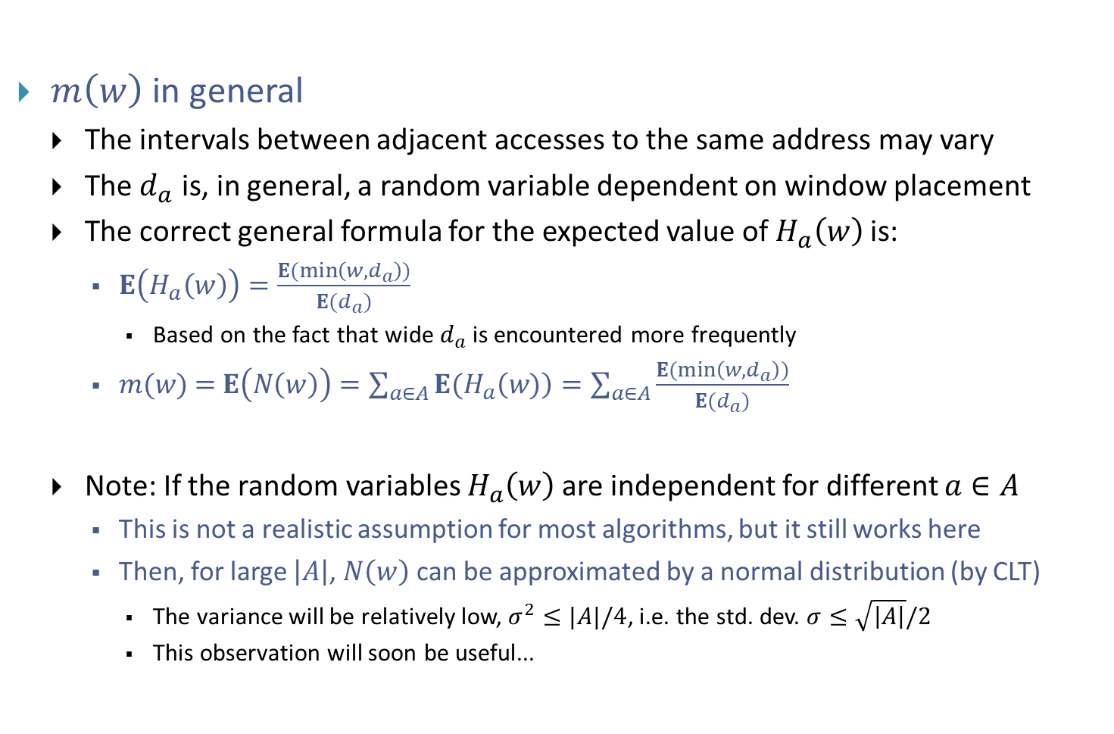
Estimating m(w)
$m\left(w\right)$ in general
  The intervals between adjacent accesses to the same address may vary
  The $d_{a}$ is, in general, a random variable dependent on window placement
  The correct general formula for the expected value of $H_{a}\left(w\right)$is:
    $E\left(H_{a}\left(w\right)\right)=\frac{E(min\left(w,d_{a}\right))}{E(d_{a})}$
      Based on the fact that wide $d_{a}$ is encountered more frequently
    $m(w) \text{=} E\left(N\left(w\right)\right)=\sum_{a∈A}{E(H_{a}\left(w)\right)}=\sum_{a∈A}{\frac{E(min\left(w,d_{a}\right))}{E(d_{a})}}$
  Note: If the random variables $H_{a}\left(w\right)$are independent for different $a∈A$
    This is not a realistic assumption for most algorithms, but it still works here
    Then, for large $\left|A\right|$, $N\left(w\right)$ can be approximated by a normal distribution (by CLT)
      The variance will be relatively low, $σ^{2}≤|A|/4$, i.e. the std. dev. $σ≤\sqrt{\left|A\right|}/2$
      This observation will soon be useful...

Slide 3
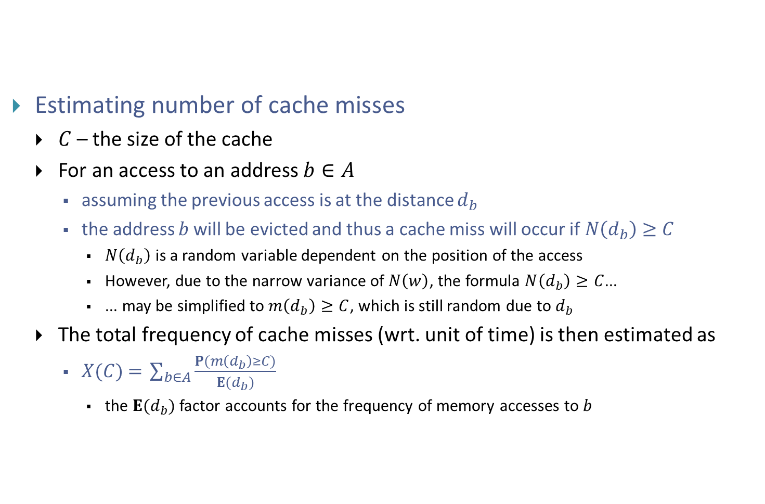
Estimating the frequency of cache misses
Estimating number of cache misses
  $C$– the size of the cache
  For an access to an address $b∈A$
    assuming the previous access is at the distance $d_{b}$
    the address $b$will be evicted and thus a cache miss will occur if$N\left(d_{b}\right)≥C$
      $N\left(d_{b}\right)$ is a random variable dependent on the position of the access
      However, due to the narrow variance of $N\left(w\right)$, the formula $N\left(d_{b}\right)≥C$...
      ... may be simplified to $m\left(d_{b}\right)≥C$, which is still random due to $d_{b}$
  The total frequency of cache misses (wrt. unit of time) is then estimated as
    $X(C) \text{=} \sum_{b∈A}{\frac{P(m\left(d_{b}\right)≥C)}{E(d_{b})}}$
      the $E(d_{b})$ factor accounts for the frequency of memory accesses to $b$

Slide 4
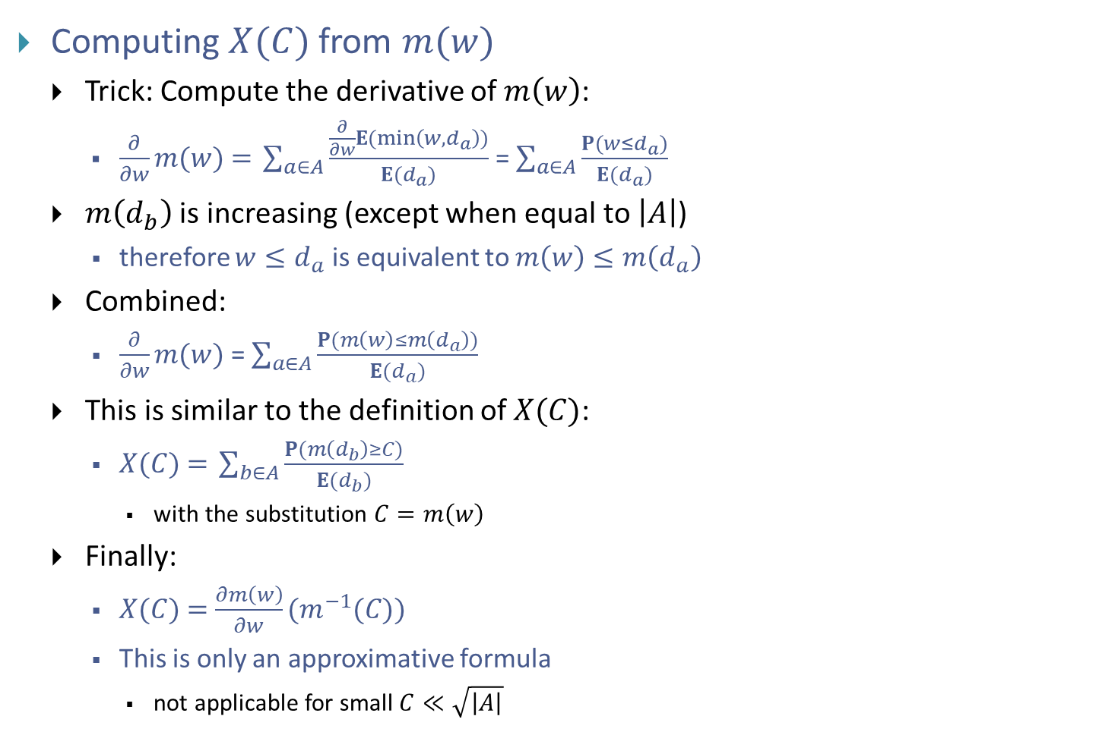
Estimating the frequency of cache misses
Computing $X(C)$from $m(w)$
  Trick: Compute the derivative of $m\left(w\right)$:
    $\frac{∂}{∂w}m(w)\text{ =} \sum_{a∈A}{\frac{\frac{∂}{∂w}E(min\left(w,d_{a}\right))}{E(d_{a})}}$ = $\sum_{a∈A}{\frac{P(w≤d_{a})}{E(d_{a})}}$
  $m\left(d_{b}\right)$ is increasing (except when equal to $\left|A\right|$)
    therefore $w≤d_{a}$ is equivalent to $m\left(w\right)≤m\left(d_{a}\right)$
  Combined:
    $\frac{∂}{∂w}m(w)$= $\sum_{a∈A}{\frac{P(m\left(w\right)≤m\left(d_{a}\right))}{E(d_{a})}}$
  This is similar to the definition of $X(C)$:
    $X(C) \text{=} \sum_{b∈A}{\frac{P(m\left(d_{b}\right)≥C)}{E(d_{b})}}$
      with the substitution $C=m\left(w\right)$
  Finally:
    $X(C) \text{=}$ $\frac{∂m\left(w\right)}{∂w}(m^{−1}(C))$
    This is only an approximative formula
      not applicable for small $C≪\sqrt{\left|A\right|}$

