Slide 1
C++ - external libraries and OS interfaces
David Bednárek
Jakub Yaghob
Filip Zavoral

Slide 2
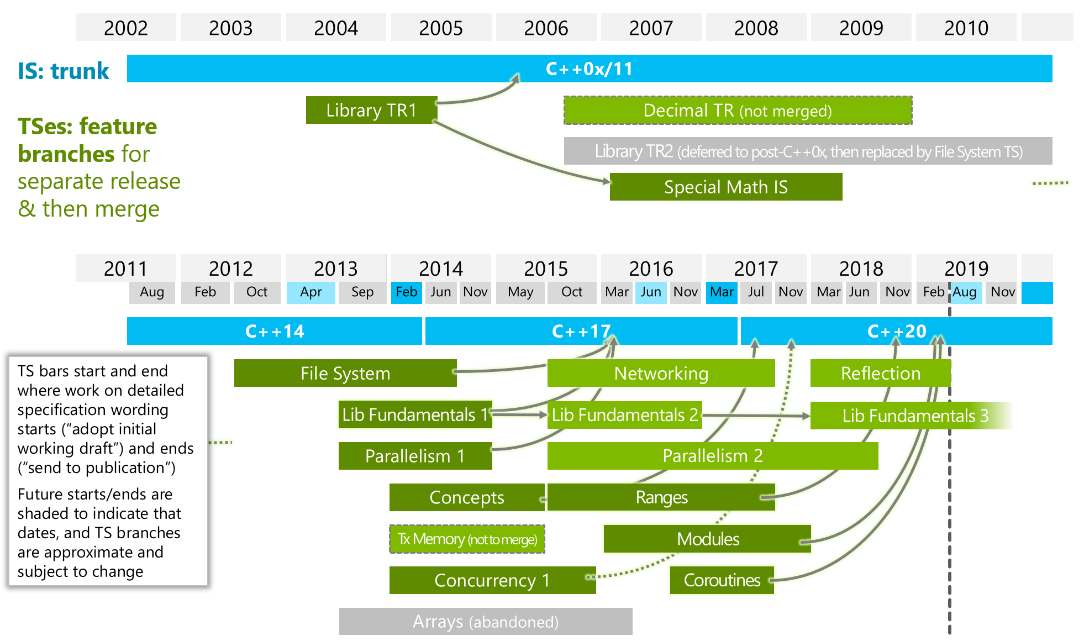
ISO C++ status

Slide 3

Database
Client connection
Aplikace
DB
DB.LIB

Slide 4
Database – native client
Oracle
OCI
MS Server
ODBC, OLE DB
Sybase
Open client
PostgreSQL
Proprietary
MySQL
Proprietary

Slide 5
Database – interface selection
Native client
Faster
Specific features available
Not portable (sometimes)
Bound to specific DB
General client (ODBC, OLE DB)
Implemented using native clients
Slower due to added layer
Specific features not accessible
Unbound to specific DB?

Slide 6
Database – API
ISO 9075:2008
Almost all interfaces conform
Excluding MySQL
Defines a program entities hierarchy
Defines an interface for manipulating with program entities

Slide 7
Database – program entities
Environment
Global setting for client library in an application
Defines memory-management
Session
Connection to one server
Properties session, user
Derived from the environment
Statement
State space for one query
Prepared statement
Parameter binding
Static/dynamic, input/output
Derived from the session

Slide 8
Database – program entities
Result-set
Container of results
Derived from the statement
Result
Query result
Data binding
Static/dynamic
Derived from the result-set
Transaction
Derived from the session

Slide 9
Database – program entities
Application
Environment
Session (User/Pwd/Server1)
Session
User
Pwd
Server2
Transaction
Statement
State- ment
Result-set
Result
R2
DB1
DB2

Slide 10
Database – example
environment e;
CreateEnvironment(e);
session ses;
CreateSession(ses, e);
ConnectSession(ses, “user”, “pwd”, “srv”);
transaction t;
CreateTransaction(t, ses);
BeginTransaction(t);
statement stm;
CreateStatement(stm, ses);
int i, j;
BindParameter(stm, “q”, i, IN, C_INT, SQL_DEC);
result_set rs = ExecuteStatement(stm, “select * from t where c=:q”);
result r = rs.first();
BindColumn(r, 1, j, C_INT, SQL_DEC);
while(Fetch(r)) { }
DestroyResult(r);DestroyRS(rs);
CommitTransaction(t);
DestroyStatement(stm);
DestroyTransaction(t);
CloseSession(ses);
DestroySession(ses);
DestroyEnvironment(e);

Slide 11
Database – C++
Something like SQLpp
Dead project
auto x = select(p.id, p.name, f.id.as(id2)) .from(p, f) .where(p.name=any(select(f.name).from(f))) .group_by(f.name) .order_by(p.name.asc());
for(const auto & row : x) { int id = row.id; string name = row.name; }

Slide 12
Network
C++26??
BSD sockets
Winsock 2
Socket
Abstract endpoint for network communication
Bind to different protocols
IPv4, IPv6
Bind to different kind of communication
Stream, datagram, raw
Bind to transportation protocol
TCP, UDP

Slide 13
Network – TCP client
SOCKET sock = socket(INET, STREAM, TCP);
struct sockaddr_in soain;
soain.sin_family = INET;
getaddrinfo(“www.nic.cz”, SRV_PORT, 0, &soain.sin_addr);
connect(sock, soain);
send(sock, buf, len);
recv(sock, buf, len);
shutdown(sock);
close(sock);

Slide 14
Network – TCP server
SOCKET listensock = socket(INET, STREAM, TCP);
struct sockaddr_in soain;
soain.sin_family = INET; soain.sin_port = SRV_PORT; soian.sin_addr = ANY;
bind(listensock, soain);
listen(listensock, queuedepth);
for(;;) {
SOCKET sock = accept(listensock); // blocks recv(sock, buf, len); send(sock, buf, len);
shutdown(sock);
close(sock);
}
shutdown(listensock);
close(listensock);

Slide 15
Network – UDP client
SOCKET sock = socket(INET, DGRAM, UDP);
struct sockaddr_in soain;
soain.sin_family = INET;
getaddrinfo(“www.nic.cz”, SRV_PORT, 0, &soain.sin_addr);
sendto(sock, buf, len, &soain);
recvfrom(sock, buf, len, &soain);
close(sock);

Slide 16
Network – UDP server
SOCKET sock = socket(INET, STREAM, TCP);
struct sockaddr_in soain;
soain.sin_family = INET; soain.sin_port = SRV_PORT; soian.sin_addr = ANY;
bind(sock, soain);
for(;;) {
struct sockaddr_in soain_cli;
int len = recvfrom(sock, buf, maxlen, &soain_cli);
sendto(sock, buf, len, &soain_cli);
}
close(sock);

Slide 17
Network – remaining functions
select
Wait for finished operations on sockets
getaddrinfo
General translation from node name to a binary representation
getnameinfo
General translation from binary representation to a node name and service name
htons, htonl, ntohs, ntohl
Translation from host byte-order to network byte-order and vice versa

Slide 18
Asynchronous I/O
Execute a file operation and continue in a work
A new entity created, which can be questioned for operation status or the application can wait for it
What about coroutines?
Application
OS
async_read
start read
is_ready
read finished

Slide 19
Asynchronous I/O – demo
Windows
AIO
HANDLE f = CreateFile(“f.txt”, FILE_READ_DATA, FILE_SHARE_READ, 0, OPEN_EXISTING, FILE_FLAG_RANDOM_ACCESS | FILE_FLAG_OVERLAPPED, 0);
OVERLAPPED o;
memset(&o, 0, sizeof(OVERLAPPED));
o.hEvent = CreateEvent(0, TRUE, FALSE, 0);
o.Offset = offs;
ReadFile(f, buf, sz, &rsz, &o);
WaitForSingleObject(o.hEvent, INFINITE);
CloseHandle(o.hEvent);
CloseHandle(f);
int f = open(“f.txt”, O_RDONLY | O_LARGEFILE, rights);
aiocb a;
memset(&a, 0, sizeof(aiocb));
aiocb. aio_fildes = f;
aiocb. aio_offset = offs;
aiocb. aio_nbytes = sz;
aiocb. aio_buf = buf;
aiocb. aio_sigevent.sigev_notify = SIGEV_NONE;
aio_read(&a);
aio_suspend(&a, 1, 0);
rsz = aio_return(&a);
close(f);

Slide 20
Memory mapped files
Mapping, unmapping files
A file must be already opened
Create, destroy window
File
VAS
window

Slide 21
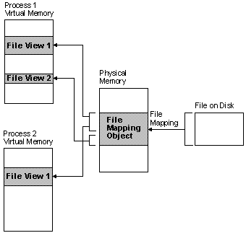
Memory mapped files – Windows

Slide 22
Memory mapped files – demo
Windows
POSIX
HANDLE f = CreateFile(“f.txt”, FILE_READ_DATA, FILE_SHARE_READ, 0, OPEN_EXISTING, FILE_FLAG_RANDOM_ACCESS, 0);
HANDLE m = CreateFileMapping(f, 0, PAGE_READONLY, 0, sz, 0);
void *p = MapViewOfFileEx(m, FILE_MAP_READ, 0, offs, sz, hinta);
UnmapViewOfFile(p);
CloseHandle(m);
CloseHandle(f);
int f = open(“f.txt”, O_RDONLY | O_LARGEFILE, rights);
void *p = mmap(hinta, sz, PROT_READ, MAP_SHARED, f, offs);
munmap(p, sz);
close(f);

Slide 23
Filesystem
Open, close directory
Some OS with name filtering
Reading directory
Getting name, attributes, size, rights, …
Create, remove directory
Already in C++17

Slide 24
Shared memory
Sharing memory among different processes
Usually identified by a name
Page granularity
MASOS, SASOS
Offsets
VAS A
VAS B
FAS
App B
App A
App A
App B

Slide 25
Shared memory – demo SASOS
Windows client
Windows server
HANDLE shm = OpenFileMapping( FILE_MAP_WRITE|FILE_MAP_READ, FALSE, “mymemory”);
void *p = MapViewOfFileEx(shm, FILE_MAP_READ, 0, 0, sz, hinta);
struct s { int n; int *ptr; };
for(int i=0;i<static_cast<s*>(p)->n;++i)
cout << static_cast<s*>(p)->ptr[i];
UnmapViewOfFile(p);
CloseHandle(shm);
HANDLE shm = CreateFileMapping
(INVALID_HANDLE_VALUE, 0, PAGE_READWRITE, 0, sz, “mymemory”);
void *p = MapViewOfFileEx(shm, FILE_MAP_WRITE, 0, 0, sz, hinta);
struct s { int n; int *ptr; };
static_cast<s*>(p)->n = N;
static_cast<s*>(p)->ptr = static_cast<char*>(p)+sizeof(s);
for(int i=0;i<N;++i)
static_cast<s*>(p)->ptr[i] = i;
UnmapViewOfFile(p);
CloseHandle(shm);

Slide 26
Shared memory – demo MASOS
Windows client
Windows server
HANDLE shm = OpenFileMapping( FILE_MAP_WRITE|FILE_MAP_READ, FALSE, “mymemory”);
void *p = MapViewOfFileEx(shm, FILE_MAP_READ, 0, 0, sz, hinta);
struct s { int n; size_t offs; };
for(int i=0;i<static_cast<s*>(p)->n;++i)
cout << static_cast<int*>(static_cast<char*>(p)+static_cast<s*>(p)->offs)[i];
UnmapViewOfFile(p);
CloseHandle(shm);
HANDLE shm = CreateFileMapping
(INVALID_HANDLE_VALUE, 0, PAGE_READWRITE, 0, sz, “mymemory”);
void *p = MapViewOfFileEx(shm, FILE_MAP_WRITE, 0, 0, sz, hinta);
struct s { int n; size_t offs; };
static_cast<s*>(p)->n = N;
static_cast<s*>(p)->offs = sizeof(s);
for(int i=0;i<N;++i)
static_cast<int*>(static_cast<char*>(p) +static_cast<s*>(p)->offs)[i] = i;
UnmapViewOfFile(p);
CloseHandle(shm);

Slide 27
Shared memory – demo
POSIX client
POSIX server
int shm = shm_open(“mymemory”, O_RDWR, rights);
void *p = mmap(hinta, sz, PROT_READ, MAP_SHARED, shm, 0);
struct s { int n; int *ptr; };
for(int i=0;i<static_cast<s*>(p)->n;++i)
cout << static_cast<s*>(p)->ptr[i];
munmap(p, sz);
close(shm);
shm_unlink(“mymemory”);
int shm = shm_open(“mymemory”, O_RDWR|O_CREAT|O_EXCL, rights);
void *p = mmap(hinta, sz, PROT_READ|PROT_WRITE, MAP_SHARED, shm, 0);
struct s { int n; int *ptr; };
static_cast<s*>(p)->n = N;
static_cast<s*>(p)->ptr = static_cast<char*>(p)+sizeof(s);
for(int i=0;i<N;++i)
static_cast<s*>(p)->ptr[i] = i;
munmap(p, sz);
close(shm);
shm_unlink(“mymemory”);

Slide 28
POSIX
Portable Operating System Interface [for Unix]
Existing native implementation for Win NT
Single UNIX Specification
IEEE standard
API
Shell
Utility

Slide 29
POSIX – versions
POSIX.1
API (includes ANSI C)
1988
POSIX.1b
Real-time extension
1993
POSIX.1c
Thread extension
1995
POSIX.2
Shell and utility
1992
POSIX:2001
API, shell, utility
POSIX:2004
Update and corrigendum
POSIX:2008
API, shell, utility

Slide 30
POSIX – compatibility
Full
AIX, HP-UX, Solaris, Mac OS X, …
Partial
FreeBSD, GNU/Linux, OpenSolaris, …
Windows
Cygwin – partial compatibility
MS Windows Services for UNIX 3.5 – full compatibility

Slide 31
Boost
Portable C++ library
Review process
Source and testing ground for ISO
Tightly coupled with ISO comittee
Large set of supported OSs and compilers
Very good library, sometimes too abstract

Slide 32
Boost – containers
Array
Constant size array
ISO C++ TR1/C++ 11
Bimap
Two-sided map
Circular buffer
Graph
Variant
Secure union
ISO C++17

Slide 33
Boost – parallel programming support
Interprocess
Shared memory
Memory mapped files
Mutexes
ISO C++ 11
MPI
Thread
ISO C++ 11

Slide 34
Boost – I/O
Asio
Asynchronous I/O, executors, networking, …
Parts maybe in C++20?
Format
Enhanced formatting like printf
Program options
Command line parameters
Serialization
Data serialization for saving or marshalling

Slide 35
Boost – mathematic and numeric
Intervals
Multi-array
Random
ISO C++ TR1/C++ 11

Slide 36
Boost – generic programming and metaprogramming
GIL
Generic Image Library
Static assert
ISO C++ 11
Type traits
ISO C++ TR1/C++ 11
MPL
General framework for compile-time algorithms, sequences, and metafunctions

Slide 37
Boost – strings
Lexical cast
Regex
ISO C++ TR1/C++ 11
Spirit
LL parser
String algo
Tokenizer
Splitting a string to tokens

Slide 38
Boost – unsorted
Shared ptr
ISO C++ TR1/C++ 11
Date time
ISO C++ 11
Filesystem
Paths, directory, files
ISO C++17

