Slide 1
System Architectures
NPRG042 Programming in Parallel Environment
Martin Kruliš

Slide 2
CPU – simplified scheme
Package
CORE 0
CORE 1
CORE 2
CORE 3
T0
T4
T1
T5
T2
T6
T3
T7
EU
EU
EU
EU
L1I
L1I
L1I
L1I
L1D
L1D
L1D
L1D
L2
L2
L2
L2
L3/LLC

Slide 3
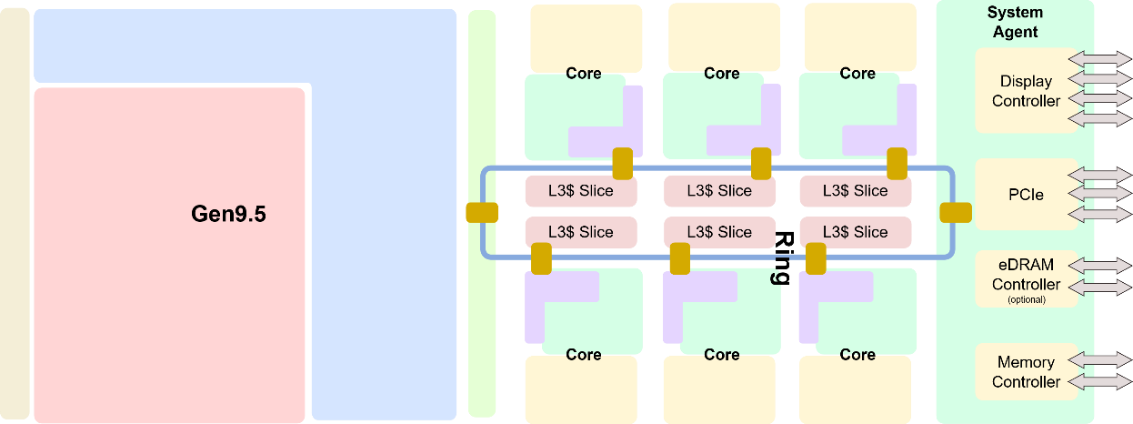
Intel Coffee Lake (Example)

Slide 4
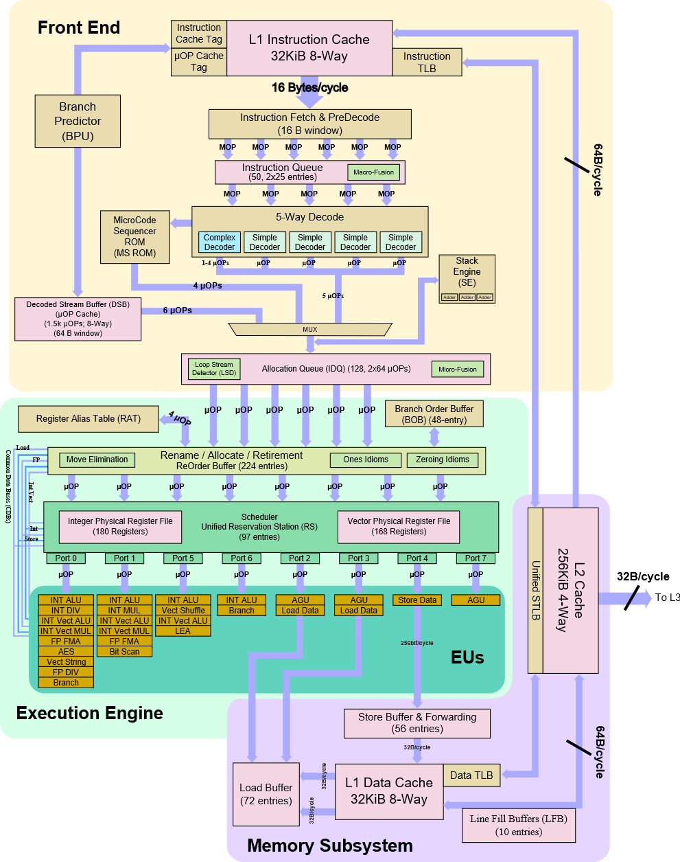
Intel Coffee Lake
Single core

Slide 5
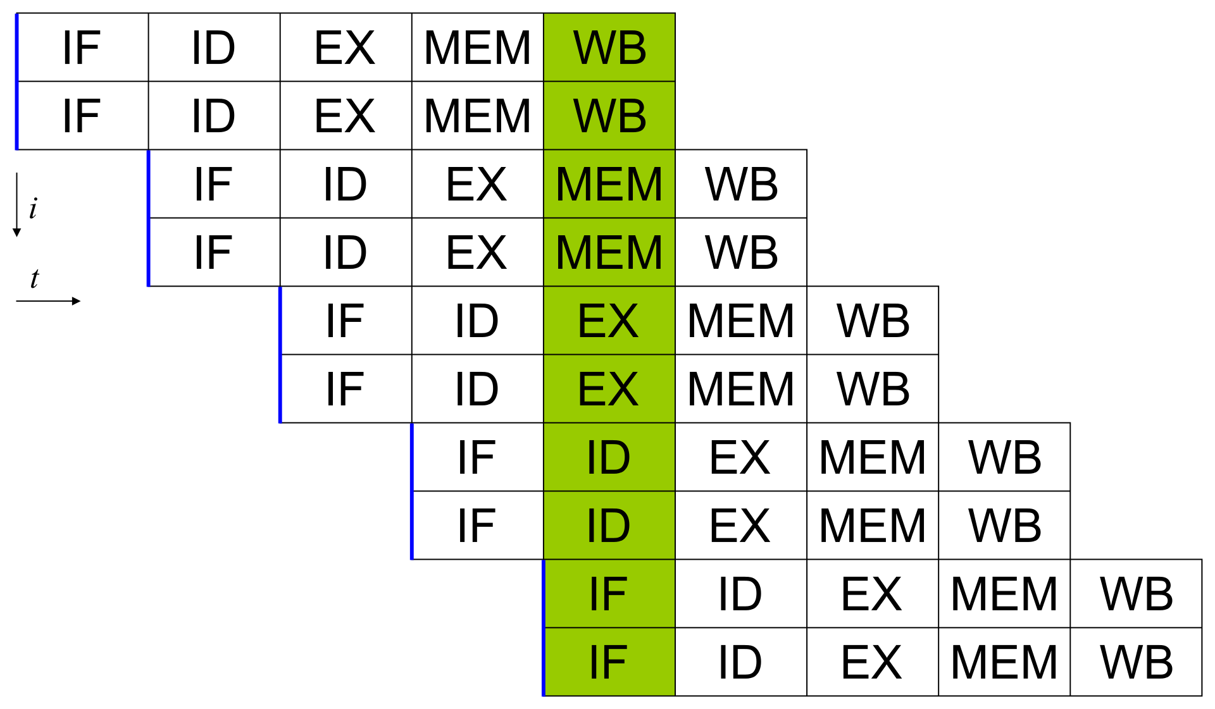
Pipelining and superscalarity

Slide 6
SIMD
Vectorization
  SSE (128b), AVX (256b), AVX512
  Issue with horizontal instructions (shuffling) and divergence (masking)
  How it works in compilers (SSE-like example):
for (i=0; i < N; ++i)
{
a[i] = b[i] + c[i];
}
for (i=0; i + 3 < N; i += 4)
{
a[i] = b[i] + c[i];
a[i+1] = b[i+1] + c[i+1];
a[i+2] = b[i+2] + c[i+2];
a[i+3] = b[i+3] + c[i+3];
}
for (; i < N; ++i)
{
a[i] = b[i] + c[i];
}
for (i=0; i + 3 < N; i += 4)
{
_mm_storeu_ps(a+i,
_mm_add_ps(
_mm_loadu_ps(b+i),
_mm_loadu_ps(c+i)));
}
for (; i < N; ++i)
{
a[i] = b[i] + c[i];
}
Example from Bednarek
(NPRG054)

Slide 7
Memory Performance
Latencies
Action | Cycles | Time (3GHz)
Local L1 cache hit | 4 | 1-2 ns
Local L2 cache hit | 14 | 4-6 ns
Branch misprediction | 16 | 5-6 ns
Local L3 cache hit | 40-75 | 12-40 ns
Mutex lock/unlock |  | 75 ns
Remote L3 | 100-300 | 30-100 ns
Local memory |  | 100 ns
Remote memory |  | 100-300 ns
Send 1KB over FDR InfiniBand |  | 900 ns
Send 1KB over 1GB Ethernet |  | 20000 ns

Slide 8
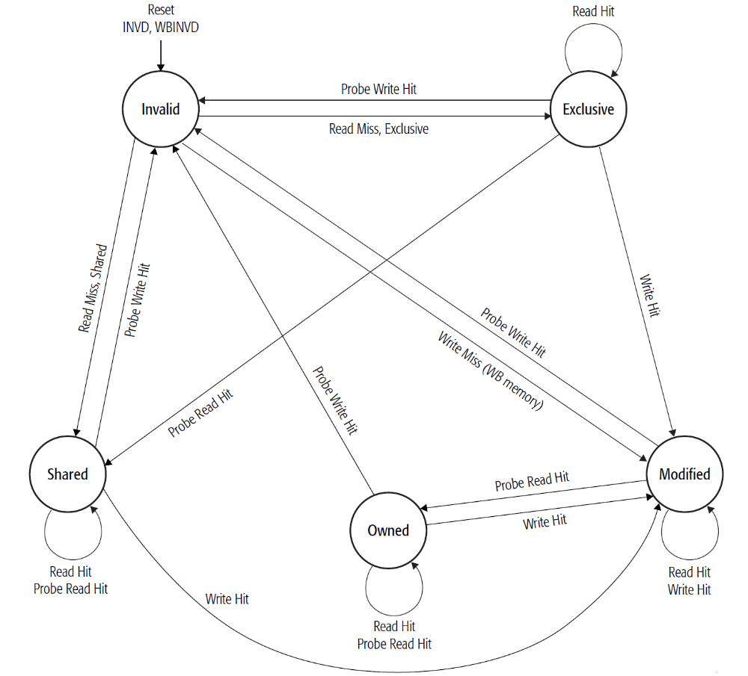
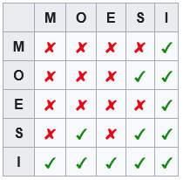
Cache coherence
MOESI protocol
  Named after cache line states
    Modified
    Owned
    Exclusive
    Shared
    Invalid
  Caches use bus snooping and
  complex transition rules
Notes:
https://en.wikipedia.org/wiki/MOESI_protocol

Slide 9
Cache coherence
False sharing
  Multiple data elements incidentally
  placed on the same cache line
  … and updated by different threads
  MOESI protocol requires exclusive
  acquisition of the cache line
    By each updating thread
    (i.e., by L1 of the corresponding core)
Updating x
cache line
x
y
core#1
core#2
Updating y

Slide 10
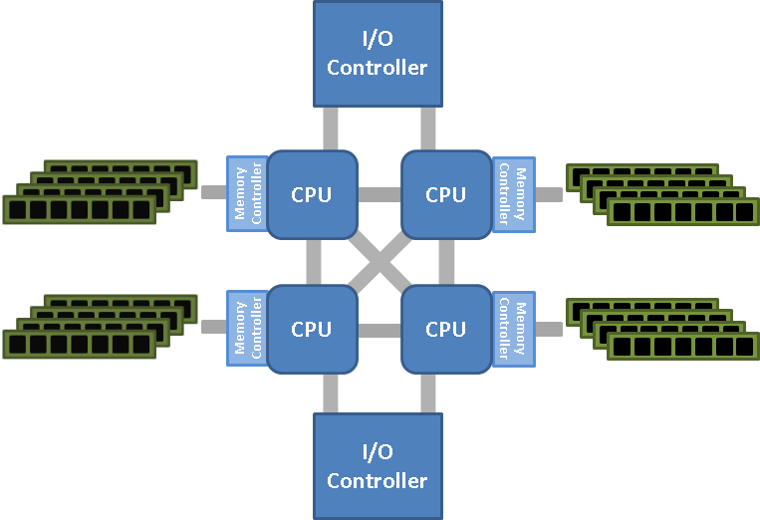
NUMA
Non-uniform memory access
  Creates one unified address space for all CPUs in the system
    Ensured by cache-coherency protocols
  Access to the memory of a different CPU die is slower than to local memory
    NUMA factor
  Example from 2-socket NUMA server
4-socket NUMA example
# cat /sys/devices/system/node/node*/distance
10 21
21 10
RAM #1
RAM #2
RAM #3
RAM #4
The latency to the next node is 2.1x higher than local RAM access
Address
space
1
2
3
4
1
2
3
4
1
2
3
4
1
2
3
4
Notes:
NUMA illustration borrowed from https://www.sqlskills.com/blogs/jonathan/understanding-non-uniform-memory-accessarchitectures-numa/

Slide 11
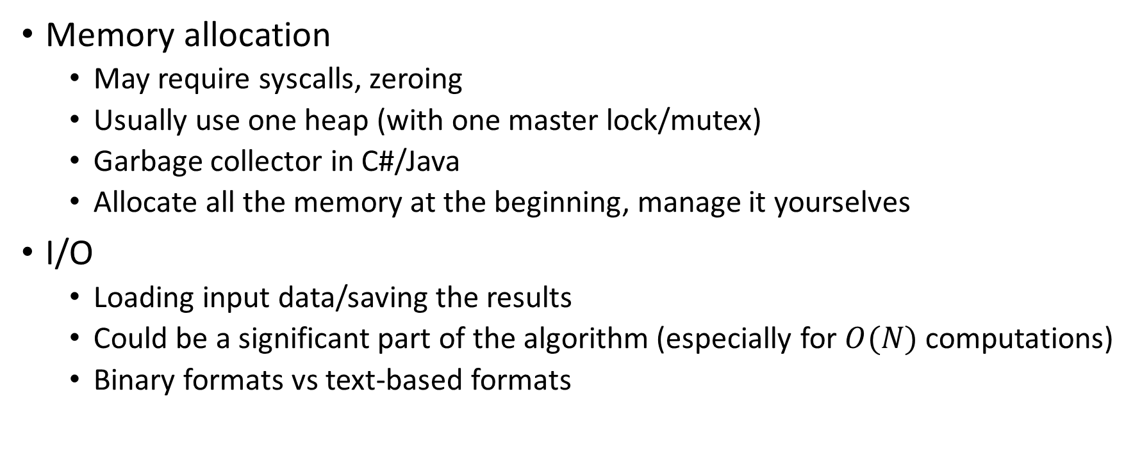
Bottlenecks
Memory allocation
  May require syscalls, zeroing
  Usually use one heap (with one master lock/mutex)
  Garbage collector in C#/Java
  Allocate all the memory at the beginning, manage it yourselves
I/O
  Loading input data/saving the results
  Could be a significant part of the algorithm (especially for $O(N)$ computations)
  Binary formats vs text-based formats

Slide 12
Lab Cluster Overview
Two SLURM clusters
  parlab.ms.mff.cuni.cz – parallel and distributed computing
  gpulab.ms.mff.cuni.cz – parallel and GPU computing, Docker
  SSH running on port 42222
Mapped home directories
  NFS array mounted on /home (both headnodes, all workers)
Authentication via MFF LDAP (use your CAS/SIS credentials)
  Set up SSL keys authentication right away!
More info
  https://gitlab.mff.cuni.cz/mff/hpc/clusters

Slide 13
Parlab
Internet
FDR
Infiniband
switch
FC16
SAN
Blade
chassis
parlab
10G
Ethernet
switch
phi[01-02]
w[201-208]

Slide 14
GPUlab
GPU lab
gpulab
Internet
10G
Ethernet
switch
volta[01-05]
ampere[01-02]
hopper01

Slide 15
SLURM crash course
Resource manager
  Commands can be issued from any node
  Acquires resources before use (uses containers for isolation)
  Cluster nodes divided to partitions (each has its own command queue)
Important commands
  srun – acquire resources and immediately run a command, creates a job
  sbatch – acquire resources and run a shell script , creates a job
  scancel – cancel a job
  sinfo – get info about partitions, nodes, …
  squeue – get info about job queue

Slide 16
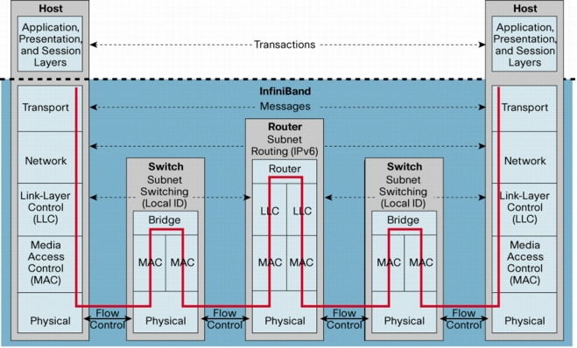
Infiniband protocol stack

Slide 17
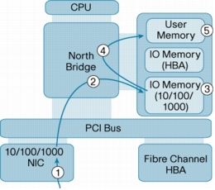
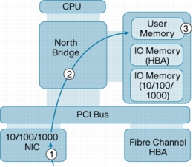
InfiniBand – RDMA (Remote DMA)
Traditional
RDMA

Slide 18
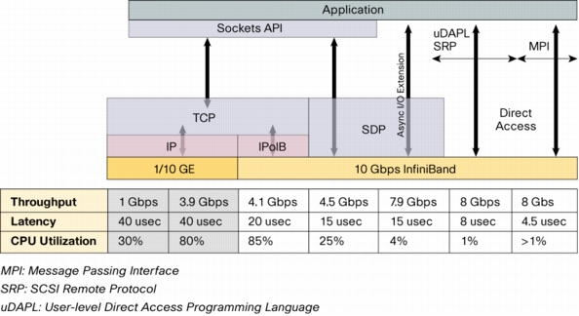
InfiniBand – latency

Slide 19

Discussion

