Slide 1
Apache Spark
NPRG042 Programming in Parallel Environment
Martin Kruliš, Jakub Yaghob

Slide 2

Spark
Apache Spark
  Unified analytics engine for large-scale data processing
  Initial release: 2014
  Speed
    Much faster than Hadoop
  Ease of use
    Write applications in Java, Python, R, and Scala
    Interactive shell
  Generality
    Combine streaming, ML, SQL, and (data) analytics
  Runs “everywhere”
    Spark runs on Hadoop, Mesos, Kubernetes, standalone, or in a cloud

Slide 3
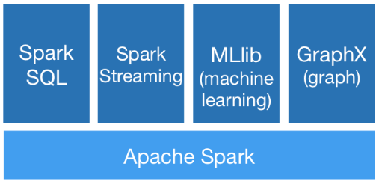
Spark
Contains
  High-level API in Java, Python, R, and Scala
  Optimized engine for general execution graph
    DAG
    MapReduce with only 2 levels
  High-level tools
    SparkSQL
    MLlib
    Spark Streaming
    GraphX

Slide 4
Spark Application
Application
  An independent set of processes on a cluster
    + isolation
    - no shared data (except file storage)
  Driver program
    Main (controlling) script
    Listen for incoming connections from executors (via network)
    Coordinated by SparkContex object
    Schedules tasks to executors
    Has a web UI, handles storage
Cluster manager
  Allocate resources across applications
Executor
  Runs on nodes of the cluster
  Executes computations and stores (caches) data
  Stays up for the duration of the application
  Runs tasks (possibly) in multiple threads

Slide 5
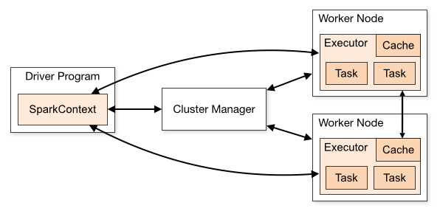
Spark Application Structure
App structure
  The programmer creates a SparkContext object
  It connects to the cluster manager(s)
  Acquires executors from cluster manager(s)
  Sends your application code to the executors
    Pass Java/Python code/files to
    the SparkContext
  Sends tasks to the executors
    Including necessary data which
    can be partitioned and cached
    at the executors

Slide 6
Spark Cluster
Cluster managers
  Spark is agnostic to the underlying cluster manager
  Supported cluster managers
    Standalone
      Simple CM, which is included in Spark (easy to set up a cluster)
    Apache Mesos
      General CM can run Hadoop MapReduce and service applications
    Hadoop YARN
      Resource manager in Hadoop 2
    Kubernetes
      Automated deployment, scaling, and management of containerized applications
This is what we will use
(with a custom sbatch script)

Slide 7
Spark Programming
Fundamentals
  Working with larger datasets (collections/tables)
    Text files, CSV, HDF5, …
  Creating “pipelines” that process the dataset and yield a result
    Emphasis on declarative approach (like SQL)
    Distributed processing, little control over the low-level details
      Except for partitioning (how the data are divided into chunks)
  Lazy evaluation
    Most operations are triggered once the data are really needed
  Strongly oriented on data (pre)processing and analysis
    For example, PySpark natively supports pandas data types

Slide 8
Data Holders
Resilient distributed dataset (RDD)
  Immutable collection of elements
  Partitioned across the nodes that can be processed in parallel
  Possibly in-memory
  Automatically recover from node failures
  Core API, from initial release, all languages
Dataset
  Distributed collection of data
  Since v1.6, only for Java and Scala
  Strong typing + lambdas from RDD
  Using Spark SQL optimized execution engine
DataFrame
  Like a Dataset, but organized into named columns
  Since v1.3, all languages
  Similar to a table in relational DB

Slide 9
Resilient Distributed Datasets (RDD)
Created in the driver program
  sc = SparkContext()
  distData = sc.parallelize(data)
  distFile = sc.textFile("data.txt")
  Datasets are immutable
  Transformations
    Each transformation takes an RDD and produces a new RDD
    Lazy evaluation, aggregation, and automated distribution of tasks
      An RDD can be cached or persisted on request to improve performance
  Actions
    Usually at the end, since they trigger evaluation
    Used to get the result (back in the driver) or save it in a file
Creating RDD from memory (list) or a file

Slide 10
RDD Transformations
map(fnc), flatMap(fnc) | applies transformation on each element (flatMap can produce 0 or more elements)
filter(fnc) | only elements that pass the given predicate are included in the new dataset
union(data) | combines two datasets in union
intersection(data) | returns the intersection of this and given data set
distinct() | returns only distinct (unique) elements in the dataset
groupByKey() | takes pairs (K,V) and produces pairs (K, iter<V>) where values are grouped
reduceByKey(fnc) | similar to group-by, but also reduces values by given function
sortByKey(asc) | takes pairs (K,V) and sorts them by K (must implement Ordered)
join(data) | pairs (K,V) are joined with data (K,W) and (K,(V,W)) collection is returned
cartesian(data) | for data U and V produces all combinations of (U,V) pairs
coalesce(numP), repartition(numP) | change the number of partitions and redistribute data among them (e.g., coalesce is useful when a new dataset with significantly less elements is produced)
Notes:
https://spark.apache.org/docs/latest/rdd-programming-guide.html#transformations

Slide 11
RDD Actions
collect() | returns the elements of the dataset (materialization)
count() | computes the number of elements in the collection
first() | returns the first element in the collection
take(n) | returns the first n elements in the collection
reduce(fnc) | performs reduction using given function and returns the result
takeOrdered(n) | like take(), but performs partial sorting (basically a top-k selection)
saveAsXXX() | save the collection in the given format to a file (e.g., saveAsTextFile)
countByKey() | for collection of pairs (K,V) yields (K, count-of-values)
foreach(fnc) | Iterates over the collection, invoking fnc (which usually has side effects, but runs on workers!)
Note that actions are executed on the workers. I.e, any side effects (like print) also take place there (so .foreach(print) is not going to work as expected)
Notes:
https://spark.apache.org/docs/latest/rdd-programming-guide.html#actions

Slide 12
RDD Example
Example
  Counting words in a (large) text file
  from pyspark import SparkContext
  sc = SparkContext()
  file = sc.textFile("wiki.txt")
  words = file.map(lambda line: len(line.split())) \
  .reduce(lambda x, y: x + y)
  print(words)

Slide 13
Functions and Shared Variables
Functions (used in transformations/actions)
  Executed on the workers
    The whole closure is transferred from the driver app
    No side effects, except for updating shared variables
  Shared variables
    Broadcast brVar = sc.broadcast(data)
      Cached read-only variable, optimizes driver->worker transfers + provides cache control
      Tasks can read it by calling the value() function
    Accumulator acc = sc.accumulator(baseVar)
      Worker tasks can call add(v) operation (accumulate a value)
      Only the driver can read the accumulator by calling the value() function
      Typically a number, but can be a custom class that defines its own “add” operation
Notes:
https://spark.apache.org/docs/latest/rdd-programming-guide.html#shared-variables

Slide 14
DataFrame
DataFrame
  A distributed dataset (like RDD) but organized as a table (like in SQL databases)
  Row-wise partitioning (selection of rows, all columns)
  Construction
    spark = SparkSession.builder.getOrCreate()
    df = spark.createDataFrame([ Row(col1=42, col2='the answer’) ]
    csv_df = spark.read.csv('foo.csv', header=True)
    pd_df = pandas.DataFrame({ … })
    Many other possibilities: external DB, existing RDD, tables from Hadoop…
  Transformations and actions similar to RDD
    Lazy evaluation, SQL-like operations

Slide 15
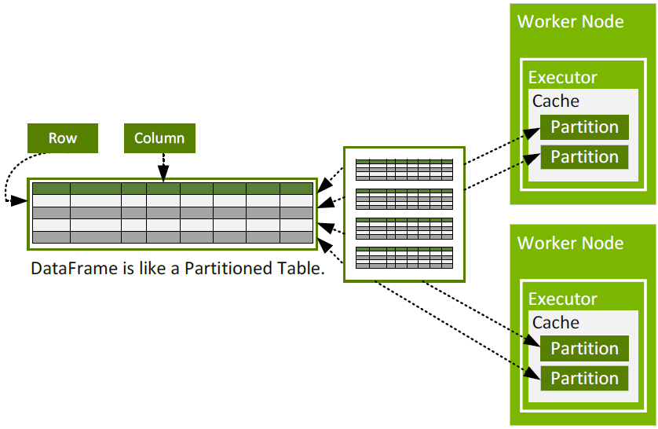
DataFrame Partitioning

Slide 16
DataFrame
Inspecting the data
  df.show(n) – prints the table (or first n rows)
  df.printSchema() – prints the column names and types
  df.columns – access the column names as a list
  df.describe().show() – get basic statistics (count, min, max…) per col.
Accessing/saving the data
  df.collect()
  df.take(n)
  df.toPandas()
  df.write.csv(file, header)

Slide 17
DataFrame
Transformations
  All yield a new DataFrame (lazily evaluated)
  df.colName – returns column object (metadata)
  df.select(df.col1, "col2") – selects a set of columns (projection)
  df.filter(df.c == 42) – filter rows using a condition (like SQL WHERE)
  df.withColumn(name, fnc) – add new column
    Values are computed from the other columns
  df.groupBy(col) – groups using specified column(s)
    Aggregate functions can be applied on the rest (.avg(), .count(), …)
  df.join(df2, on) – join with another DataFrame using the on join expr.

Slide 18
DataFrame Example
Example
  spark = SparkSession.builder.getOrCreate()
  df = spark.read.csv("employees.csv", header=True)
  sel_df = df.select("department", "salary")
  fil_df = sel_df.filter(sel_df.salary > 50000)
  grp_df = fil_df.groupBy("department")
  .avg("salary").alias("average_salary")
  grp_df.show()

Slide 19
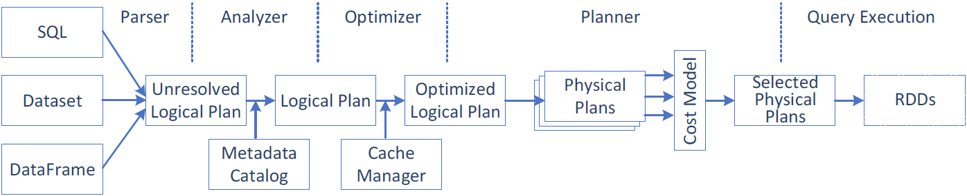
Spark Query Execution
Query execution steps
  Create a logical plan
  Transform the logical plan into a physical plan
  Generate the code
  Execute the tasks on a cluster

Slide 20
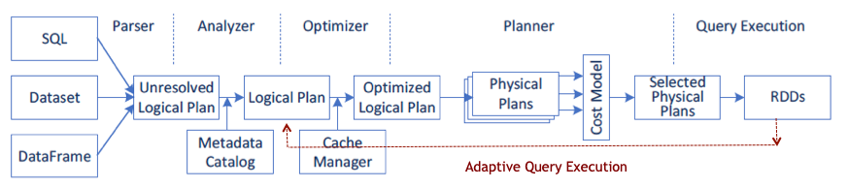
Advanced Spark 3.x Features
Adaptive Query Execution (AQE)
  Runtime statistics retrieved from completed stages of the query plan are used to re-optimize the execution plan
  Dynamically coalescing shuffle partitions
    Combine adjacent small partitions into bigger partitions, reducing the number of tasks
  Dynamically switching join strategies
    Optimize join strategy at runtime based on the join relation size
  Dynamically optimizing skew joins
    Detect data skew and split skew partitions into smaller sub-partitions

Slide 21
Advanced Spark 3.x Features
Dynamic partition pruning
  Data warehouse queries
    One or more fact tables referencing any number of dimensional tables
  Pruning at runtime by reusing the dimension table broadcast results in hash joins
Accelerator-aware scheduling
  GPU/CUDA with RAPIDS

Slide 22
Launching Spark Application
Runtime (Spark + Hadoop)
  Self contained in one directory (we denote SPARK_ROOT): /home/_teaching/para/spark
Starting interactive shell (in Python)
  SPARK_ROOT/bin/pyspark
Standalone applications (debugging)
  SPARK_ROOT/bin/spark-submit ./yourSparkApp.py
    --master URL of the master node for the cluster
      local[k] – run locally with k worker threads (with one thread if [k] is missing)
      local[*] – run locally with max number of worker threads (=cores, use `-c` in srun)
      spark://HOST:PORT – run on a standalone Spark cluster master
      CM://HOST:PORT – connect to a cluster manager [mesos, yarn, k8s]
    --class entry point for the application (no need for top-level statement scripts)
Please, do not do this on parlab since interactive sessions block workers for a long time

Slide 23
Launching Spark Cluster
Submitting to a standalone cluster with simple CM
  Start the master
  Start the workers, and make them connect to the master
  Use spark-submit with the master from 1.
Prepared script spark-slurm.sh
  A sbatch script that performs all aforementioned tasks
  $> sbatch ./spark-slurm.sh ./yourSparkApp.py
    Creates ./slurm-<JOBID>.spark subdir with configs and logs
    Directs stdout and stderr into ./spark-slurm-* files in local dir
    Executes 2 workers per node (i.e., 1 per socket)
    You can tune the #SBATCH -N parameter to select the number of nodes (up to 8)

Slide 24

Discussion

