Slide 1
GPGPU with SYCL
NPRG042 Programming in Parallel Environment
Martin Kruliš

Slide 2
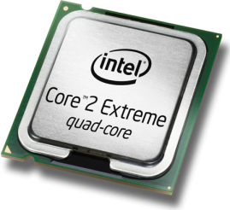
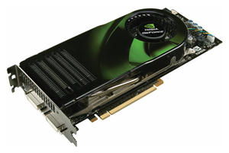
GPU vs. CPU
CPU
  Few cores per chip
  General-purpose cores
  Processing different threads
  Huge caches to reduce memory latency
    Locality of reference problem
GPU
  Many cores per chip
  Cores specialized for numeric computations
  SIMT thread processing
  Huge number of threads and fast context switch
    Results in more complex memory transfers
Architecture Convergence

Slide 3
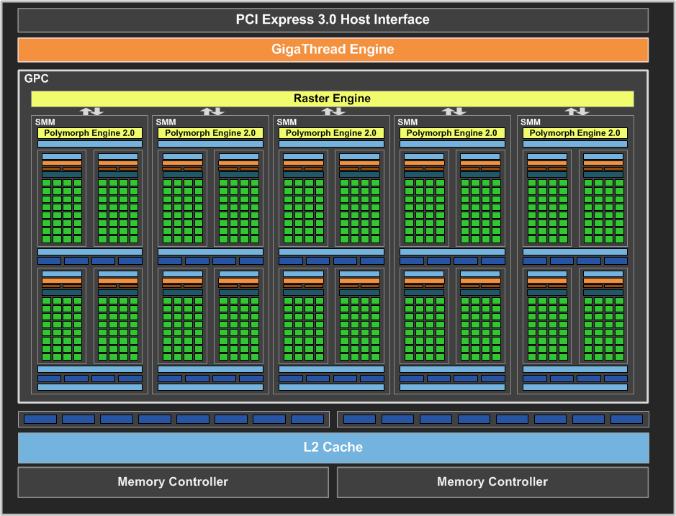
GPU Architecture
Streaming multiprocessor (SM)
Maxwell GPU
CUDA core

Slide 4
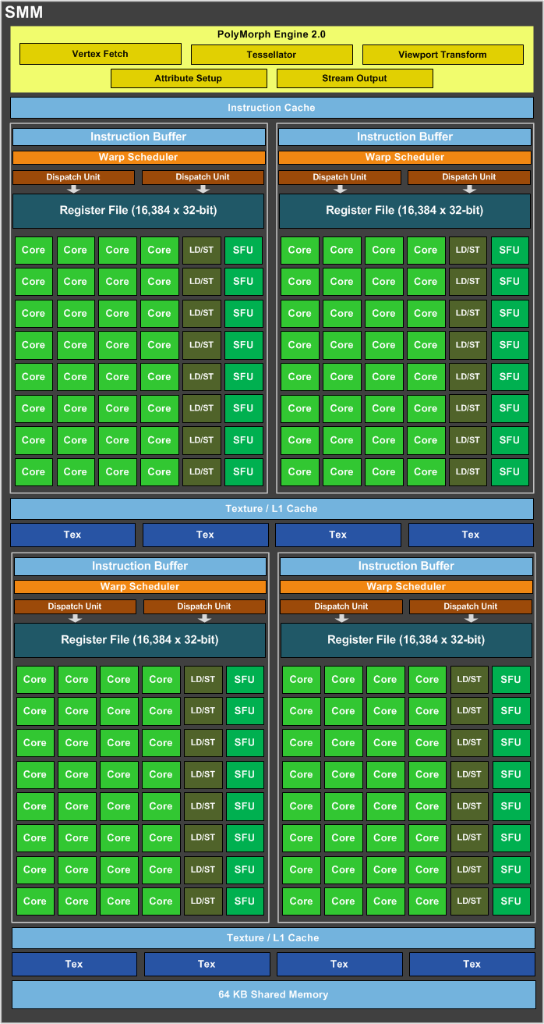
GPU Architecture
Maxwell Architecture
  4 identical parts
    32 cores
    64 kB shared memory
    2 instruction schedulers
  CC 5.0
  SMM
  (Streaming Multiprocessor - Maxwell)

Slide 5
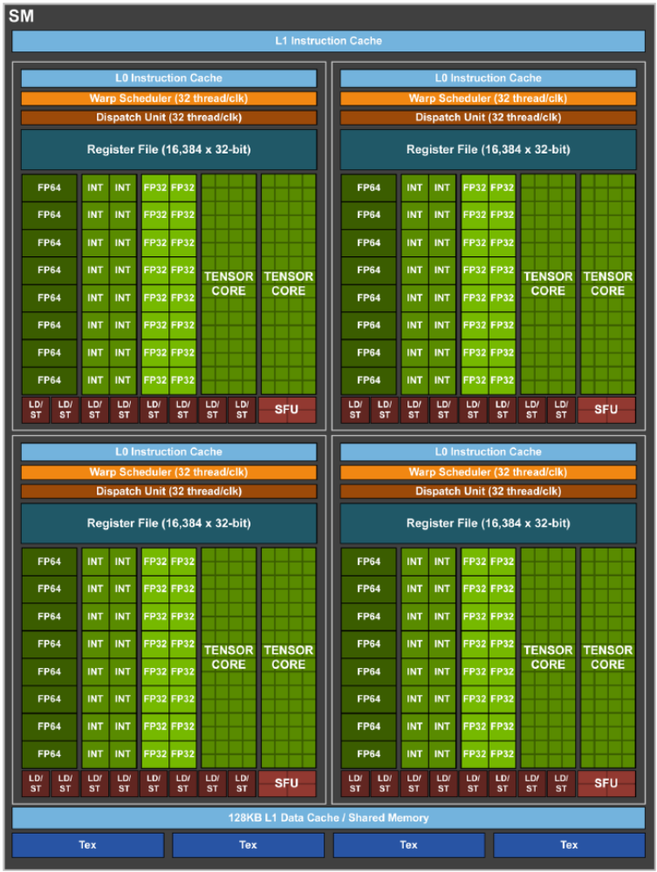
GPU Architecture
Volta SM
  7.x CC
  8x tensor core
  (64 FMA/clock each)

Slide 6
Execution Model
Data Parallelism
  Many data elements are processed concurrently by the same routine
  GPUs are designed under this particular paradigm
  Also have limited ways to express task parallelism
Threading Execution Model
  One function (kernel) is executed in many threads (work items)
  Much more lightweight than the CPU threads
  Threads are grouped into blocks (work groups) of the same size

Slide 7
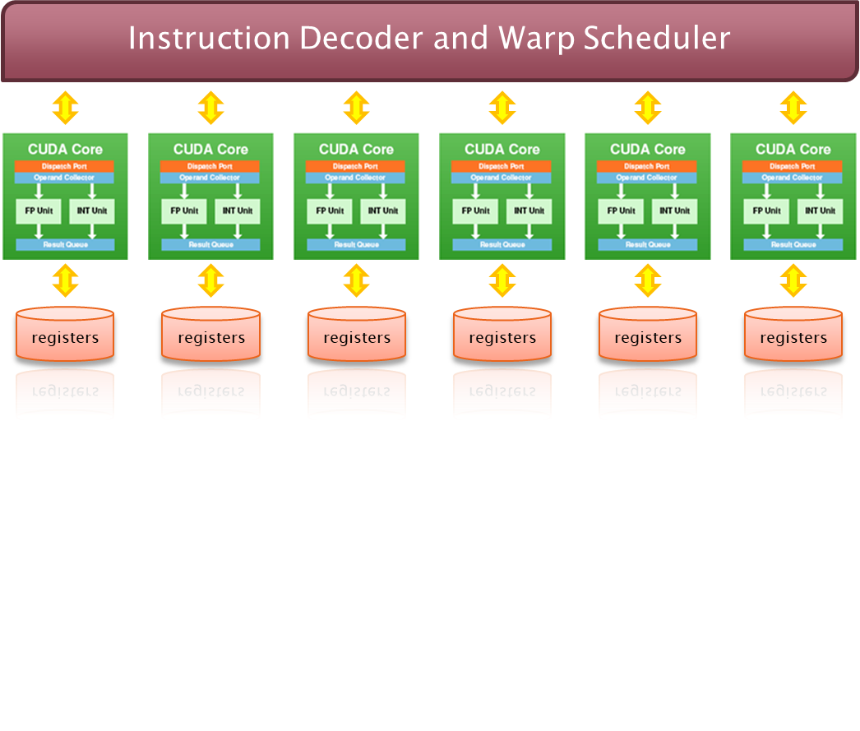
Single Instruction Multiple Threads
Single Instruction Multiple Threads
  All cores are executing the same instruction
  Each core has its own set of registers

Slide 8
SIMT vs. SIMD
Single Instruction Multiple Threads
  Width-independent programming model
  Serial-like code
  Achieved by hardware with a little help from the compiler
  Allows code divergence
Single Instruction Multiple Data
  Explicitly expose the width of the SIMD vector
  Special instructions
  Generated by the compiler or directly written by a programmer
  Code divergence is usually not supported or tedious

Slide 9
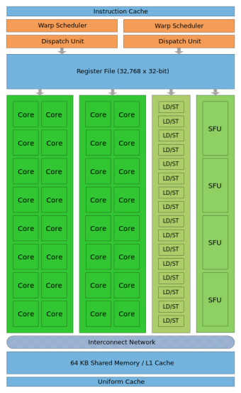
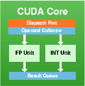
Workload Distribution
Nd-grid and work elements assignment
nd-grid
work-group
warp
work-item
The same kernel
Threads in a warp run in lockstep
Threads (warps) are being swapped quite fast
Assigned to SM
Core
GPU
Streaming Multiprocessor

Slide 10
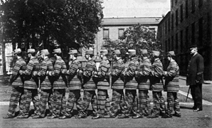
Lockstep Execution
Lockstep
  Multiple threads (warp) execute the same instruction simultaneously
  Simplifies the design of the SMs
  The programmer needs to know
    When optimizing the code
    Not expressed explicitly in SYCL
    Cannot rely on that (e.g., for sync.)
  Divergence is possible
    But not very efficient
  Volta significantly loosens lockstep
    Threads may diverge in hardware

Slide 11
Memory
GPU Device
Host Memory
Local memory
GPU Chip
Private memory
SMP
~ 30-60 GBps
Global Memory
L2 Cache
Shm
Registers
Core
…
Host
L1
Core
…
Shm
Registers
Core
PCI Express
(60/120 GBps)
…
L1
> 100 GBps
and
>1000 (HBM2)
Core
CPU

Slide 12
Memory
Host-device transfers
  Implicit (declared by accessors, handled by the scheduler) – no control
  Explicit handler.copy(src, dest);
Registers
  All local variables of the kernel
  Limited size, registry spilling (cached in L1)
Local (shared) memory
  Special memory shared among work-group
  Very fast, used for (manual) caching or data exchange (items in group)
  auto shm = sycl::accessor<int, 1, sycl::access::target::local>(…);

Slide 13
Code Example
static auto exh =
[](sycl::exception_list l)
{
for (std::exception_ptr const &e : l){
try {
std::rethrow_exception(e);
}
catch (std::exception const &e) {
std::terminate();
}
}
};
std::vector<int> A, B, C;
auto selector = sycl::gpu_selector_v;
try {
sycl::buffer a_buf(A);
sycl::buffer b_buf(B);
sycl::range<1> rng{ A.size() };
sycl::buffer c_buf(C.data(), rng);
sycl::queue q(selector, exh);
q.submit([&](sycl::handler &h) {
sycl::accessor a(a_buf, h, sycl::read_only);
sycl::accessor b(b_buf, h, sycl::read_only);
sycl::accessor c(c_buf, h, sycl::write_only,
sycl::no_init);
h.parallel_for(rng, [=](auto i) {
c[i] = a[i] + b[i];
});
}
q.wait_and_throw();
} catch (std::exception const &e) {
// print e and terminate
}

Slide 14
Synchronization (Reminder)
Queue can be configured as in-order
Host side
  queue.wait();
  Events
    Returned by queue operations
    auto event =
    queue.submit(…);
    event.wait();
    Events can be passed as dependencies to some operations
    queue.submit(…, event, …)
In kernel
  Barriers
    nd_item::barrier()
    Only within the work group!
  Atomic operations
    Similar to C++
    auto v = sycl::ext::oneapi::atomic_ref
    <int,order,scope,space>(a[0]);
    v += something;
Kernel execution overhead is in the range of μs
Available both for local and global memory, quite efficient (if no collisions)

Slide 15

Lockstep Implementation
Masking Instructions
  In case of data-driven branches
    if-else conditions, while loops, …
  All branches are traversed, threads mask their execution in invalid branches
    if (threadIdx.x % 2 == 0) {
    ... even threads code ...
    } else {
    ... odd threads code ...
    }
0
1
2
3
4
…
0
1
2
3
4
…

Slide 16
Reducing Thread Divergence
Work Reorganization
  In case the workload is imbalanced
  “Cheap” load balancing can lead to better occupancy
  Example
    Matrix with dimensions not divisible by warp size
    Item (i,j) has linear index i*width + j
The overhead must not eliminate the gain
Notes:
Cheap = the cost of the balancing must not overweight the actual savings.

Slide 17
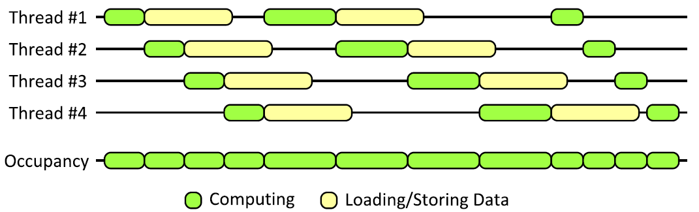
Optimizations: Hiding Latency
Fast Context Switch
  When a warp gets stalled
    E.g., by data load/store
  Scheduler switch to next active warp

Slide 18
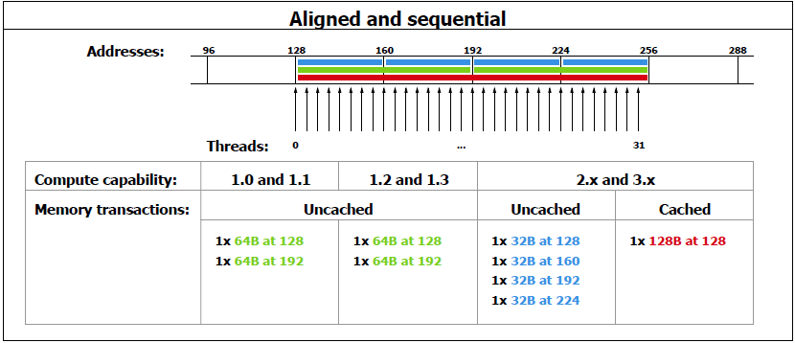
Optimizations: Global Memory
Access Patterns
  Perfectly aligned sequential access

Slide 19
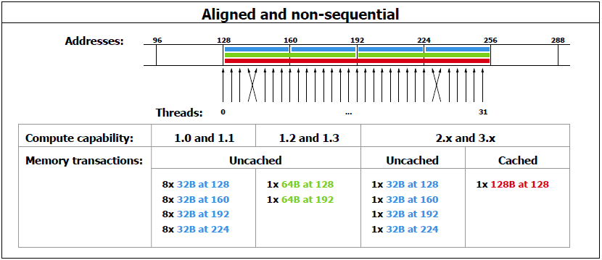
Optimizations: Global Memory
Access Patterns
  Perfectly aligned with permutation

Slide 20
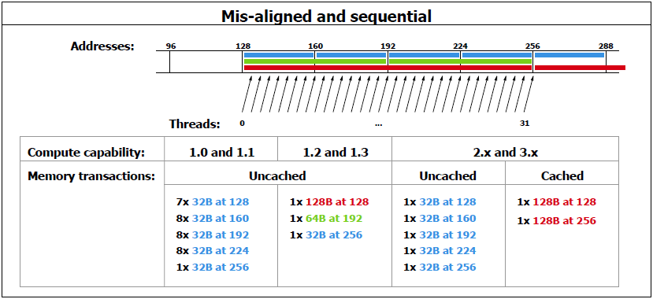
Optimizations: Global Memory
Access Patterns
  Continuous sequential, but misaligned

Slide 21
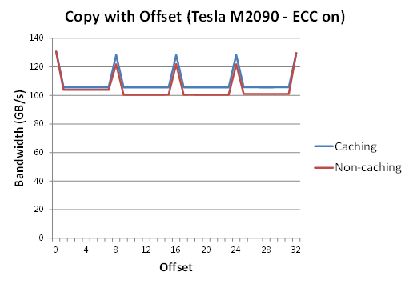
Optimizations: Global Memory
Coalesced Loads Impact

Slide 22
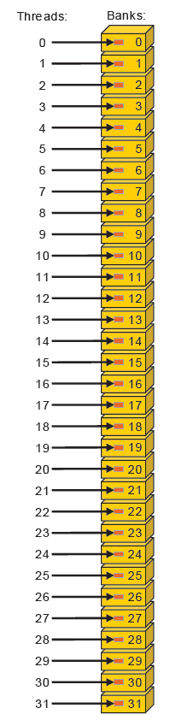
Optimizations: Local (Shared) Memory
Linear Addressing
  Each thread in warp access different memory bank
  No collisions

Slide 23
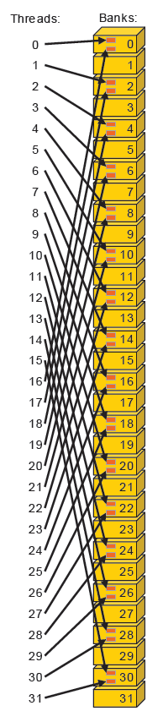
Optimizations: Local (Shared) Memory
Linear Addressing with Stride
  Each thread access 2*i-th item
  2-way conflicts (2x slowdown) on CC < 3.0
  No collisions on CC 3.x
    Due to 64-bits per cycle throughput

Slide 24
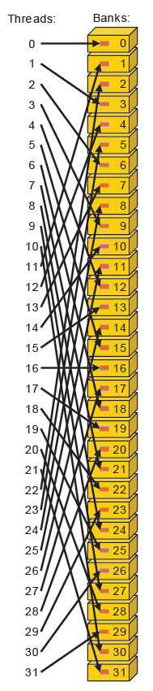
Optimizations: Local (Shared) Memory
Linear Addressing with Stride
  Each thread access 3*i-th item
  No collisions, since the number of banks is not divisible by the stride

Slide 25
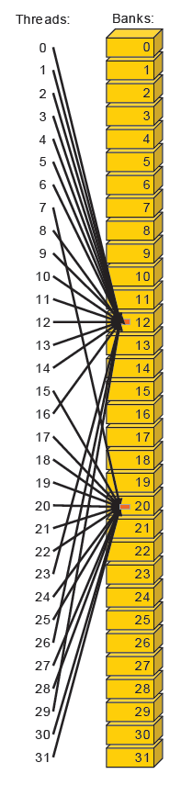
Optimizations: Local (Shared) Memory
Broadcast
  One set of threads access value in bank #12 and the remaining threads access value in bank #20
  Broadcasts simultaneously

Slide 26
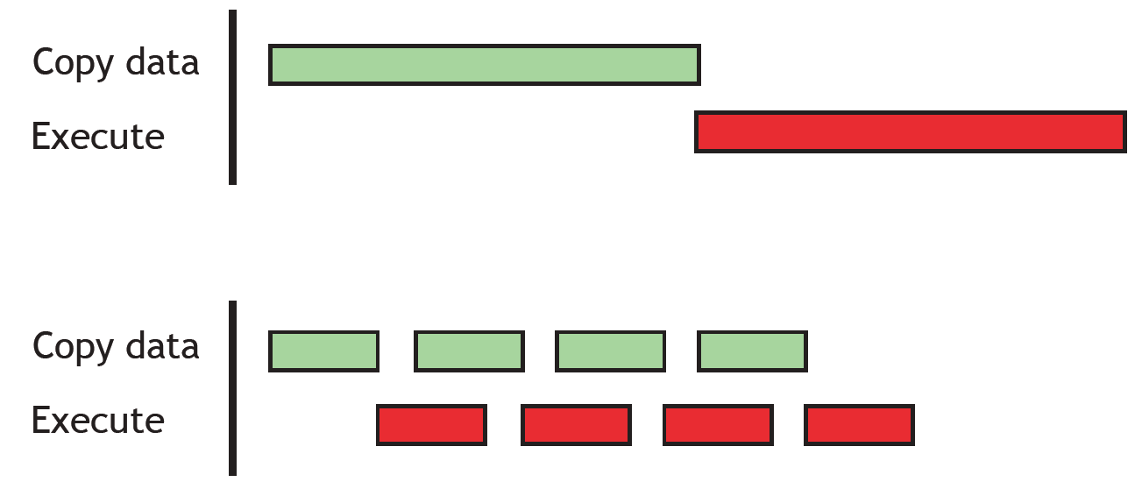
Optimizations: Host-device Transfers
Making a Good Use of Overlapping
  Split the work into smaller fragments
  Create a pipeline effect (load, process, store)

Slide 27
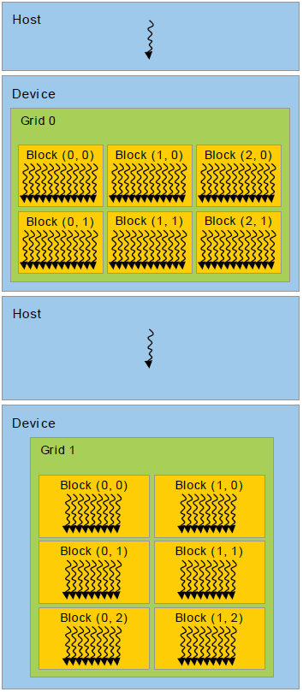
Heterogeneous Programming
GPU
  “Independent” device
  Controlled by host
  Used for “offloading”
Host Code
  Needs to be designed in a way that
    Utilizes GPU(s) efficiently
    Utilize CPU while GPU is working
    CPU and GPU do not wait for each other
Notes:
Remember Amdahl’s Law.

Slide 28

Discussion

