Slide 1
Designing Parallel Algorithms
NPRG042 Programming in Parallel Environment
Martin Kruliš, Jakub Yaghob

Slide 2
Parallel Algorithms Design Patterns
Algorithm design patterns
  We already covered how to find concurrency
  Let’s move a bit closer to the implementation…
  A selected pattern applies to one algorithm (not the entire program)
Organize by tasks
Organize by data decomposition
Organize by flow of data
Task Parallelism
Geometric decomposition
Pipeline
Divide and Conquer
Recursive data
Event-Based Coordination

Slide 3
Parallel Algorithms Design Patterns
Target platform
  An ideal parallel algorithm could be deployed on any platform, but…
    The more constraints we apply, the more platform-specific optimizations we can employ
    We need to find the right balance and use the right abstractions
  Concerns
    Number of cores (computing units), synchronization costs, hierarchy
    Vectorization
    Memory model (shared memory vs. distributed memory)
      Communication costs (caches, NUMA, message passing latency, …)
  Technical aspects
    Programming language(s), libraries, target OS(es), …
    Let’s put these aside for a moment

Slide 4
Parallel Algorithms Design Patterns
Selecting a design pattern
  Implied by the (revealed) concurrency
  Organization by tasks
    Independent operations are the most dominant aspect of an algorithm
  Organization by data (decomposition)
    Data structure/organization is the most dominant aspect
  Organization by dataflow (or workflow)
    The data (or the tasks) appear continuously, or their (inter)actions are data-driven
  A program (usually) combines multiple algorithms (patterns)
    Sometimes, even one algorithm needs to be composed from multiple patterns

Slide 5
Parallel Algorithms Design Patterns
Selecting a design pattern
Start
Is organized by tasks?
Is organized by data decomposition?
Is organized by flow of data?
Linear
Recursive
Linear
Recursive
Regular
Irregular
Task Parallelism
Divide and Conquer
Geometric decomposition
Recursive data
Pipeline
Event-Based Coordination

Slide 6
Parallel Algorithms Design Patterns
Task parallelism
  The problem can be decomposed into (mostly) independent (concurrent) tasks
    Dependencies are possible, but should be scarce
  We are talking about expressing the parallelism (not about the implementation)
    Other patterns may also be implemented using task-executing frameworks
Organize by tasks
Organize by data decomposition
Organize by flow of data
Task Parallelism
Geometric decomposition
Pipeline
Divide and Conquer
Recursive data
Event-Based Coordination

Slide 7
Task Parallelism
Task parallelism issues
  How to divide the algorithm into tasks
    Indicated by the revealed concurrency (function calls, loops, …)
    Some effort is still required (grouping, detecting/expressing data dependencies, …)
  How to execute the tasks
    Utilizing available processing units via natural means (like threads)
    Scheduling problem, efficiency, optimizing for caches, …
  Completion detection
    Usually, all tasks must be completed
    Sometimes, early termination is required (on error, special cases, short circuits, …)
  Dealing with dependencies
    A task can be executed after all its dependencies have been completed

Slide 8
Task Parallelism
Task creation
  How many? (grouping issue)
    Should be more than the available processing units
    Too small tasks increase scheduling/execution/management overhead
  When?
    All tasks are available at the beginning
    Tasks are spawned dynamically during the computation (data-driven)
  How? (creation interface details)
    Allowing programmers to express helpful details (task size, data are hot in the cache)
    Too many details are problematic
      Tedious for the programmer, error-prone
      Less generic for multi-platform solutions

Slide 9
Task Parallelism
Task dependencies
  Enforcing explicit ordering of task execution
    E.g., task A must be completed before task B is started
    One task may have multiple dependencies
  Reasons
    Data dependencies
      One task’s outputs are the next task’s inputs
      Enforcing implicit synchronization (avoiding explicit synchronization)
    Side-effect ordering (writing data to the output in the right order)
  Soft-dependencies
    A task, which has its data hot in the cache, should go before a task with no data in the cache
    Not expressed as task dependencies, left to the scheduling algorithm (heuristics)

Slide 10
Task Parallelism
Removable task dependencies
  Code transformation (work reorganization)
    Using direct indexing/computation instead of task enumeration
    Shifting part of the computations to earlier/standalone tasks
    Duplicating computations
Task A:
a = fncA();
// other work or A
b = fncB(a);
Task B:
b = fncB(a);
x = fncX(b);
// other work of B
Task C:
…
c = fncC(b);
…
Task A:
a = fncA();
// other work or A
Task B:
b = fncB(a);
x = fncX(b);
// other work of B
Task C:
b = fncB(a);
c = fncC(b);
…

Slide 11
Task Parallelism
Removable task dependencies
  Removing data dependencies
    Multiple tasks updating the same structure
      Implicit synchronization – tasks are made mutually exclusive via dependencies
      Explicit synchronization – tasks use locks (or atomic updates) to access the data structure
    Privatization
      Each task/thread/group of tasks has a private copy of the data structure
      Final aggregation (reduction) is required at the end
      The update operations must be associative
    Multi-versioning
      The data structure is mostly read; there is a single copy for reading
      Update creates a new (modified) copy of the structure
        Then it is swapped for the main copy atomically

Slide 12
Task Parallelism
Scheduling
  Assigning tasks to processing units (threads)
    Non-preemptive – a task must finish before a thread can get another one
    Cooperative – a task may/could let the scheduler execute another task, then resume
    Preemptive – tasks may be switched at any time (this is not widely used here)
  Scheduling objectives
    The whole task set must be completed (a single lingering task delays the job)
    Efficiently resolving task dependencies
    Observing additional hints (hot tasks, deferred tasks, …)
    Overhead minimization

Slide 13
Task Parallelism
Scheduling – Load balancing
  The main issue that hinders our objectives
  The length of tasks is rarely known a priori
  The available threads may get stalled by
  external issues (OS, frequency scaling)
A
B
C
D
E
F
A
B
C
D
E
A
C
B
F
D
F
E
good
poor

Slide 14
Task Parallelism
Scheduling strategies
  Static
    Distribution of the tasks (among threads) is created at the beginning and does not change
    Good if the tasks are about the same size and the processors (threads) are identical and not disrupted by OS or other applications
  Dynamic
    Tasks are placed in queues and distributed as the processors become available
  Hybrid
    Tasks are scheduled statically. If a thread gets idle, it checks the state of other thread queues, and tries to reschedule the tasks if an imbalance is detected
    A part of the tasks is scheduled statically (at the beginning), and the remaining tasks are put in a queue for dynamic scheduling

Slide 15
Task Parallelism
Implementation details
  Many task-parallel problems are loop-based
    Use the loop parallelism design pattern
    If there are no dependencies, it is an “Embarrassingly Parallel” problem
  Task queue(s)
    Loop parallelism is not a good fit
    Not all tasks are known initially
    Use the Master/Worker or SPMD pattern
  Terminating before all the tasks are complete
    Termination condition (bool variable), true means the computation is completed
      Needs to be set/checked atomically; creates additional overhead
    The scheduler should not execute any new tasks once the condition is set

Slide 16
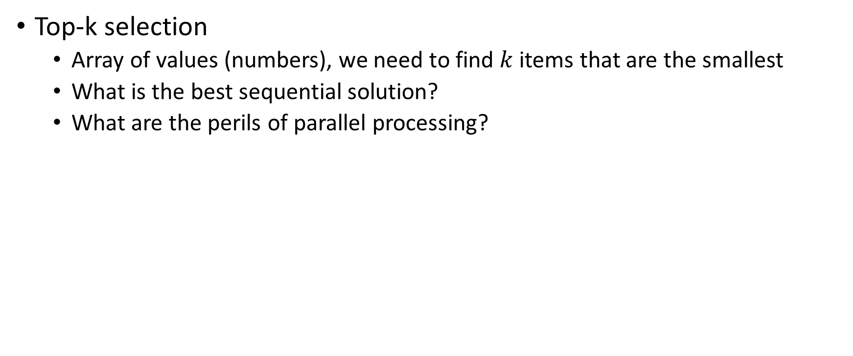
Example: Top-k Selection
Top-k selection
  Array of values (numbers), we need to find $k$ items that are the smallest
  What is the best sequential solution?
  What are the perils of parallel processing?
data
data
data
data
data
top-k
result
top-k
result
top-k
result
top-k
result

Slide 17
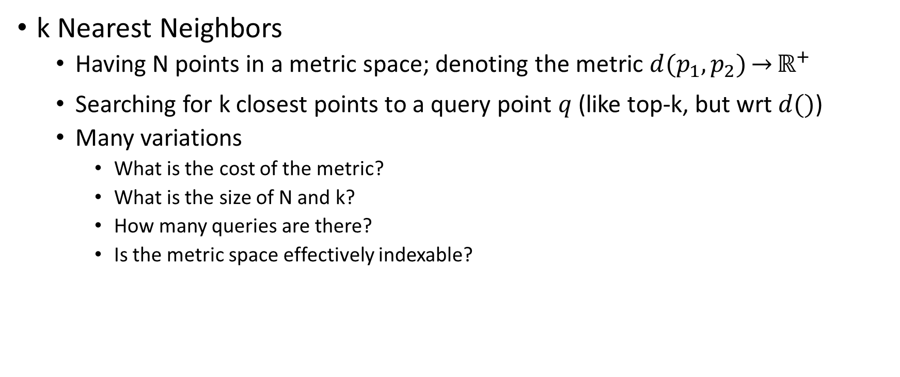
Example: k Nearest Neighbors (kNN)
k Nearest Neighbors
  Having N points in a metric space; denoting the metric $d(p_{1},p_{2})\overset{→}{}ℝ^{+}$
  Searching for k closest points to a query point $q$ (like top-k, but wrt $d()$)
  Many variations
    What is the cost of the metric?
    What is the size of N and k?
    How many queries are there?
    Is the metric space effectively indexable?
kNN (k=3)

Slide 18
Parallel Algorithms Design Patterns
Divide and conquer
  A well-known strategy for (serial) algorithm design
    Decompose the problem, solve sub-problems recursively, and merge the results
    Small sub-problems are solved directly/trivially (which ends the recursion)
Organize by tasks
Organize by data decomposition
Organize by flow of data
Task Parallelism
Geometric decomposition
Pipeline
Divide and Conquer
Recursive data
Event-Based Coordination

Slide 19
Divide and Conquer
sequential
problem
up to 2-way concurrency
subproblem
subproblem
subproblem
subproblem
subproblem
subproblem
up to 4-way concurrency
subsolution
subsolution
subsolution
subsolution
up to 2-way concurrency
subsolution
subsolution
sequential
solution

Slide 20
Divide and Conquer
Benefits
  Subproblems are independent, so they can be solved concurrently
  Easy to implement even with (crude) fork-join model
Drawbacks
  The level of concurrency is determined by the level of recursion
    This can be mitigated by employing additional parallel patterns in problem decomposition or (sub)results synthesis
  Sub-problems may be executed on different processing units
    Cost of communication needs to be considered (especially for distributed memory)

Slide 21
Divide and Conquer
Important realization details
  The recursion level needs to be adjusted
    Recursion is stopped when the sub-problems are just right for parallelism
    (more than processing units, large enough to keep scheduling overhead down)
  If sub-problems are regular
    A fork-join (like) model can be used
  If sub-problems are irregular
    The number of sub-problems should exceed # of PUs several times
    Dynamic scheduling approach (sub-problems = tasks, using queues, …)
  Additional data dependencies may exist
    E.g., when sub-problems access the same (additional) data structure

Slide 22
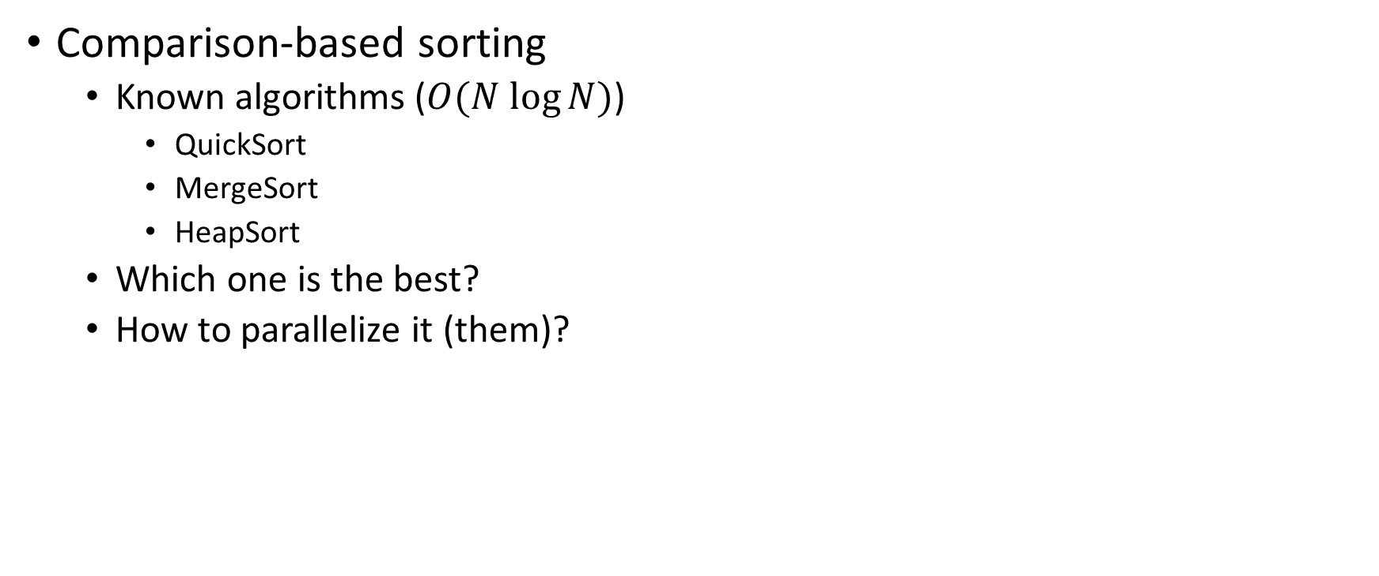
Example: Sorting
Comparison-based sorting
  Known algorithms ($O(N log⁡N)$)
    QuickSort
    MergeSort
    HeapSort
  Which one is the best?
  How to parallelize it (them)?

Slide 23
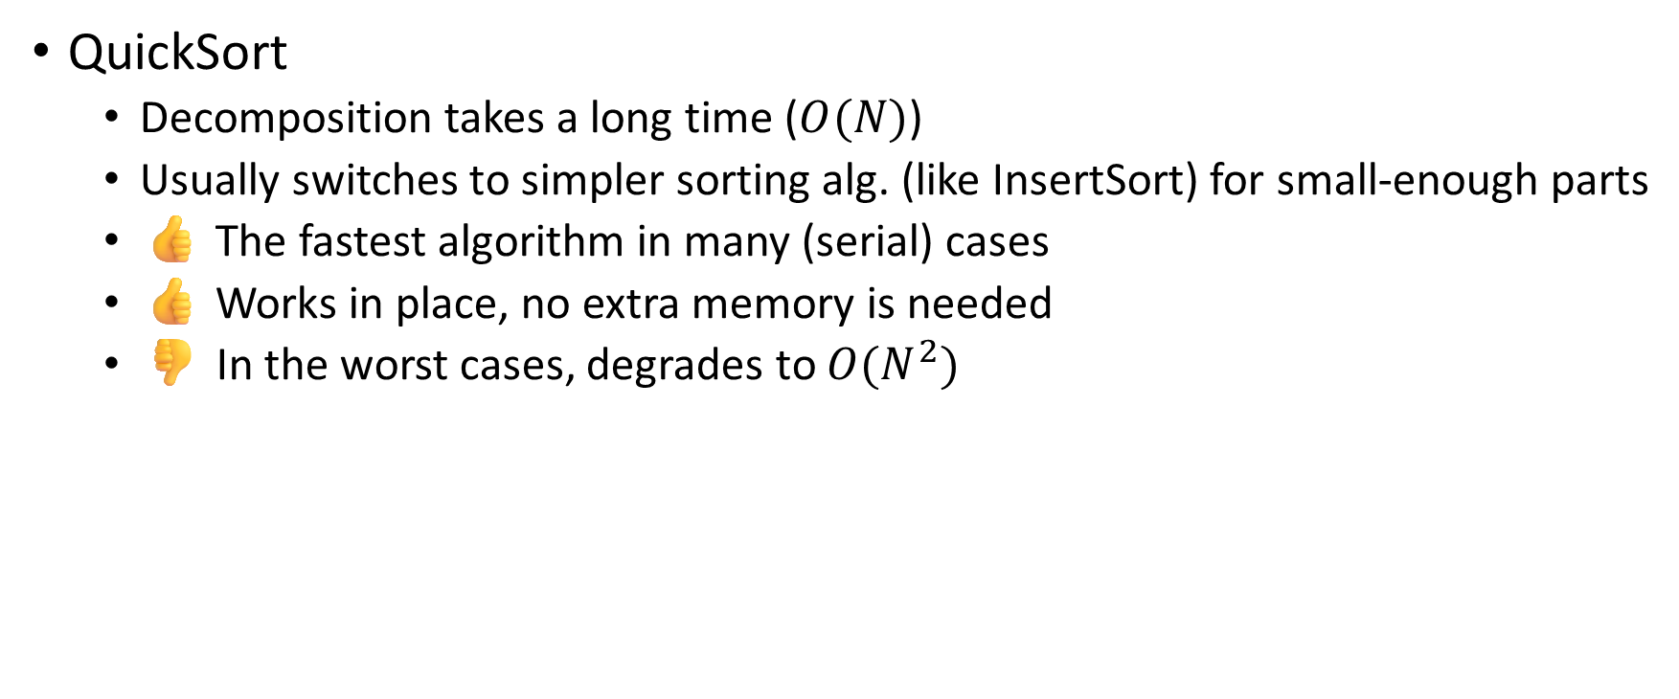
Example: Sorting
QuickSort
  Decomposition takes a long time ($O(N)$)
  Usually switches to simpler sorting alg. (like InsertSort) for small-enough parts
  👍 The fastest algorithm in many (serial) cases
  👍 Works in place, no extra memory is needed
  👎 In the worst cases, degrades to $O(N^{2})$
data
split
<
=
>
solved recursively
solved recursively

Slide 24

Example: Sorting
MergeSort
  Divides the sorted array in half, sorts both parts recursively, and merges them
  Also, may switch to alternate sorting algorithms for short-enough ranges
  👍 Divides workload evenly (stable $O(N log⁡N)$)
  👍 Division has (almost) zero cost
  👎 Requires additional memory (in-place merge is possible, but costly)
    This also includes a lot of copying
sorted
sorted
merged

Slide 25

Example: Sorting
MergeSort
  The division can directly yield parallel tasks/steps (no need for recursion)
    Potentially, all sub-problems can be started immediately
  The merge step can be parallelized as well, with some overhead
sorted
sorted
sorted
sorted
sorted
sorted
sorted
sorted
sorted
sorted
sorted
sorted
sorted
sorted
fully sorted

Slide 26
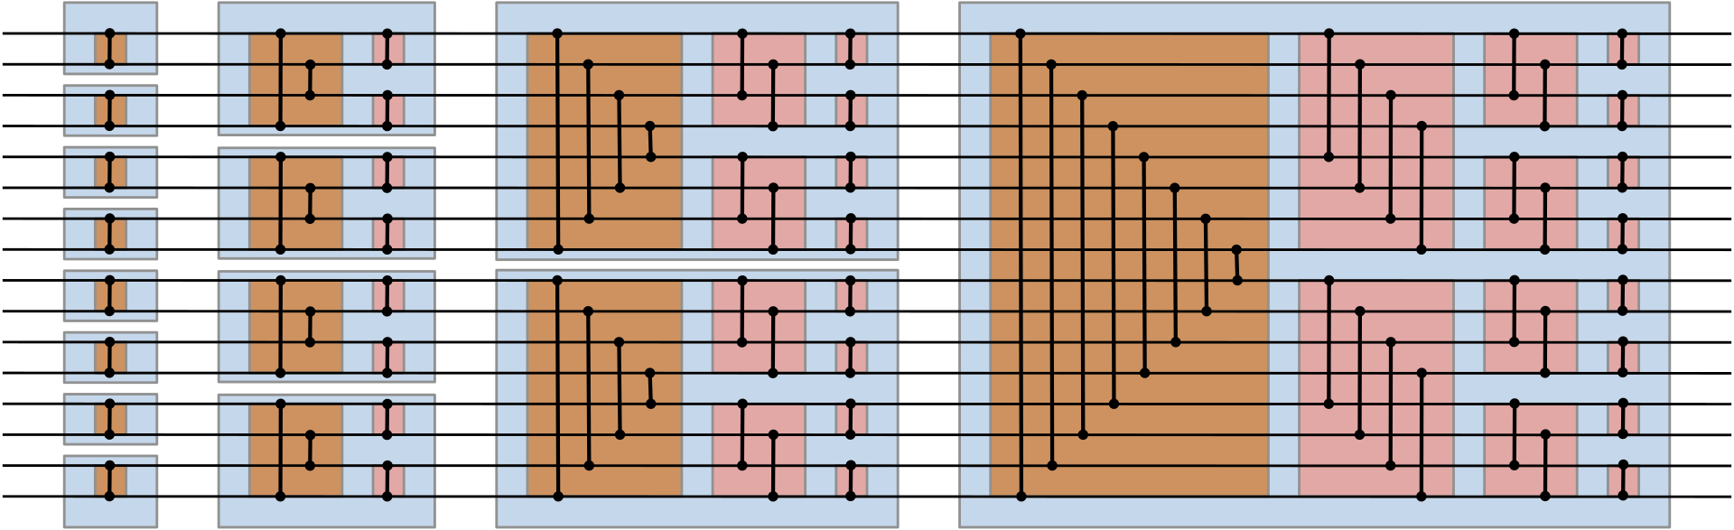
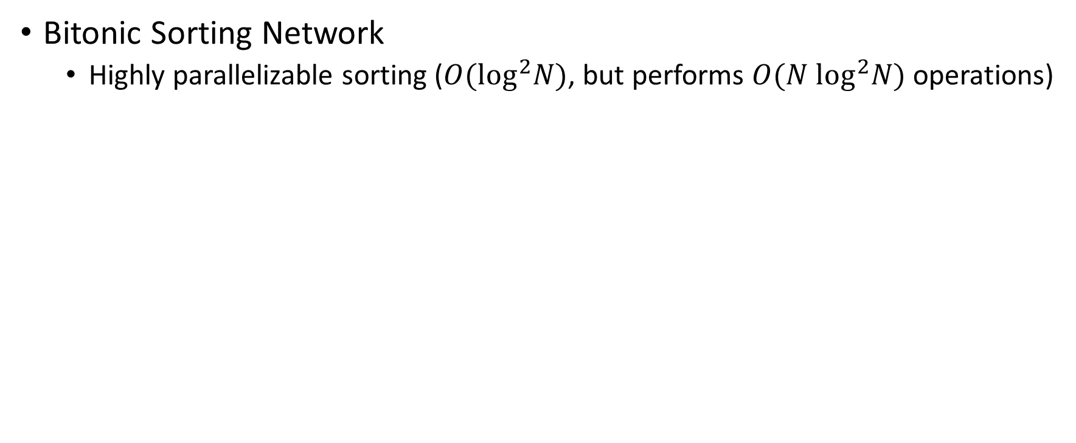
Example: Sorting
Bitonic Sorting Network
  Highly parallelizable sorting ($O(\log^{2}N)$, but performs $O({N log}^{2}N)$ operations)
https://en.wikipedia.org/wiki/Bitonic_sorter

Slide 27
Example: Sorting
Radix Sorting
  When the data (keys) are numbers, we may employ more efficient sorting
  Iterates over bits in keys (from LSB to MSB)
  In each run, it splits the keys into two buckets (0 and 1) whilst keeping their order from previous runs
  Then it concatenates the buckets
  We can take different bases (10, 16, …) with the appropriate number of buckets to balance between the number of steps and multi-bucket management
  Also works on floats (with a little fix to handle negative numbers)

Slide 28
Parallel Algorithms Design Patterns
Geometric decomposition
  Data-centric work organization (division, transfers, …)
  How to decompose data into “chunks” that can be processed in parallel
    Assuming the data structure is regular and the processing kernel is stable
Organize by tasks
Organize by data decomposition
Organize by flow of data
Task Parallelism
Geometric decomposition
Pipeline
Divide and Conquer
Recursive data
Event-Based Coordination

Slide 29
Geometric decomposition
Data decomposition
  The data are regular and continuous (arrays, tensors, …)
    Linear (possibly multi-dimensional) indexing
    Can be easily divided into sub-regions (sub-ranges, blocks, tiles, …) – “chunks”
  Data decomposition => decomposition of the update operation (kernel)
    Chunks can be processed independently
  Data dependencies
    Strictly local computation (no dependencies, embarrassingly parallel)
    Update requires information from other chunks (usually neighbors)
      Requires double-buffering (or other types of multi-versioning)

Slide 30

Geometric decomposition
Data decomposition
  Granularity
    Coarser-grained – parallelism 👎, load balancing 👎, comm./scheduling overhead 👍
    Finer-grained – parallelism 👍, load balancing 👍, communication/scheduling overhead 👎
  Shape
    Affect the size of the shared data in many problems
    Surface-to-volume effect
    Multi-dimensional decomposition is often preferred

Slide 31
Geometric decomposition
Data decomposition
  Shape, other concerns (contra-arguments)
    Sequential code can be more easily reused with lower-dimensional decomposition
    Lower-dimensional decomposition may be better for caches
    More complex decomposition requires more complex indexing (code)
  Ghost boundary
    Removing data dependencies by replicating data at the chunk boundaries
    Requires additional updates and/or additional work performed by each chunk
    Memory overhead, may cause misalignment
  Grid boundaries
    Special code/dedicated tasks
    Padding with zeroes

Slide 32

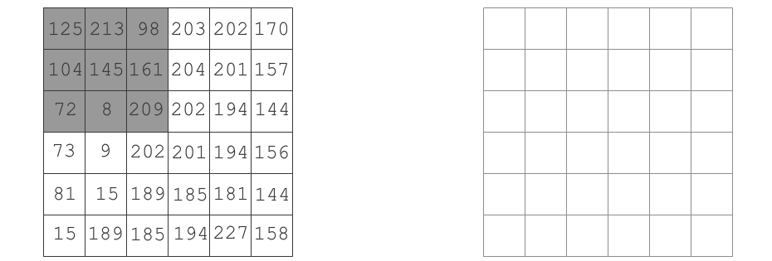
Stencil Computations
Grid-based iterative computation
  Cells organized in a regular grid (usually 2D or 3D)
  Simple function (kernel) that computes the new state of each cell from its immediate neighborhood (cells near by)
  Usually, multiple iterations are performed
  (Physical) simulations, image processing, cellular automata, …
5-stencil
9-stencil
7-stencil

Slide 33

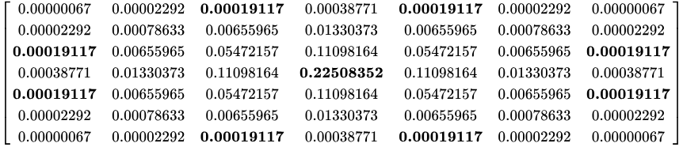

Example: Blur Stencil
Blur
  Weighted average of surrounding pixels
    Weight is often computed from pixel distance
  Rather special
    One iteration only
    Neighborhood is usually rather large
Gaussian blur weight matrix (source: Wiki)

Slide 34


Example: Diffuse Stencil
Diffusion simulation
  Simulates how gas/liquid spreads in a stable environment
  Based on a parabolic partial differential equation
  When discretized, it leads to a stencil computation
    Similar to blur, but using only a 9-stencil (2D) or 27-stencil (3D)
    Computed iteratively
    One iteration is one time step
  Opens the topic of removing unnecessary
  computations in the parts of the grid where
  “nothing happens”

Slide 35
Diffuse Stencil
Temporal Blocking
  One chunk is iterated multiple times
    To save data transfers to/from processing units
  The valid chunk area that is computed is restricted after each iteration
    By the radius computed from the stencil neighborhood
  The outer areas must be handled
    Overlapping
    A separate kernel that finalizes the computation
  Optimal patterns are an objective of research
 |  |  |  | halo
3 iterations for 9-stencil

Slide 36
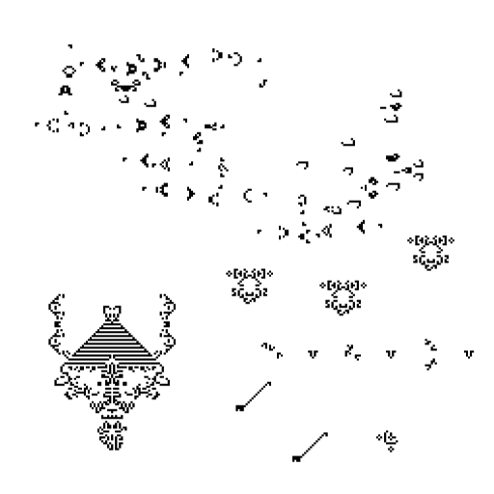
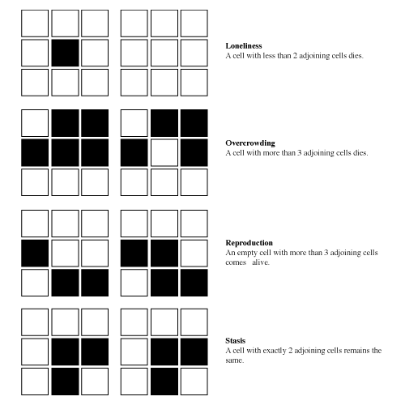
Example: Conways Game of Life
Game of Life
  Cellular automaton on 2D grid
  Cells are either dead or alive (1 bit)
  Simple rules for transformation
Lonely
Crowded
Reproduction
Survives

Slide 37
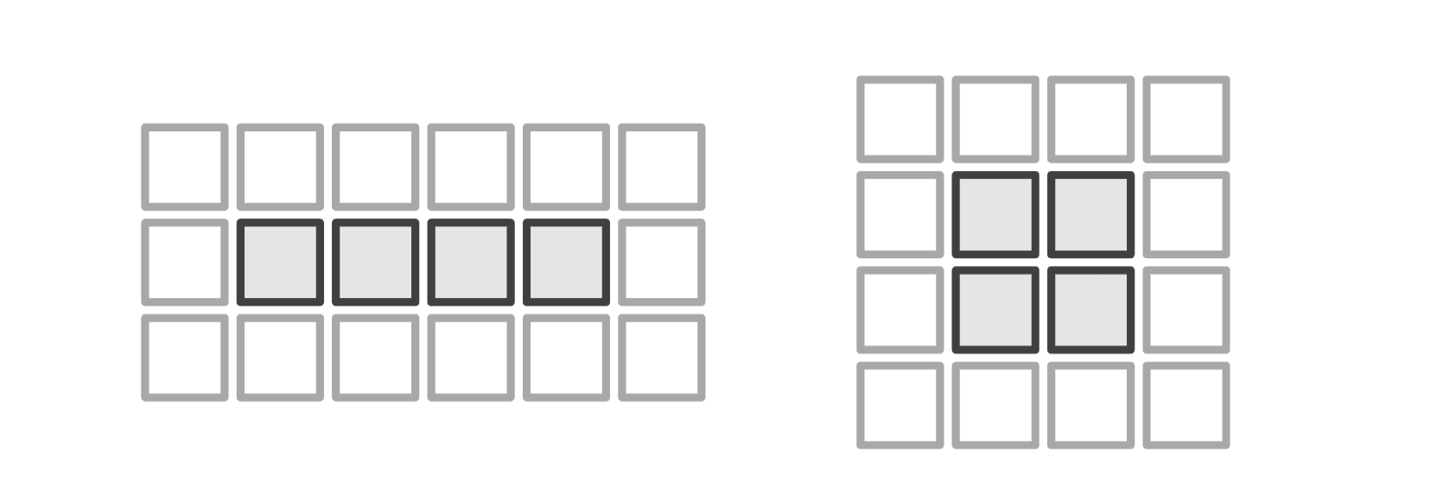
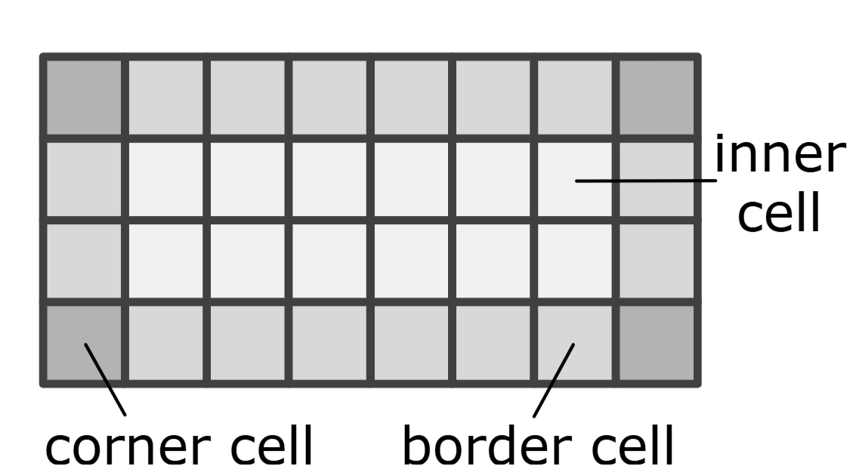
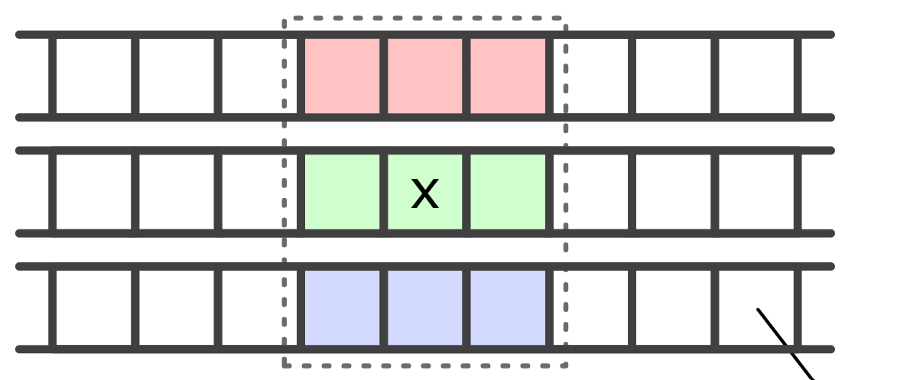
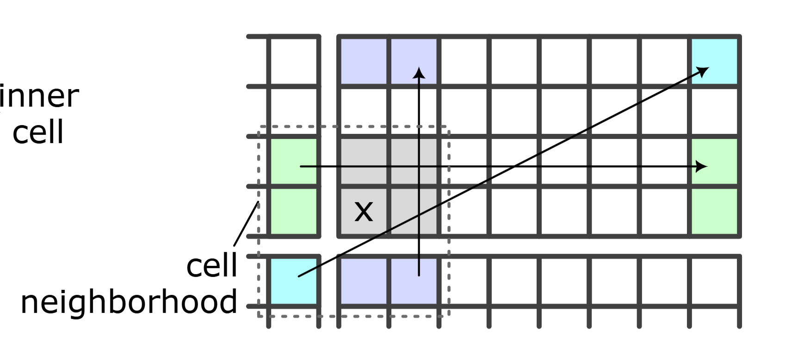
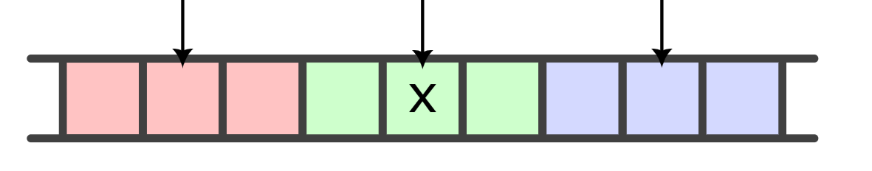
Conways Game of Life
Linear encoding
  32/64b words
  Data from multiple words needs to be assembled
Tile encoding
  Easier for inner cells
  (1 and + 1 popc)
popc( )

Slide 38
Conways Game of Life
Streaming
  One PE iterates over multiple chunks to reduce the communication overhead
  Usually in the orthogonal dimension – creates more surface-to-volume ratio
  Used for the lowest level of parallelism
    Vector instructions, SYCL work items…
  Example for linear encoding in Game of Life:
One more thing: https://erunno.github.io/gol-work-reduction/

Slide 39
Parallel Algorithms Design Patterns
Recursive data
  Processing a recursively-defined data structure (tree, graph, …)
  Sometimes even the traversal of the data structure is defined sequentially
Organize by tasks
Organize by data decomposition
Organize by flow of data
Task Parallelism
Geometric decomposition
Pipeline
Divide and Conquer
Recursive data
Event-Based Coordination

Slide 40
Recursive Data
Issues
  Sequential traversal, difficult to speed up
  Load imbalance
  Inevitable data sharing (e.g., an edge connects two vertices)
Best practices
  Regularization of the data
    Transforming into more regular structures, indexing, matrix representation, …
  Redundant work
    Some parts of the structure are processed multiple times unnecessarily
  Atomic instructions and lock-free techniques for synchronization

Slide 41
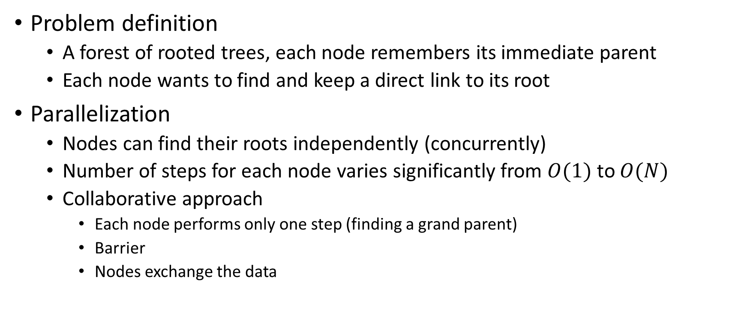
Example: Finding roots
Problem definition
  A forest of rooted trees, each node remembers its immediate parent
  Each node wants to find and keep a direct link to its root
Parallelization
  Nodes can find their roots independently (concurrently)
  Number of steps for each node varies significantly from $O(1)$ to $O(N)$
  Collaborative approach
    Each node performs only one step (finding a grand parent)
    Barrier
    Nodes exchange the data

Slide 42
Example: Finding roots
4
12
4
12
3
11
14
3
11
14
2
10
13
2
10
13
1
6
9
1
6
9
5
7
8
2nd iteration
5
7
8
1st iteration
4
12
final iteration
3
11
14
2
10
13
1
6
9
5
7
8

Slide 43
Graph Traversal
Example: Breadth-First Search (BFS) traversal
  Starting from a single vertex, unvisited nodes are placed in a queue, …
  Shared queue
    Requires synchronization
    The only potential for parallelization (processing, bulk insertions)
  Vertex-grained locking
    Using atomic compare-and-exchange or in synergy with queue synchronization
  Not very suitable for parallel processing
    The queue usually does not contain too many vertices
    Slowly develops at the beginning
    Elementary work per-vertex is usually rather small

Slide 44
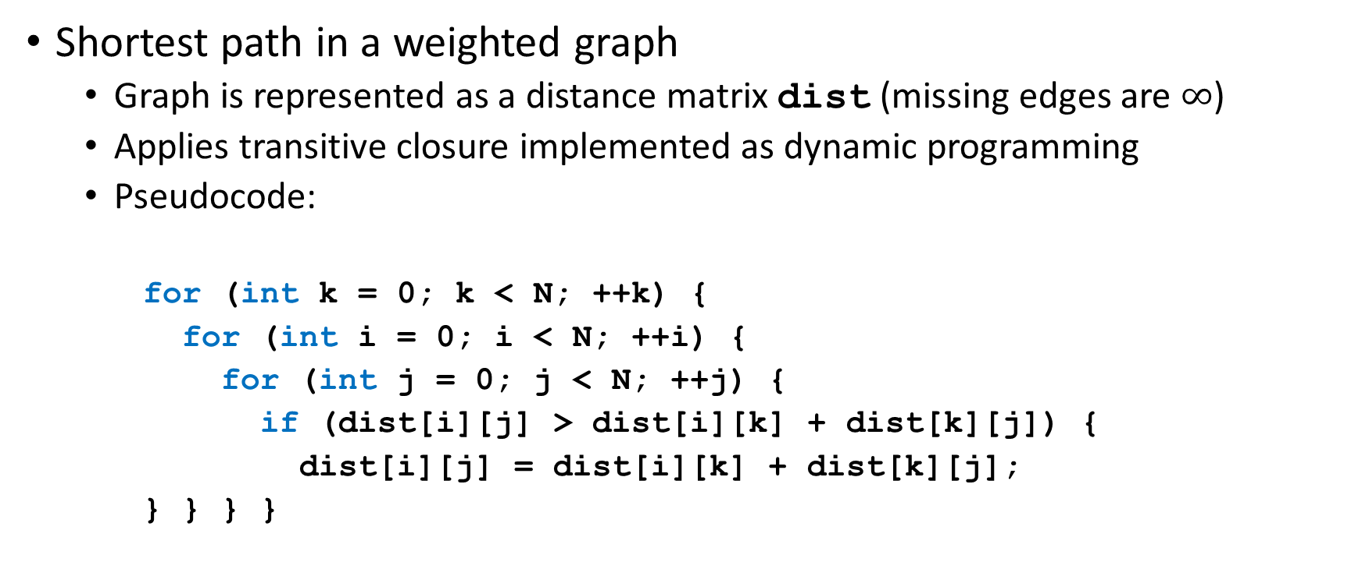
Example: Floyd-Warshal
Shortest path in a weighted graph
  Graph is represented as a distance matrix dist (missing edges are $∞$)
  Applies transitive closure implemented as dynamic programming
  Pseudocode:
    for (int k = 0; k < N; ++k) {
    for (int i = 0; i < N; ++i) {
    for (int j = 0; j < N; ++j) {
    if (dist[i][j] > dist[i][k] + dist[k][j]) {
    dist[i][j] = dist[i][k] + dist[k][j];
    } } } }
Only the inner loops can be parallelized…
Notes:
https://en.wikipedia.org/wiki/Floyd%E2%80%93Warshall_algorithm

Slide 45
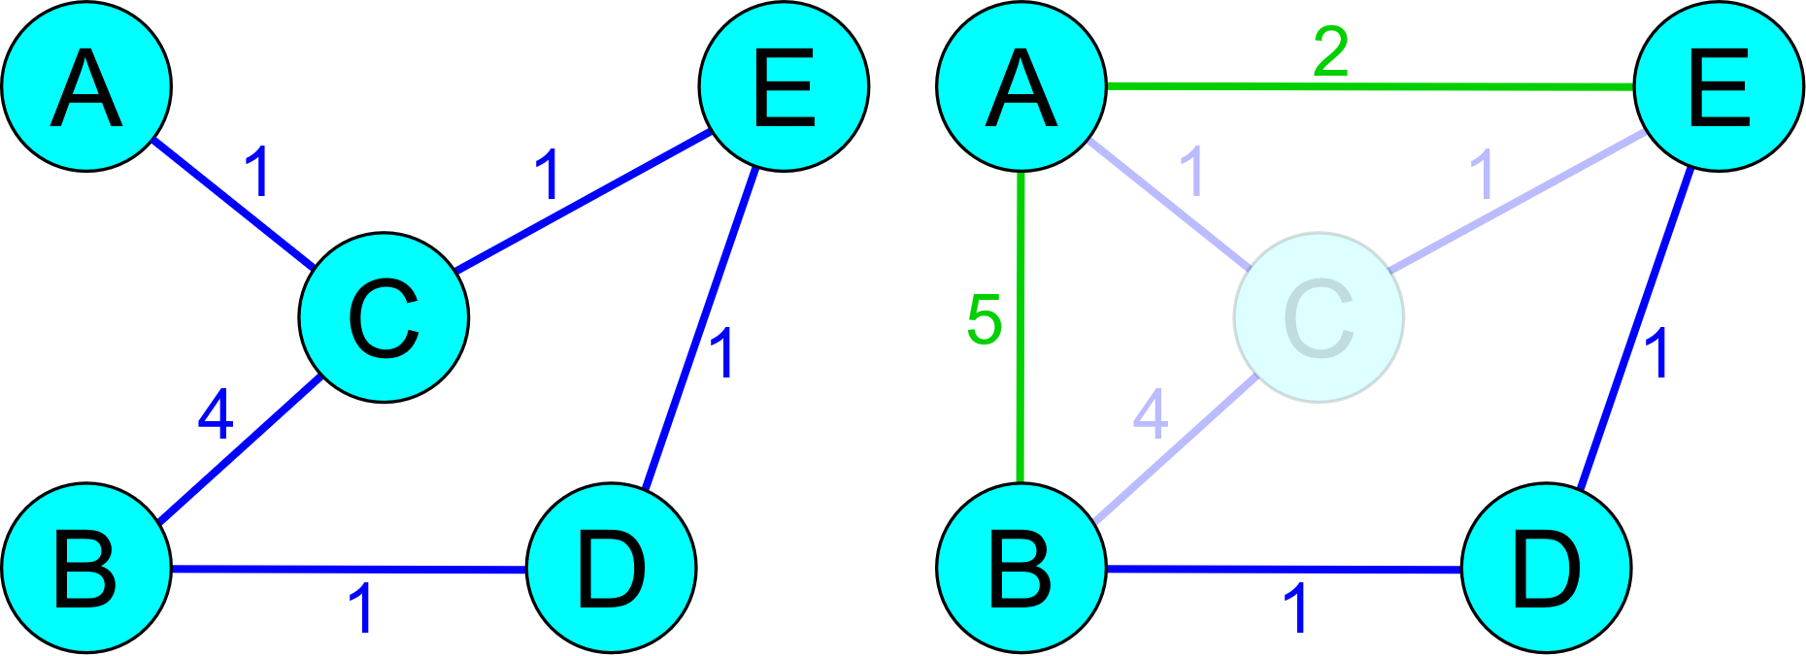
Path-finding Problems
Shortest path finding problem
  Variation on A* algorithm currently represents the best option
  For large graphs, hierarchical preprocessing is performed
    Contraction of vertices and aggregation of edges
    Path is first found on a rougher version of the graph,
    then fine-grained in the contracted nodes
    Great potential for parallelism
    In addition, top-level graph representation
    is usually more dense
      More suitable for matrix-based algorithms
Notes:
Image taken from https://www.mjt.me.uk/posts/contraction-hierarchies/

Slide 46
Minimal Spanning Tree
MST algorithms
  All based on the Cut property
  Jarnik’s (Prim’s) algorithm
    Adds one edge at a time, no (real) potential for parallel processing
  Boruvka’s algorithm
    Merges components (contract vertices) n/2 in each step
  Kruskal’s algorithm
    Sorts the edges, then tries to add them using a union-join set for filtering
  Reverse delete algorithm (reversed Kruskal) and a few others

Slide 47
Parallel Algorithms Design Patterns
Pipeline
  Sequence of stages (tasks) through which the data flows
  Regular shape (linear, possibly graph-like), fixed for the duration of the algorithm
Organize by tasks
Organize by data decomposition
Organize by flow of data
Task Parallelism
Geometric decomposition
Pipeline
Divide and Conquer
Recursive data
Event-Based Coordination

Slide 48
Pipeline
Pipeline
  Independent stages, data blocks (messages) passed between the stages
  Parallelism is achieved by executing the stages concurrently
    Some stages may run in parallel themselves (processing multiple messages)
  Suitable when the data are arriving as a stream (from HDD, network, …)
    Or when the entire dataset cannot fit into memory at once
    Or when the stages occupy different devices/cores/units
  Synchronization is required only between stages
Stage 3a
Stage 2
Stage 4
Stage 1
Stage 2
Stage 3b

Slide 49
Pipeline
Variations
  Shape of the pipeline (linear/DAG/generic graph)
  Decisions on multi-edge connections (round-robin, broadcast, …)
  How data (messages) are transmitted (pull/push, queues, …)
Challenges
  Takes some time to fill the whole pipeline, limits parallelism
  Load imbalance, one slow stage may stall the entire pipeline
  Efficient mapping to processing units (cores)
    Data locality (efficient utilization of caches)
  Termination (cancellation)

Slide 50
Pipeline
Examples
  Multimedia (audio/video encoding/decoding)
  Database and data analytics systems
    Querying (SQL, Linq, …)
  Signal analysis
  Batch image processing
  Network data transfers
Often suitable for hardware-encoded data parallel solutions
  CPU pipeline, FPGAs, cameras, signal encoders, …

Slide 51
Parallel Algorithms Design Patterns
Event-based coordination
  Semi-independent tasks interacting in an irregular fashion
  Interactions are determined by the data flow
    Some ordering constraints are still required
Organize by tasks
Organize by data decomposition
Organize by flow of data
Task Parallelism
Geometric decomposition
Pipeline
Divide and Conquer
Recursive data
Event-Based Coordination

Slide 52
Event-based Coordination
Abstraction
  Multiple components interacting
    Component ~ stages
  Each component processes events
  Each component may also generate events (for other comp.)
  Events are spawned unpredictably
  Events may have dependencies
    Dependencies are also create when new events are spawned
Component main routine
  initialize
  while (not done) {
  receive_event
  process_event
  send_events
  }
  finalize

Slide 53
Event-based Coordination
Challenges
  Difficult to determine which events are safe to execute
  Example
Solutions
  Optimistic
    Speculative execution of events
      Rollback
      Re-validation before the write phase
      Re-execution of events if necessary
  Pessimistic
    Only “safe” events are executed
      No new dependencies can spawn
    Limits concurrency
    Error-prone, deadlock
E1
E3
E1.1
E1.2
But E3 is already running…
E2

Slide 54





Example: Discrete-event Simulation
Discrete simulation
event
event
Priority queue (ordered by time)
event
event
event
event
event
Components

Slide 55
Conclusions
Choosing the patterns
 | Task parallelism | Divide and Conquer | Geometric Decom-position | Recursive Data | Pipeline | Event-Based Coordi-nation
SPMD |  |  |  |  |  | 
Loop Parallelism |  |  | 
Master/ Worker |  |  | ★ | ★ | ★ | ★
Fork/Join |  |  |  |  |  | 

Slide 56
Conclusions
Choosing the patterns
 | GPGPU | TBB | OpenMP | Spark
SPMD |  | ★ | 
Loop Parallelism |  |  |  | ★
Master/Worker |  |  |  | 
Fork/Join |  |  | 

Slide 57

Discussion

