Slide 1
GPU Architectures and CUDA in More Detail
Martin Kruliš

Slide 2
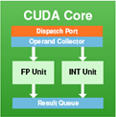
SIMT Execution (Revision)
Single Instruction Multiple Threads
  All cores are executing the same instruction
  Each core has its own set of registers
Instruction Decoder and Warp Scheduler
registers
registers
registers
registers
registers
registers

Slide 3
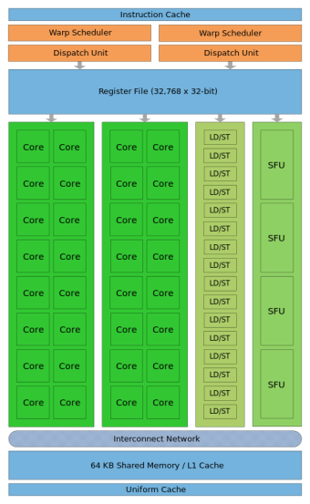
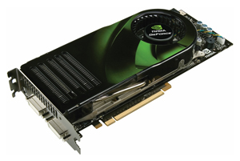
Thread-Core Mapping (Revision)
How are threads assigned to SMPs
Grid
Block
Warp
Thread
The same kernel
Simultaneously run on SM cores. Threads in a warp run in lockstep.
Assigned to SM
Core
GPU
Streaming Multiprocessor
Notes:
Warp is made by subsequent 32 threads of the block according to their thread ID (i.e., threads 0-31, 32-63, …). Warp size is 32 for all compute capabilities.
Thread ID is threadIdx.x in one dimension, (threadIdx.x + threadIdx.y*blockDim.x) in two dimensions and threadId.x + threadId.y*blockDim.x + threadId.z*blockDim.x*blockDim.y) in three dimensions.
Multiple kernels may run simultaneously on the GPU (since Fermi) and multiple blocks may be assigned simultaneously to an SM (if the registers, the schedulers, and the shared memory can accommodate them).

Slide 4
Instruction Schedulers
Decomposition
  Each block assigned to the SMP is divided into warps and the warps are assigned to schedulers
Schedulers
  Select warp that is ready at every instruction cycle
  The SMP instruction throughput depends on CC:
    1.x – 1 instruction per 4 cycles, 1 scheduler
    2.0 – 1 instruction per 2 cycles, 2 schedulers
    2.1 – 2 instructions per 2 cycles, 2 schedulers
    3.x and 5.x – 2 instructions per cycle, 4 schedulers
Notes:
The most common reason, why a warp is not ready to execute is that the operands of the next instruction are not available yet (i.e., they are being loaded from global memory, subjected to a read-after-write dependency, …).
Maxwell (CC 5.0) has also 4x double-dealing schedulers (as Kepler), however, there are only 128 cores (assigned 32 cores per scheduler) and latency of math instructions has been improved.

Slide 5
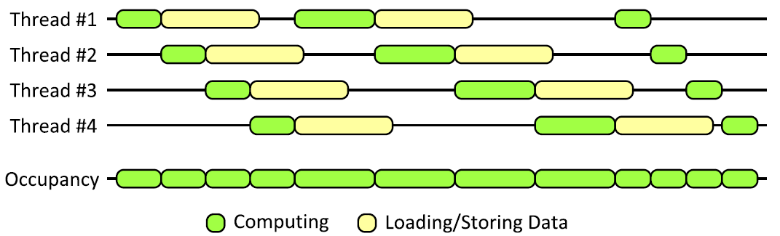
Hiding Latency
Fast Context Switch
  When a warp gets stalled
    E.g., by data load/store
  Scheduler switch to next active warp

Slide 6

SIMT and Branches
Masking Instructions
  In case of data-driven branches
    if-else conditions, while loops, …
  All branches are traversed, threads mask their execution in invalid branches
    if (threadIdx.x % 2 == 0) {
    ... even threads code ...
    } else {
    ... odd threads code ...
    }
0
1
2
3
4
…
0
1
2
3
4
…

Slide 7
Reducing Thread Divergence
Work Reorganization
  In case the workload is imbalanced
  Cheap balancing can lead to better occupancy
  Example
    Matrix with dimensions not divisible by warp size
    Item (i,j) has linear index i*width + j

Slide 8
Block-wise Synchronization
Memory Fences
    __threadfence();
    __threadfence_block()
    __threadfence_system();
Barrier
  Synchronization between warps in block
    __syncthreads();
    __syncthreads_count(predicate);
    __syncthreads_and(predicate);
    __syncthreads_or(predicate);
Notes:
https://docs.nvidia.com/cuda/cuda-c-programming-guide/index.html#memory-fence-functions
__threadfence_block is weakest, __threadfence_system is strongest
__syncthreads is stronger than threadfences

Slide 9
GPU Memory (Revision)
Note that details about host memory interconnection are platform specific
GPU Device
Host Memory
GPU Chip
SMP
~ 25 GBps
Global Memory
L2 Cache
L1 Cache
Registers
Core
…
Host
Core
…
L1 Cache
Registers
Core
PCI Express
(16/32 GBps)
> 100 GBps
…
Core
CPU

Slide 10
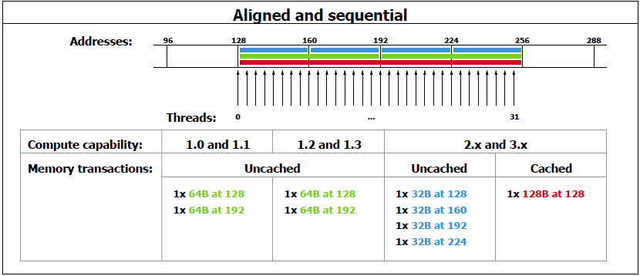
Global Memory
Access Patterns
  Perfectly aligned sequential access

Slide 11
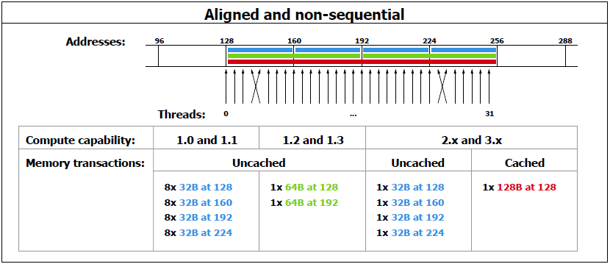
Global Memory
Access Patterns
  Perfectly aligned with permutation

Slide 12
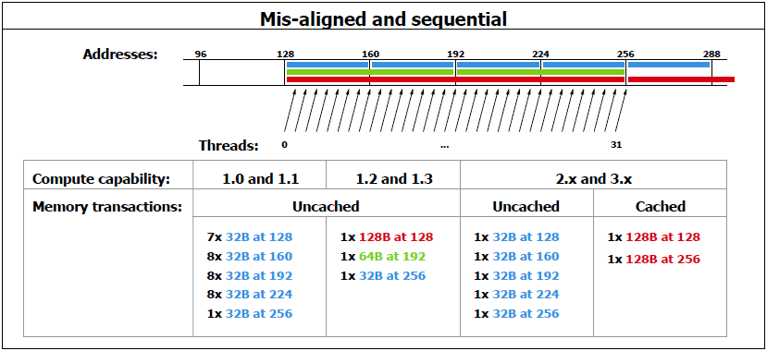
Global Memory
Access Patterns
  Continuous sequential, but misaligned

Slide 13
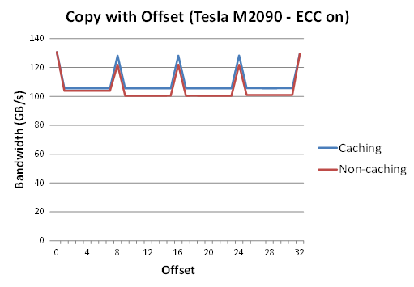
Global Memory
Coalesced Loads Impact

Slide 14
Shared Memory
Memory Shared by SM
  Divided into banks
    Each bank can be accessed independently
    Consecutive 32-bit words are in consecutive banks
      Optionally, 64-bit words division is used (CC 3.x)
  Bank conflicts are serialized
    Except for reading the same address (broadcast)
Compute capability | Mem. size | # of banks | latency
1.x | 16 kB | 16 | 32 bits / 2 cycles
2.x | 48 kB | 32 | 32 bits / 2 cycles
3.x | 48 kB | 32 | 64 bits / 1 cycle
Notes:
In newer architectures (CC 5.x and 6.x), the size of the shared memory may vary a little, but the limit per thread block remains 48kB.

Slide 15
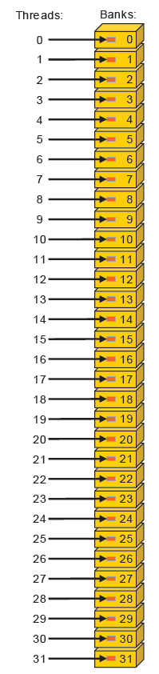
Shared Memory
Linear Addressing
  Each thread in warp access different memory bank
  No collisions

Slide 16
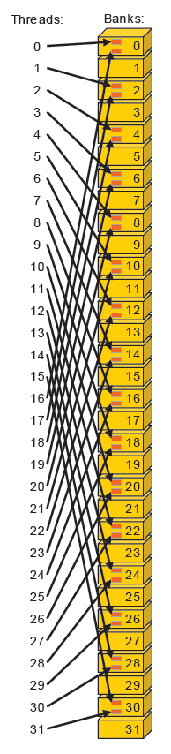
Shared Memory
Linear Addressing with Stride
  Each thread access 2*i-th item
  2-way conflicts (2x slowdown) on CC < 3.0
  No collisions on CC 3.x
    Due to 64-bits per cycle throughput

Slide 17
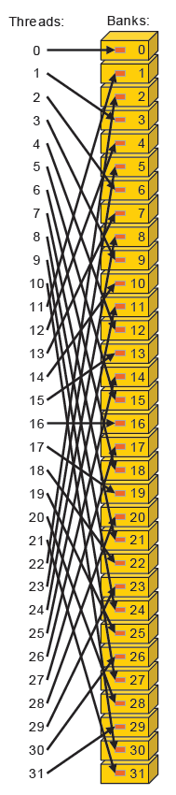
Shared Memory
Linear Addressing with Stride
  Each thread access 3*i-th item
  No collisions, since the number of banks is not divisible by the stride

Slide 18
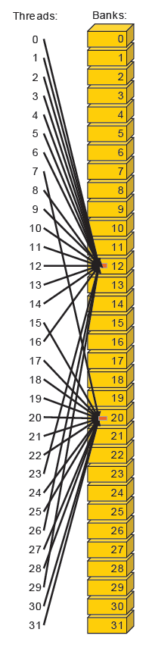
Shared Memory
Broadcast
  One set of threads access value in bank #12 and the remaining threads access value in bank #20
  Broadcasts are served independently on CC 1.x
    I.e., sample bellow causes 2-way conflict
  CC 2.x and newer serve broadcasts simultaneously

Slide 19
Registers
Registers
  One register pool per multiprocessor
    8-64k of 32-bit registers (depending on CC)
    Register allocation is defined by compiler
  All allocated blocks share the registry pool
    Register pressure (heavy utilization) may limit number of blocks running simultaneously
      It may also cause registry spilling
  As fast as the cores (no extra clock cycles)
  Read-after-write dependency
    24 clock cycles
    Can be hidden if there are enough active warps

Slide 20
Local Memory
Per-thread Global Memory
  Allocated automatically by compiler
    Compiler may report the amount of allocated local memory (use --ptxas-options=-v)
  Large local structures and arrays are places here
    Instead of the registers
  Register Pressure
    The registers are spilled into the local memory

Slide 21
Memory Allocation
Global Memory
  cudaMalloc(), cudaFree()
  Dynamic kernel allocation
    malloc() and free() called from kernel
    cudaDeviceSetLimit(cudaLimitMallocHeapSize, size)
Shared Memory
  Statically (e.g., __shared__ int foo[16];)
  Dynamically (by 3rd kernel launch parameter)
    extern __shared__ float bar[];
    float *bar1 = &(bar[0]);
    float *bar2 = &(bar[size_of_bar1]);

Slide 22
Page-locked Memory
Page-locked (Pinned) Host Memory
  Host memory that is prevented from swapping
  Created/dismissed by
      cudaHostAlloc(), cudaFreeHost()
      cudaHostRegister(), cudaHostUnregister()
  Optionally with flags
      cudaHostAllocWriteCombined
      cudaHostAllocMapped
      cudaHostAllocPortable
  Copies between pinned host memory and device are automatically performed asynchronously
  Pinned memory is a scarce resource
Optimized for writing, not cached on CPU
Notes:
On systems with a front-side bus, bandwidth between host memory and device memory is higher if host memory is allocated as page-locked and even higher if in addition it is allocated as write-combining as described in Write-Combining Memory.
Write-combining memory frees up the host's L1 and L2 cache resources, making more cache available to the rest of the application. In addition, write-combining memory is not snooped during transfers across the PCI Express bus, which can improve transfer performance by up to 40%.

Slide 23
Memory Mapping
Device Memory Mapping
  Allowing GPU to access portions of host memory directly (i.e., without explicit copy operations)
    For both reading and writing
  The memory must be allocated/registered with flag cudaHostAllocMapped
  The context must have cudaDeviceMapHost flag (set by cudaSetDeviceFlags())
  Function cudaHostGetDevicePointer() gets host pointer and returns corresponding device pointer
Notes:
Note: Atomic operations on mapped memory are not atomic from the host (or other devices) perspective.

Slide 24
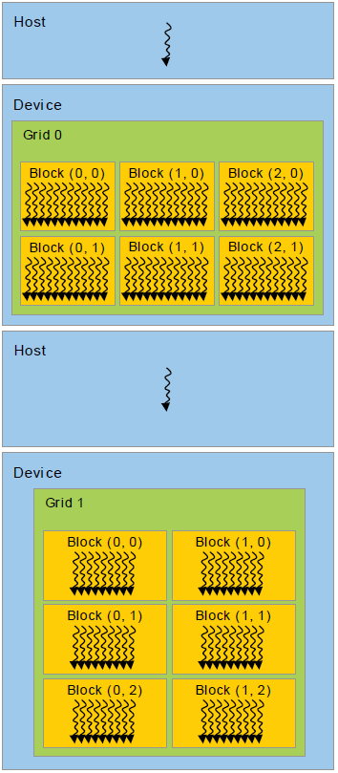
Heterogeneous Programming
GPU
  “Independent” device
  Controlled by host
  Used for “offloading”
Host Code
  Needs to be designed in a way that
    Utilizes GPU(s) efficiently
    Utilize CPU while GPU is working
    CPU and GPU do not wait for each other
Notes:
Remember Amdahl’s Law.

Slide 25
Heterogeneous Programming
Bad Example
  cudaMemcpy(..., HostToDevice);
  Kernel1<<<...>>>(...);
  cudaDeviceSynchronize();
  cudaMemcpy(..., DeviceToHost);
  ...
  cudaMemcpy(..., HostToDevice);
  Kernel2<<<...>>>(...);
  cudaDeviceSynchronize();
  cudaMemcpy(..., DeviceToHost);
  ...
CPU
GPU
Device is doing something useful

Slide 26
Overlapping Work
Overlapping CPU and GPU work
  Kernels
    Started asynchronously
    Can be waited for (cudaDeviceSynchronize())
    A little more can be done with streams
  Memory transfers
    cudaMemcpy() is synchronous and blocking
    Alternatively cudaMemcpyAsync() starts the transfer and returns immediately
    Can be synchronized the same way as the kernel

Slide 27
Overlapping Work
Using Asynchronous Transfers
  cudaMemcpyAsync(HostToDevice);
  Kernel1<<<...>>>(...);
  cudaMemcpyAsync(DeviceToHost);
  ...
  do_something_on_cpu();
  ...
  cudaDeviceSynchronize();
CPU
GPU
Workload balance becomes an issue

Slide 28
Streams
Stream
  In-order GPU command queue
    Asynchronous GPU operations are registered in queue
      Kernel execution
      Memory data transfers
    Commands in different streams may overlap
    Provide means for explicit and implicit synchronization
  Default stream (stream 0)
    Always present, does not have to be created
    Global synchronization capabilities

Slide 29
Streams
Stream Creation
  cudaStream_t stream;
  cudaStreamCreate(&stream);
Stream Usage
  cudaMemcpyAsync(dst, src, size, kind, stream);
  kernel<<<grid, block, sharedMem, stream>>>(...);
Stream Destruction
  cudaStreamDestroy(stream);

Slide 30
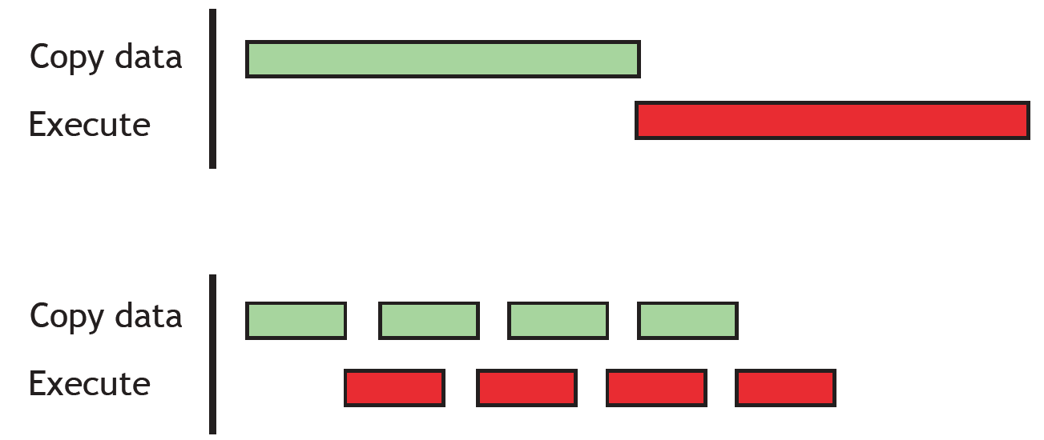
Pipelining
Making a Good Use of Overlapping
  Split the work into smaller fragments
  Create a pipeline effect (load, process, store)

Slide 31
Instruction Set
GPU Instruction Set
  Oriented for rendering and geometry calculations
  Rich set of mathematical functions
    Many of those are implemented as instructions
    Separate functions for doubles and floats
      e.g., sqrtf(float) and sqrt(double)
  Instruction behavior depends on compiler options
    -use_fast_math – fast but lower precision
    -ftz=bool – flush denormals to zero
    -prec-div=bool – precise float divisions
    -prec-sqrt=bool – precise float sqrts
    -fmad=bool – use mul-add instructions (e.g., FFMA)
Single precision floats only

Slide 32
Atomic Instructions
Atomic Instructions
  Perform read-modify-write operation of one 32bit or 64bit word in global or shared memory
  Require CC 1.1 or higher (1.2 for 64bit global atomics and 2.0 for 64bit shared mem. atomics)
  Operate on integers, except for atomicExch() and atomicAdd() which also work on 32bit floats
  Atomic operations on mapped memory are atomic only from the perspective of the device
    Since they are usually performed on L2 cache

Slide 33
Atomic Instructions
Atomic Instructions Overview
  atomicAdd(&p,v), atomicSub(&p,v) – atomically adds or subtracts v to/from p and return the old value
  atomicInc(&p,v), atomicDec(&p,v) – atomic increment/decrement computed modulo v
  atomicMin(&p,v), atomicMax(&p,v)
  atomicExch(&p,v) – atomically swaps a value
  atomicCAS(&p,v) – classical compare-and-set
  atomicAnd(&p,v), atomicOr(&p,v), atomicXor(&p,v) – atomic bitwise operations

Slide 34
Warp Functions
Voting Instructions
  Intrinsics that allows the whole warp to perform reduction and broadcast in one step
    Only active threads are participating
  __all(predicate)
    All active threads evaluate predicate
    Returns non-zero if ALL predicates returned non-zero
  __any(predicate)
    Like __all, but the results are combined by logical OR
  __ballot(predicate)
    Return bitmask, where each bit represents the predicate result of the corresponding thread

Slide 35
Warp Functions
Warp Shuffle Instructions
  Fast variable exchange within the warp
  Available for architectures with CC 3.0 or newer
  Intrinsics
    __shfl_sync() – direct copy from given lane
    __shfl_up_sync() – copy with lower relative ID
    __shfl_down_sync() – copy with higher relative ID
    __shfl_xor_sync() – copy from a lane, which ID is computed as XOR of caller ID
    All functions have optional width parameter, that allows to divide warp into smaller segments

Slide 36
Summary
Right amount of threads
  Saturate SMPs, but avoid registry spilling
SIMT
  Avoid warp divergence
  Synchronization within a block is cheap
Memory
  Host-device transfer overlapping
  Global memory coalesced transactions
  Shared memory banking

Slide 37

Discussion

