Slide 1
OpenMP
Martin Kruliš
Jakub Yaghob

Slide 2
About
OpenMP (http://www.openmp.org)
  API for multi-threaded, shared memory parallelism
  Supported directly by compilers
    C/C++ and Fortran
    Activated by compiler directive (e.g., g++ -fopenmp)
  Three components
    Compiler directives (pragmas)
    Runtime library resources (functions)
    Environment variables (defaults, runtime configuration)

Slide 3
History
Specification versions
  1.0 – C/C++ and FORTRAN versions (1997-1998)
  2.0 – C/C++ and FORTRAN versions (2000-2002)
    Supported by MSVC
  2.5 – combined C/C++ and FORTRAN (2005)
  3.0 – tasks (2008)
  3.1 – additional extensions for tasks and atomics (2011)
  4.0 – SIMD, cancellation, array sections (2013)
  4.5 – Fortran 2003 (2015)
    Widely available (gcc 6+, Intel compilers, clang)
  5.0 – memory model, accelerators (GPU), unified shared memory, iterators, debugger support (2018)
  5.1 – full C++20 and Fortran 2008 support, C++ attributes (2020)
    Partial support (gcc 11, Intel compilers, clang)

Slide 4
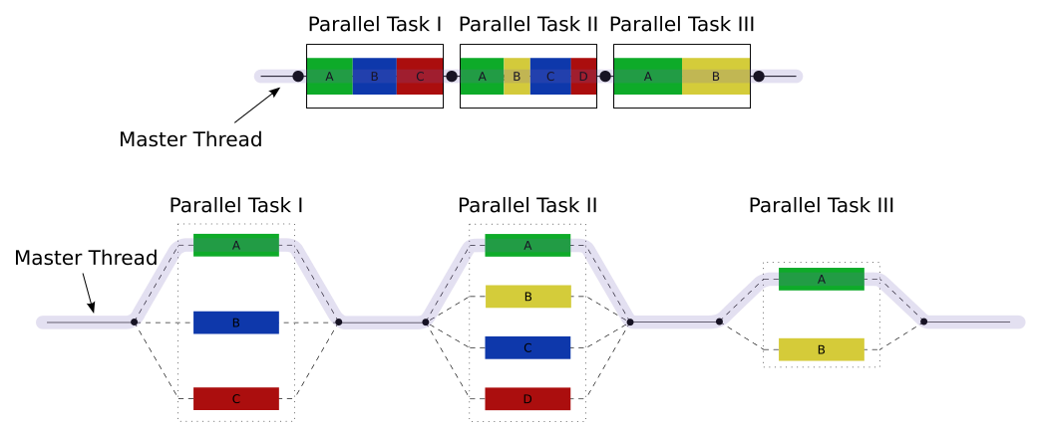
Execution Model
„Team” of threads
Fork/join model
Nested (recursive) fork/joins may be allowed optionally
Threads allocated dynamically, but thread pool may be used to optimize management

Slide 5
Memory model
Relaxed consistency, shared memory model
Memory
  Storage location may by associated with one or more devices
  Only threads on devices may access it
Thread private memory
  Not accessible by other threads
Load/store are not guaranteed to be atomic
Memory operations are considered unordered, unless some defined cases

Slide 6
Pragmas
Basic Syntax
  #pragma omp directive [clause, …]
  Code should work without the pragmas (as serial)
  Pragmas may be used to
    Spawn a parallel region
    Divide workload among threads
    Serialize sections of code
    Synchronization

Slide 7
Directives as C++ attributes
Effort to remove C++ preprocessor
  [[ omp :: directive( directive [clause, …] ) ]]
  or
  [[ using omp : directive( directive [clause, …] ) ]]
  Attribute directives that apply to the same statement are unordered
  Ordering can be imposed
  [[ omp :: sequence( [omp::]directive , [omp::]directive ) ]]

Slide 8
Directives as C++ attributes – demo
[[ omp::sequence( directive(parallel), directive(for)) ]]
for(...) {}
#pragma omp parallel
#pragma omp for
for(...) {}

Slide 9
Parallel Region
Spawning a thread team
  #pragma omp parallel
  {
  int tid = omp_get_thread_num();
  // use tid to do thread’s bidding
  }
  Implicit barrier at the end
  No branching/goto-s that will cause the program to jump in/out to/of parallel blocks
  Regular branching or function calls are OK
Spawns one thread per CPU code by default
Thread index within its team (master == 0)

Slide 10
Variable Scope
Variables Scope
  Private – a copy per each thread
  Shared – all threads share the same variable
    Synchronization may be required
  int x, y, id;
  #pragma omp parallel private(id), shared(x,y)
  {
  id = x + omp_get_thread_num();
  ...
  }

Slide 11
Variable Scope
Private Scope
  Most variables are private by default
    Variables declared inside the parallel block
    All non-static variables in called functions
    Values are not initialized (at the beginning and the end of the block)
      Except for classes (default constructor must be accessible)
Other scopes and additional clauses
  Will be presented later

Slide 12
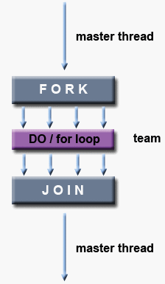
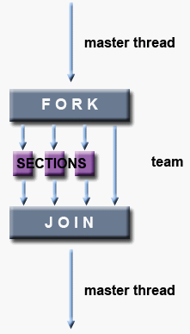
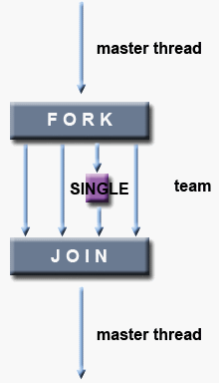
Work-sharing Constructs
Divide the work in parallel block

Slide 13
Work-sharing Constructs
For-loop
  #pragma omp parallel
  {
  #pragma omp for
  for (int i = 0; i < N; ++i) { ... }
  }
  Additional clauses of for directive
    schedule(strategy) – scheduling (work division)
      static, dynamic, guided, runtime, auto
    collapse(n) – encompass nested for-loops
Spawns the threads
Divide for-loop workload among the threads

Slide 14
Work-sharing Constructs
For-loop
  #pragma omp ordered
    A block inside for-loop that must be executed in exactly the same order, as if the code was serial
  #pragma omp parallel for
    Shorthand for both creating parallel block and apply it on a parallel for-loop
    May have clauses applied to both parallel and for directives
    Probably the most often used construct in OpenMP

Slide 15
Work-sharing Constructs
For-loop Pitfalls
  Use #pragma omp for outside of
  #pragma omp parallel block
    Has no effect, there is only one thread available
  Forgetting the for itsef
    #pragma omp parallel
    for (int i = 0; i < N; ++i) { … }
    The entire loop is executed by ALL threads

Slide 16
Work-sharing Constructs
Sections
  Independent blocks of code executed concurrently
  #pragma omp parallel
  {
  #pragma omp sections
  {
  #pragma omp section
  load_player_data();
  #pragma omp section
  load_game_maps();
  ...
  }
  }

Slide 17
Work-sharing Constructs
Single
  Code executed by single thread from group
  #pragma omp parallel
  {
  #pragma omp for
  for (...) ...
  #pragma omp single
  report_progress();
  #pragma omp for
  ...
  }
Only one thread reports the progress

Slide 18
Work-sharing Constructs
Synchronization
  Implicit barrier at the end of each construct
    for, sections, single
  nowait clause
    Removes the barrier

Slide 19
Synchronization Constructs
Synchronization Directives
  To be used within a parallel block
  #pragma omp master
    Region being executed only by master thread
      Similar to #pragma omp single
  #pragma omp critical [name]
    Standard critical section with lock guard
      Only one thread may be in the section at a time
    If name is provided, all sections with the same name are interconnected (use the same lock)

Slide 20
Synchronization Constructs
Synchronization Directives
  #pragma omp barrier
    All threads in a team must meet on a barrier
  #pragma omp atomic
    Followed by a statement like x += expr; or ++x;
    Allowed operations: +, *, -, /, &, ^, |, <<,or >>
  #pragma omp flush [memory-ordering]
    Make sure changes of shared variables become visible
    Executed implicitly for many directives
      barrier, critical, parallel, …

Slide 21
Tasks
Tasks
  Pieces of code that may be executed by a different thread (within a parallel section)
    #pragma omp task
  Additional clauses
    untied – different thread may resume task after yield
    priority(p) – scheduling hint
    depend(list) – tasks that must conclude first
    And few other that control when and who can execute the task

Slide 22
Tasks
Tasks Synchronization
  #pragma omp taskwait
    Wait for all child tasks (spawned in this task)
  #pragma omp taskyield
    Placed as statement inside a task
    The processing thread may suspend this task and pick up another task
  #pragma omp taskgroup
    Spawning thread will not continue unless all tasks in the group are completed

Slide 23
Data Sharing Management
Data-related Clauses
  We already know private and shared
  firstprivate – similar to private, but the value is initialized using the value of the main thread
  lastprivate – value after parallel block is set to the last value, that would be computed in serial processing
  copyprivate – used with single block, last value is broadcasted to all threads

Slide 24
Data Sharing Management
Reduction
  Variable is private and reduced at the end
  #pragma omp ... reduction(op:list)
    Op represents operation (+, *, &, |, …)
      Each operation has its own default (e.g., + has 0)
    List of variables
  Custom reducers
    #pragma omp declare reduction (identifier : typename-list : combiner) [initializer-clause]

Slide 25
Synchronization Constructs
Local Thread Storage
  #pragma omp threadprivate(list)
  Variables are made private for each thread
    No connection to explicit parallel block
    Values persist between blocks
  Variables must be either global or static
  copyin(list) clause (of parallel block)
    Similar to firstprivate
    Threadprivate variables are initialized by master value

Slide 26
Runtime Library
Runtime Library
  #include <omp.h> usually required
Functions
  void omp_set_num_threads(int threads)
    Set # of threads in next parallel region
  int omp_get_num_threads(void)
    Get # of threads in current team
  int omp_get_max_threads(void)
    Current maximum of threads in a parallel region

Slide 27
Runtime Library
Functions
  int omp_get_thread_num(void)
    Current thread index within a team (master == 0)
  int omp_get_num_procs(void)
    Actual number of CPU cores (available)
  int omp_in_parallel(void)
    True, if the code is executed in parallel
  omp_set_dynamic(), omp_get_dynamic()
    Dynamic ~ whether # of threads in a block can be changed when the block is running

Slide 28
Runtime Library
Locks
  Regular and nested locks
    omp_lock_t, omp_nest_lock_t
  Initialization and destruction
    omp_init_lock(), omp_init_nest_lock()
    omp_destroy_lock(), omp_destroy_nest_lock()
  Acquiring (blocking) and releasing
    omp_set_lock(), omp_unset_lock(), …
  Acquiring the lock without blocking
    omp_test_lock(), omp_test_nest_lock()

Slide 29
Environmental Variables
Environmental Variables
  May affect the application without recompilation
  OMP_NUM_THREADS
    Max number of threads during execution
  OMP_SCHEDULE
    Scheduling strategy for for-loop construct
    The loop must have the strategy set to runtime
  OMP_DYNAMIC
    Enables dynamic adjustment of threads in a block

Slide 30
Thread Team Configuration
Actual number of threads in parallel region
  if(condition) clause is evaluated
  num_threads(n) clause is used if present
  omp_set_num_threads() value is used
  OMP_NUM_THREADS env. value is used
  System default (typically # of CPU cores)
Affinity
  Whether threads are bound to CPU cores
  proc_bind(policy) clause
  OMP_PROC_BIND, OMP_PLACES

Slide 31
Nested Parallelism
Nested Parallel Blocks
  Implementations may not support it
  Must be explicitly enabled
    omp_set_nested(), OMP_NESTED
  Nesting depth may be limited
    omp_set_max_active_levels(), OMP_MAX_ACTIVE_LEVELS
  More complex to get the right thread ID
    omp_get_level(), omp_get_active_level(), omp_get_ancestor_thread_num()

Slide 32
SIMD Support
SIMD Instructions
  Generated by compiler when possible
  Hints may be provided by pragmas to loops
    #pragma omp simd, #pragma omp for simd
  Important clauses
    safelen – max. safe loop unroll width
    simdlen – recommended loop unroll width
    aligned – declaration about array(s) data alignment
    linear – declaration of variables with linear relation to iteration parameter
Use both SIMD and parallel for

Slide 33
Accelerator Support
Offload Support
  Execute code on accelerator (GPU, FPGA, …)
    #pragma omp target ...
  Slightly more complicated
    Memory has to be allocated on target device
      And data transferred there and back
    Or memory has to be mapped to target device
  Target device may have more complex thread structure
    OpenMP introduce thread teams directive

