Slide 1
Threading Building Blocks
Martin Kruliš

Slide 2



Introduction
http://threadingbuildingblocks.org/
  Commercial and open source versions
J. Reinders - Intel® Threading Building Blocks: Outfitting C++ for Multi-core Processor Parallelism – O’REILLY 2007

Slide 3
Introduction
C++ library
  Namespace tbb
Templates
Compatible with other threading libraries (pthreads, OpenMP,…)
Works with tasks, not threads

Slide 4
Contents of the Library
Parallel
Algorithms
Flow Graph
Containers
Task Scheduler
Thread Local
Storage
Threads
Sync.
Primitives
Utilities
(Timing,…)
Memory
Allocator

Slide 5
Initialization
None required (starts automatically)
  task_scheduler_init class
    Constructor takes number of threads
    DEPRECATED!
  global_control class
    Constructor takes limit values for
    number of threads and their stack sizes
Optional, for debugging/testing only

Slide 6
Parallel algorithms
parallel_for
parallel_for_each
parallel_reduce, parallel_deterministic_reduce
parallel_scan
parallel_do
pipeline, parallel_pipeline
parallel_sort
parallel_invoke

Slide 7
parallel_for (type 1)
template<typename Range, typename Body>
void parallel_for( const Range& range, const Body& body );
compare to
template <class InIter, class UnaryFunc>
UnaryFunc for_each(InIter first, InIter last, UnaryFunc f);
Range vs. Iterator

Slide 8
Splittable Concept
A splittable object has the following constructor:
  X::X(X& x, Split)
Unlike copy constructor, the first argument is not constant
Divides (splits) the first argument into two parts
  one is stored back into the first argument
  other is stored in the newly constructed object
Applies to both Range and Body
  splitting of a range into two parts (first part into argument, second part into newly created object)
  splitting body to two instances executable in parallel
Notes:
Note that in theory, body does not have to split (be copied) in every pattern. However, the concept is to split the body whenever range splits.

Slide 9
Body
Action (functor) to be executed in parallel
  void Body::operator()(Range& range) const
Unlike STL functor, the argument is a range
  your job is to iterate the range

Slide 10
Range
bool R::empty() const
bool R::is_divisible() const
R::R( R& r, split )
split should create two parts of similar size
  recommendation, not requirement
struct TrivialIntegerRange {
int lower, upper;
bool empty() const { return lower == upper; }
bool is_divisible() const { return upper > lower+1; }
TrivialIntegerRange(TrivialIntegerRange& r, split) {
int m = (r.lower+r.upper) / 2;
lower = m; upper = r.upper; r.upper = m;
}
};

Slide 11
blocked_range<Value>
template<typename Value> class blocked_range;
  Value needs to support:
    copy constructor, destructor
    < (Value, Value)
    + (Value i, size_t k) – k-th value after I
    - (Value, Value) – returns size_t – distance
  Grainsize
    minimal number of elements in a range
  Funkce begin(), end()
    minimal and maximal value – half-closed interval

Slide 12
parallel_for (type 1) – Again
Splits the range until it cannot be split further
  Range::is_divisible()
Creates a copy of body for each subrange
Executes bodies over ranges
Actual splitting and execution is done in parallel in a more sophisticated manner
  Better use of CPU caches

Slide 13

blocked_range - Grainsize
How to determine proper grainsize
  depends on the actual algorithm
  one call ~ at least 10.000 to 100.000 instructions
  set the grainsize to ~10.000
  run on one processor
  halve the grainsize
Repeat steps 2 and 3 and observe slowdown
  the performance decreases with growing overhead (1 core)
  optimal grainsize is considered for 5-10% slowdown
No exact way to get the best value

Slide 14
Partitioners
Other solution to grainsize problem
Third (optional) parameter to parallel_for
Range may not be split to the smallest parts
  simple_partitioner (default) – split to the smallest parts
  auto_partitioner – enough splits for load balancing, may not provide optimal results
  affinity_partitioner – same as auto_partitioner but better cache affinity

Slide 15
parallel_for (type 2)
template<typename Index, typename Func>
void parallel_for(Index first, Index last, Index step, const Func& f);
template<typename Index, typename Func>
void parallel_for(Index first, Index last, const Func& f);
Index must be an integral type
Semantics:
for (auto i=first; i<last; i+=step) f(i);

Slide 16
parallel_reduce<Range,Body>
template<typename Range, typename Body>
void parallel_reduce(const Range& range,
const Body& body);
Similar to parallel for, but returns a result
Example: sum of all values
New requirement for Body
void Body::join(Body& rhs);
  join two results into one

Slide 17
parallel_reduce<Range,Body>
template<typename Range, typename Body>
void parallel_reduce(const Range& range,
const Body& body);
One body may process more ranges (seq.)
operator() and join() can run parallel with splitting constructor (but not each other)
  does not cause problems in most cases
Noncomutative operatation ⊕
  left.join(right) should produce left ⊕ right

Slide 18
parallel_reduce (type 2)
template<typename Range, typename Value, typename Func, typename Reduction>
void parallel_reduce(const Range& range,
const Value& identity, const Func& f,
const Reduction& reduction);
Identity is the left identity element for left operator of Func::operator()
Value Func::operator() (const Range& range, const Value& x) accumulates subrange to the result starting with value x
Value Reduction::operator() (const Value& x, const Value& y)
Lambda-friendly, more data copying

Slide 19
parallel_scan<Range,Body>
y₀ = id⊕ ⊕ x₀, y_{i} = y_{i−1} ⊕ x_{i}
⊕ needs to be associative
x
y
final scan
pre-scan
pre-scan
+
+
final scan
final scan
final scan

Slide 20
parallel_do
template<typename InIter, typename Body>
void parallel_do(InIter first, InIter last, Body body);
Different Body than e.g. parallel_for
  operator() is unary and must be reentrant
    Optional 2nd argument is feeder, which is used to add more work that is process by subsequent calls (for better scalability)
  no splitting
Not suitable for trivial operations
  less than 10.000 instructions in Body::operator()
Notes:
Replaces parallel_while algorithm, which is currently deprecated.

Slide 21
parallel_for_each
Like STL’s for_each
  Same semantics, except for parallel processing
  Equivalent with parallel_do
    But without feeder

Slide 22
pipeline
Sequence of filters
class pipeline {
public:
void add_filter(filter& f);
void run(size_t max_num_of_live_tokens);
};
Filters are serial or parallel
  serial is either in-order or out-of-order
Filters derive from class filter and override virtual
void* operator()(void *item);
  the first filter’s operator() is called repeatedly until it returns NULL
  the results returned by the last filter are ignored

Slide 23
parallel_pipeline
Strongly typed lambda-friendly pipeline
void parallel_pipeline(
size_t max_number_of_live_tokens,
const filter_t<void,void>& filter_chain);
Filters
  combined using & operator
  same modes as original pipeline
  input and output type (first and last are voids)
  functor for the action

Slide 24
parallel_pipeline
float RootMeanSquare(float* first, float* last) {
float sum=0;
parallel_pipeline(/*max_number_of_live_token=*/16,
make_filter<void,float*>(filter::serial,
[&](flow_control& fc) -> float* {
if (first < last) return first++;
else { fc.stop(); return nullptr; }
}
) &
make_filter<float*,float>(filter::parallel,
[](float* p){ return (*p)*(*p); }
) &
make_filter<float,void>(filter::serial,
[&](float x) { sum += x; }
)
);
return sqrt(sum);
}
Notes:
First filter is a special case as it controls the flow. It gets special control_flow structure, which is used for signaling that there are no more data to process (fc.stop()).

Slide 25
Flow graph
Generalization of the pipeline
  arbitrary oriented graph
  nodes and explicit (dataflow) connections
More complex rules for execution
  e.g., no explicit “number of live tokens”
Pre-defined set of node types
  function, join, limiter,…
See the documentation…

Slide 26
parallel_sort
template<typename RndAccIter>
void parallel_sort(RndAccIter begin, RndAccIter end);
template<typename RndAccIter, typename Compare>
void parallel_sort(RndAccIter begin, RndAccIter end,
const Compare& comp);
  Parallel unstable sort
  Average time complexity of O(N log (N))
  Usage:
parallel_sort(a, a + N);
parallel_sort(b, b+N, std::greater<float>());

Slide 27
parallel_invoke
Parallel invocation of 2 to 10 functors
  May be used to invoke completely different tasks in a simple manner
  tbb::parallel_invoke(
  myfunc1,
  []{ bar(2); },
  []{ bar(3); },
  );

Slide 28
Containers
concurrent_unordered_map<Key,Val,Hash,Eq,Alloc>
concurrent_unordered_set<Key,Hash,Eq,Alloc>
concurrent_hash_map<Key,T,HashCompare,Alloc>
concurrent_queue<T,Alloc>
concurrent_bounded_queue<T,Alloc>
concurrent_priority_queue<T,Compare,Alloc>
concurrent_vector<T>
Selected operations are thread-safe
Can be used with “raw” threads, OpenMP,…
Designed for high concurrency
  fine grained locking, lock-free algorithms
Higher overhead than STL (due to concurrency)

Slide 29
concurrent_vector
Concurrent growth and access
Careful with exceptions
  Special rules for item constructors and destructors
Existing elements are never moved
  iterators and references not invalidated by growth
  results in fragmentation – call compact()
Copy construction and assignment are not thread-safe

Slide 30
concurrent_vector
grow_by(size_type delta [, const T& t]);
  adds delta elements (atomically) to the end of vector
  returns original size of the vector … k
  new elements have indexes [k,k+delta)
size_t push_back(const T& value);
  atomically ads copy of value to the end of the vector
  returns index of the new value
access
  operator[], at, front, back – all const and non-const
  can be called concurrently while the vector grows
  may return reference that is currently being constructed!

Slide 31
concurrent_vector
range (const and non-const)
  used in parallel algorithms
size()
  number of elements, including those currently being constructed
standard ISO C++ random access iterators

Slide 32
concurrent_queue
push, try_pop
  non-blocking
No STL-like front and back
  can’t be made thread-safe
  unsafe_begin, unsafe_end, unsafe_size
concurrent_bounded_queue
  added later, originally concurrent_queue was bounded
  limits the maximal number of elements in queue
  push and pop are blocking
    active lock used for blocking operations – should not wait long!
  size() returns number of pushes minus number of pops
Notes:
Note that size() may return negative number.

Slide 33
concurrent_queue
Order of items partially preserved
  if one threads pushes X before Y and another thread pops both values, then X is popped before Y
Provides iterators
  for debugging only, invalidated on modification
  STL compliant iterator and const_iterator
To be used wisely
  maybe parallel_do or pipeline can be used as well
  parallel algorithms perform better – avoid one bottleneck (the queue), better use caches, …
  resist the temptation to implement producer-consumer
  (or similar) algorithms

Slide 34
concurrent_priority_queue
Similar to STL priority_queue
  With fixed underlying container
  try_pop() instead of pop()
  thread-unsafe empty() and size()

Slide 35
concurrent_unordered_map
Similar to std::unordered_map
Insertion and iteration are safe
  Even combined
  Insertion does not invalidate iterators
Erasing is unsafe
No visible locking
Same analogy goes for unordered_set

Slide 36
concurrent_hash_map
template<typename Key, typename T,
typename HashCompare, typename Alloc>
class concurrent_hash_map;
Provides accessors
  const_accessor and accessor
  smart pointer with implicit lock (read or RW lock)
  cannot be assigned or copy constructed
  operators * and ->
  explicit release of locks – call release()
    if points “to nothing” – can be tested by empty()

Slide 37
concurrent_hash_map
Concurrent operations
  find (returns const or non-const accessor)
  insert (returns const or non-const accessor)
  erase
  copy constructor
    the copied table may have operations running on it
range(size_t grainsize)
  returns (constant or non-constant) range that can be used for parallel algorithms to iterate over contents of the map
  cannot be run concurrently with other operations
Forward iterators – begin(), end()

Slide 38
Memory Allocation
Optional part of the library
  C++ and STL compliant allocators
  C functions (malloc and free)
template<typename T, size_t N>
class aligned_space;
  variable that has size big enough to contain N elements of type T cache-aligned in memory
  T* begin(), T* end()
    actual begin and end of the aligned data
  to be used as a local variable or field

Slide 39
Memory Allocation
scalable_allocator
  each thread has its own memory pool
    no global lock, prevents false sharing of private memory
cache_alligned_allocator
  all functionality of scalable_allocator
  aligns memory to cache lines
    prevents false sharing of separate allocations
    always pads data to cache line size (usually 128bytes) !
  use only when it proves to be needed
tbb_allocator
  uses scalable_allocator if possible (TBB malloc is present) or the standard malloc/free
Notes:
The allocators have also standard C interface.

Slide 40
Explicit Synchronization
Mutexes
  mutex
  recursive_mutex
  spin_mutex
  queuing_mutex
  spin_rw_mutex
  queuing_rw_mutex
atomic<T>
  provides atomic operations over a type
    fetch_and_increment, compare_and_swap, operator++, operator+=, …

Slide 41
Mutexes
Many variations
  different implementation (OS / user space, …)
  different semantics (simple/recursive, fair/unfair, plain/read-write)
Scoped locking pattern
  acquired lock is represented by an object
  no explicit unlocking – less prone to errors
  exception safe

Slide 42
Thread Local Storage
Separate variable for each thread
  lazily created (on demand)
combinable<T>
  reduction variable, each thread has a private copy
  combined using a bin. functor or unary (for_each)
enumerable_thread_specific<T>
  container with element for each thread (lazy)
  can access either local value or iterate all values
  may be combined using a binary functor

Slide 43
Timing
Thread-safe timing routines
Classes tick_count and tick_count::interval_t
tick_count t0 = tick_count::now();
... action being timed ...
tick_count t1 = tick_count::now();
printf("time for action = %g seconds\n",
(t1-t0).seconds());

Slide 44
Task Scheduling
Task scheduler assigns tasks to threads
Maintains task graph
  directed graph of dependent task
  parent node can start only when all children have finished
class task {
public:
task* execute();
};

Slide 45
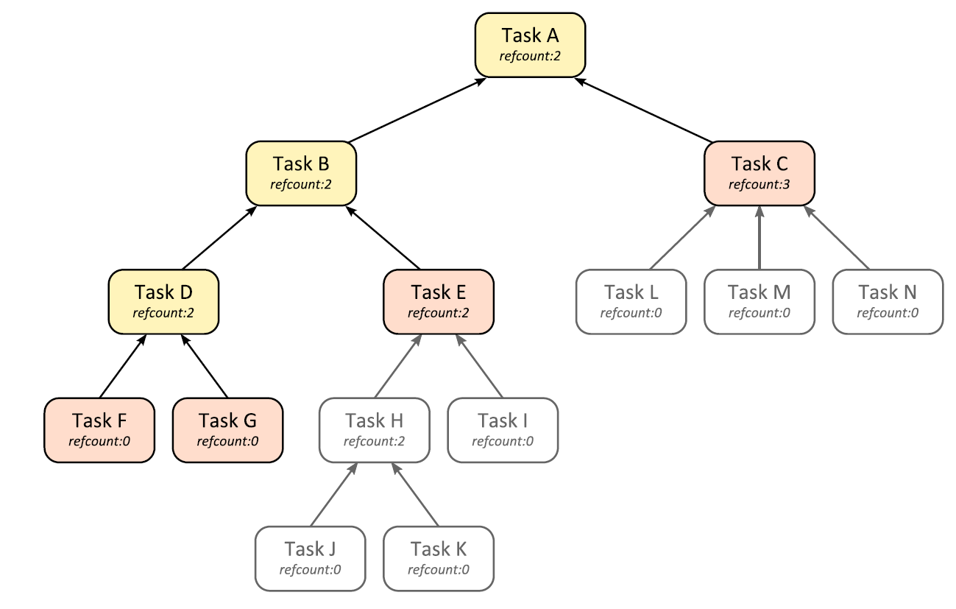
Task Scheduling
Example of a task graph

Slide 46
Task Scheduling
TBB offer interface to directly work with tasks
Used to explicitly create tasks and their relations
Declarative
  provides data to the task scheduler
  does not control the scheduler itself

Slide 47
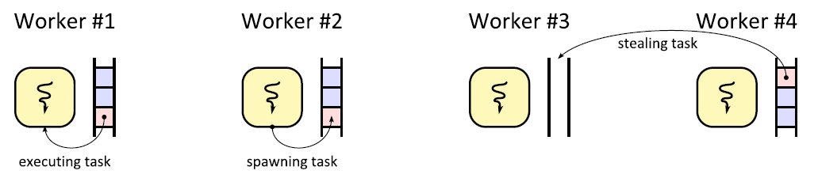
Task Scheduling
Each thread has its own pool of ready tasks
  task is ready when it has no children
  new tasks are spawned to the front of the stack
  tasks are stolen from the end of the stack

Slide 48
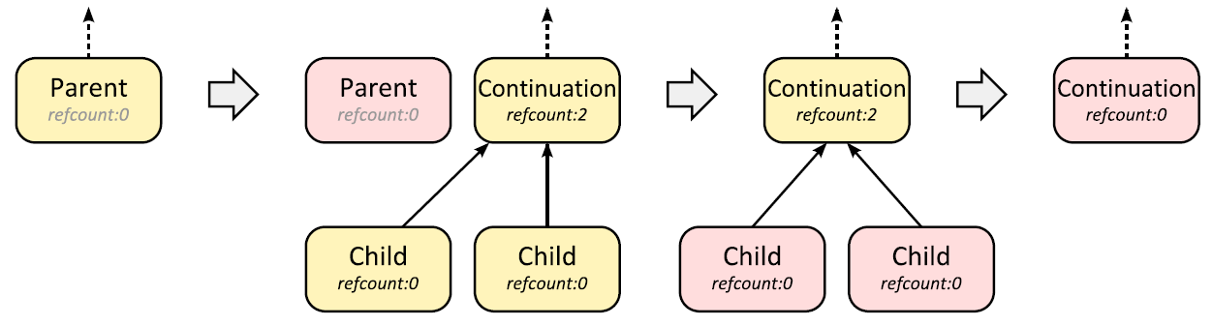
Spawning Child Tasks
Spawning children with continuation
  Parent spawns children and continuation task
  Continuation is executed automatically when children terminate

Slide 49
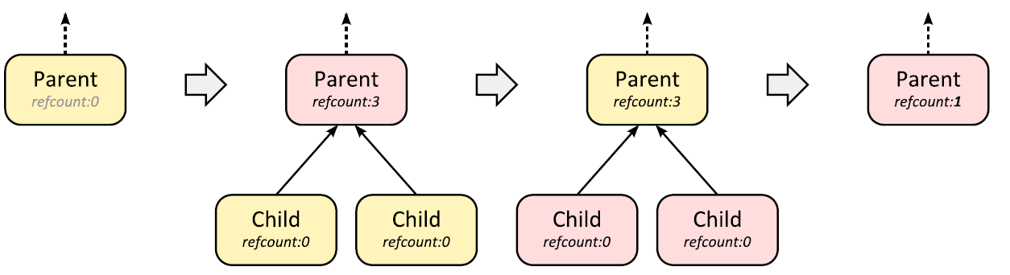
Spawning Child Tasks
Blocking task spawning
  Parent spawns the children
  Blocks on wait operation until the children terminate

Slide 50
Task Scheduling
Summary
  other algorithms (parallel_for, …) are translated into tasks
    therefore, the algorithms can be easily nested
    use tasks explicitly only if you cannot fit any of the parallel algorithms provided
  task as scheduled non-preemptively
    should not block

