Slide 1
SYCL: SYstem-wide
Compute Language
Since 2020, it has been considered a name, not an acronym…
NPRG042: Programming in Parallel Environment
Martin Kruliš

Slide 2
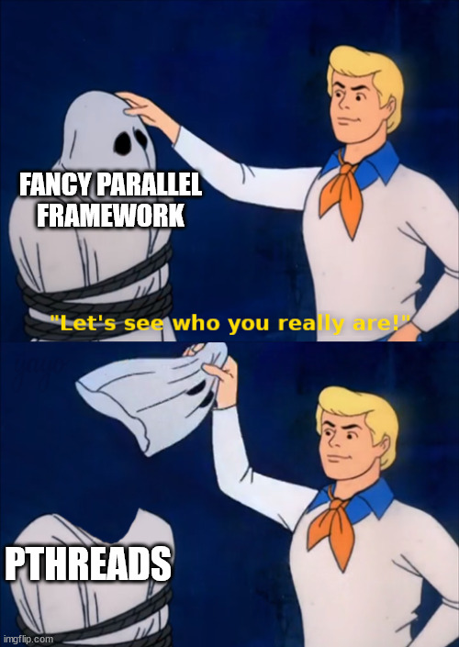
Motivation
Parallel programming is getting out of hand
  Many device types (CPU, GPU, FPGA, …)
  Even similar devices (GPUs) have different approaches (NVIDIA vs AMD)
Holy grail of parallel computing
  Universal parallel framework
    Allowing code migration across devices
    Enabling all low-level optimization
  Raises lots of issues
    Coding model, portability, device discovery, compilation

Slide 3
History
1985 – First commercial FPGA
1996 – 3Dfx Voodoo 1 (computing GPU)
2001 – GPU has programmable parts
2003 – First desktop multicore CPUs
2006 – Unified shader architecture in HW
2006 – Ageia PPU (PhysX) accelerator
2007 – NVIDIA CUDA, AMD Stream SDK
2009 – OpenCL, Direct Compute
2011 – Intel Xeon Phi (Knights Ferry)
2012 – NVIDIA Kepler Architecture (CC 3.5)
2013 – OpenMP 4.0 (accelerator support)
2014 – SYCL announced
2015 – Intel buys Altera (an FPGA co.)
2016 – ROCm (from AMD)
2018 – NVIDIA Volta architecture
2020 – Intel oneAPI launched
2020 – NVIDIA Ampere architecture
2022 – Latest version of SYCL

Slide 4
About SYCL
High-level parallel programming model
  Extends (modern) C++, requires special compiler
    Platform and device detection
    Buffer (data) management
    Kernel (function) compilation and execution
    Synchronization, dependency management, scheduling
  Single source (both host control and device code)
  It’s a standard (not a library)
    Multiple implementations exist (we will use Intel oneAPI)
  Target many heterogeneous platforms
    CPU, GPU, FPGA, …

Slide 5
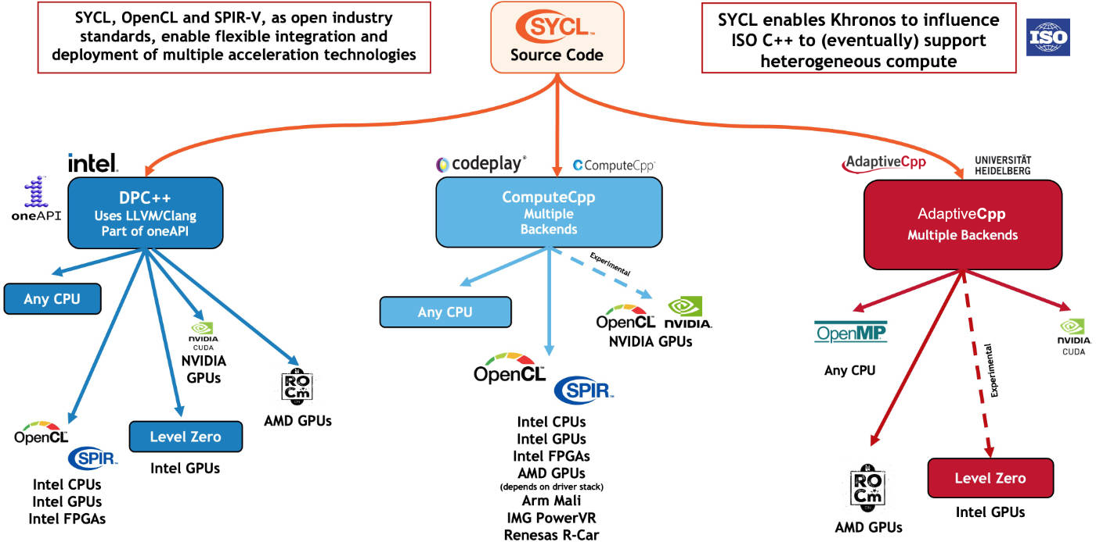
About SYCL
from https://www.khronos.org/sycl/

Slide 6
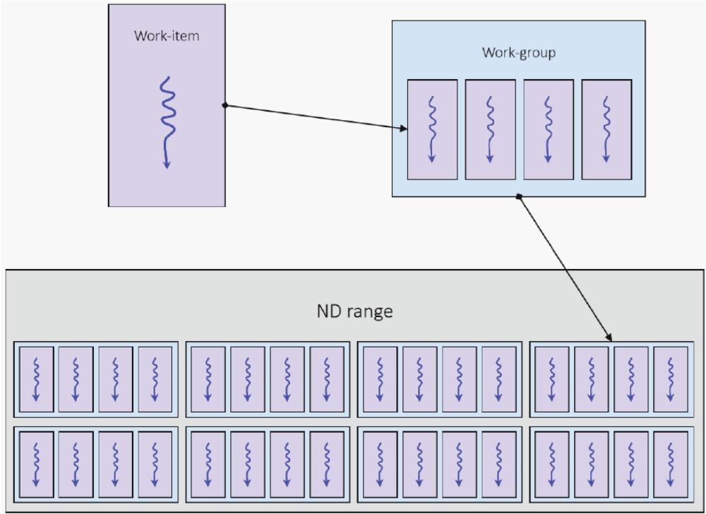
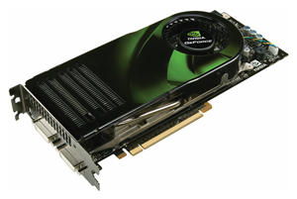
Computing Model
A function to be executed on the device
Kernel
SYCL
Handles compilation and execution
queue
device
The kernel can be executed as a single task, but we usually use data parallelism

Slide 7
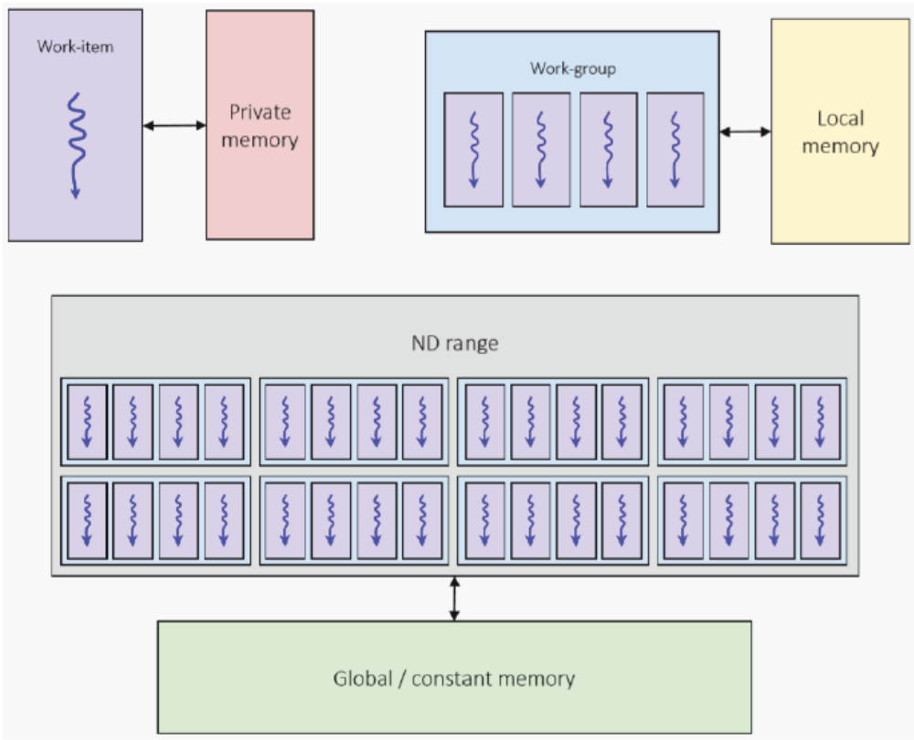
Memory Model
Types of memory
  Private memory
    Local variables of a kernel function
  Local memory
    Special, shared among work-group
  Global memory
    Buffers shared by the whole range
    Can be transferred to/from host
  Constant memory
    Global, read-only

Slide 8
Queues
Queue
  Interface for commands
  Associated with one device
  Out of order by default
    in_order property for constructor
Command groups
  Series of commands that need to be executed in a particular order
    Kernel execution
    Copying data
    Waiting for other commands
sycl::queue gpuQueue(
sycl::gpu_selector_v
);
gpuQueue.submit(
[&](sycl::handler &h){
// copy data
// execute kernel
}
);
Easiest way, selector is a function for ranking devices
The lambda is the command group factory

Slide 9
Kernel Execution
Kernel
  Lambda or class with operator()
    Not fnc pointer nor std::function
    Must capture/store by value
    No dynamic allocation
    No dynamic polymorphism
    No recursion
  At most one kernel in CG
  Lambdas can be named by classes
class name_holder {};
q.submit([&](sycl::handler &h) {
h.single_task<name_holder>([=]() {
// kernel code
});
}).wait();
struct my_kernel {
void operator()(){
// kernel code
}
};
...
q.submit([&](sycl::handler &h) {
h.single_task(my_kernel{});
}).wait();

Slide 10
Kernel Execution
Data parallelism
  Executes the same kernel in many threads (work items)
  Kernel is given an index
    May have up to 3 dimensions
    May be hierarchical (work-groups)
  sycl::id – simple index
  nd_item indexation
    get_global_id()
    get_local_id()
    …
q.submit([&](sycl::handler &h) {
h.parallel_for(1024, [=](auto i) {
acc[i] = ...
});
}).wait();
h.parallel_for(sycl::range{32, 32},
[=](sycl::id<2> i) {
accTo2DBuf[i] = ...
});
h.parallel_for(sycl::nd_range<1>{
sycl::range<1>{1024}, // global
sycl::range<1>{64}, // local
}, [=](sycl::nd_item<1> item) { ...

Slide 11
Memory Abstraction
Buffer
  Logically detached from physical mem.
    Usually have 1 copy in host memory
  May be in multiple copies
  Transferred as needed
    Or explicitly
Accessor
  Used to access buffer in kernel
  Announcement of intention
    So SYCL may transfer the data
Command
group
Device memory
Accessor
Buffer
Host memory
Transferred back explicitly or when the buffer is destroyed

Slide 12
Memory Abstraction
Buffer construction
  Tied to a host memory
Accessor
  Mem. usage specifiers
  Acts as a smart pointer
Explicit copying
Host accessor
sycl::buffer<float, 1> buf(ptr, size);
// in the command group
sycl::accessor acc(buf, handler,
sycl::write_only, sycl::no_init);
float f = acc[i];
handler.copy(acc, hostPtr);
auto hacc = buf.get_host_access();

Slide 13
Synchronization
Host side
  queue.wait();
  Events
    Returned by queue operations
    auto event =
    queue.submit(…);
    event.wait();
    Events can be passed as dependencies to some operations
    queue.submit(…, event, …)
In kernel
  Barriers
    nd_item::barrier()
    Only within the work group!
  Atomic operations
    Similar to C++
    auto v = sycl::ext::oneapi::atomic_ref
    <int,order,scope,space>(a[0]);
    v += something;
    NEVER implement a global barrier using atomics (causes DEADLOCK)!

Slide 14
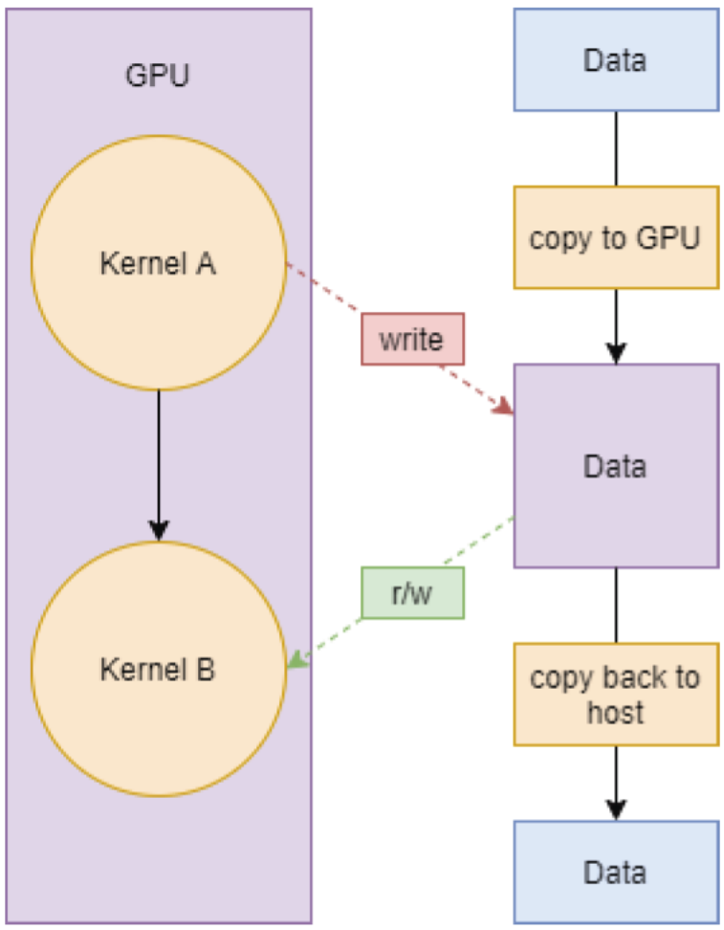
Data dependencies
Data dependencies tracking
  Tracked by buffers
  Accessors express the kernel’s intent to use them
  Scheduler executes CG (kernels) with respect to these dependencies
  Example (on the right)
    Read-after-write dependency between A and B
    B is executed when A finishes

Slide 15
Error Handling
Errors = exceptions
  Synchronous
    In user (main) thread
  Asynchronous
    Thrown by the scheduler
    Exception handler may be passed to the queue
    Used to re-throw exceptions in the main thread
    Invoked by special methods of the queue
static auto exception_handler =
[](sycl::exception_list l)
{
for (std::exception_ptr const &e : l){
try {
std::rethrow_exception(e);
}
catch (std::exception const &e) {
std::terminate();
}
}
};
...
sycl::queue q(sycl::default_selector_v,
exception_handler);
q.throw_asynchronous();
q.wait_and_throw();

Slide 16
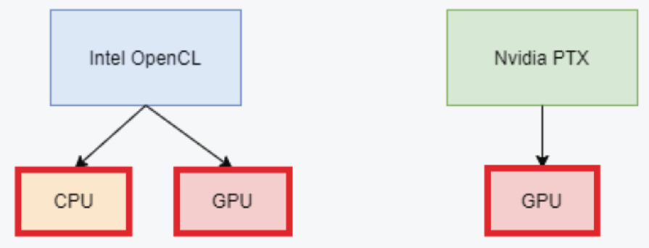
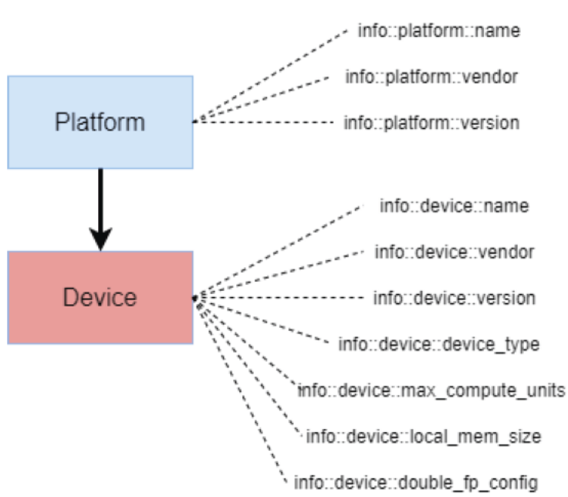
Device Detection
Platform
  An implementation of SYCL
  sycl::platform::get_platforms();
Device
  myPlatform.get_devices();
  sycl::device(sycl::gpu_selector_v);
Selectors
  int fastest_gpu(const sycl::device &d) {
  if (d.is_gpu())
  return //… compute gpu speed rank
  else
  return -1;
  }

Slide 17
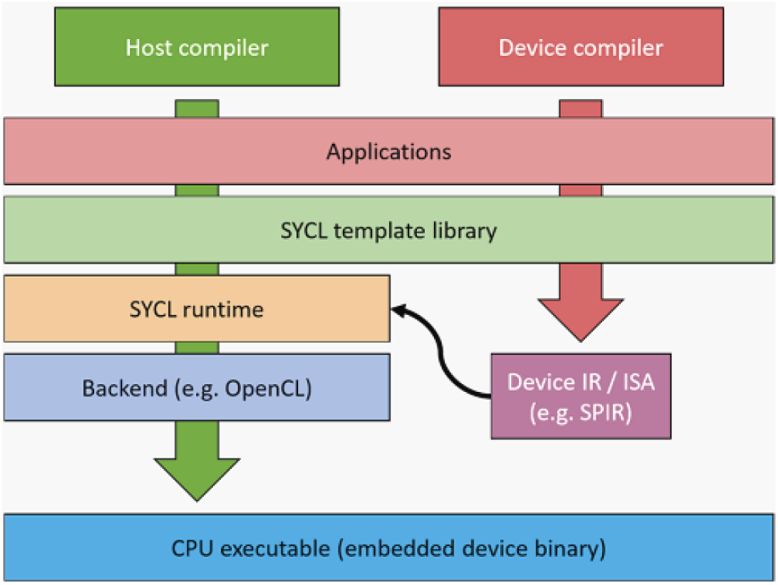
Compilation
Special compiler required
  icpx –fsycl
  -fsycl-targets=spir64_x86
  _64,nvptx64-nvidia-cuda
  Kernels are compiled in intermediate representation
    Specified by target (backend)
  SPIR
    Standard Portable Intermediate Representation (by Khronos)
    Used in OpenCL, Vulkan, …
    Current version SPIR-V

Slide 18
References
Khronos
  https://www.khronos.org/sycl/
SYCL Academy
  https://github.com/codeplaysoftware/syclacademy
  Most diagrams in this presentation were borrowed from them
Intel oneAPI
  https://www.intel.com/content/www/us/en/developer/tools/oneapi/base-toolkit.html

Slide 19

Discussion

