Slide 1
Everyday Parallel Programming in C# and .NET
NPRG042: Programming in Parallel Environment
Martin Kruliš

Slide 2
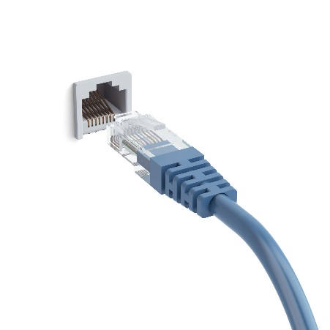


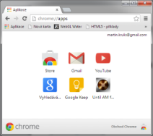


Everyday Parallel Programming
Modern applications need to perform many tasks simultaneously
Handling network I/O
Main thread, event loop
Intensive computations
(rendering, data preprocessing,
data analysis, ML tasks, …)
User interface
Rest of the course will focus on this
Files (I/O)
Database (heavy I/O)

Slide 3
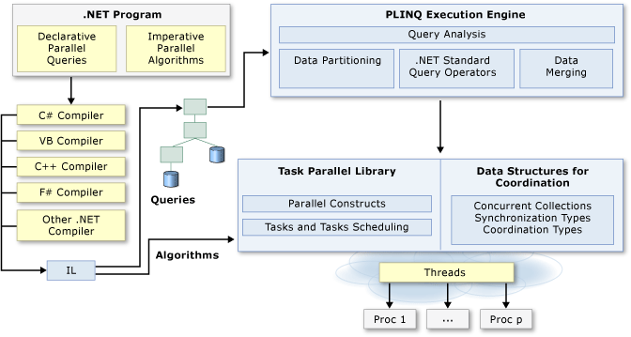
Parallel Programing in .NET
Notes:
Source: https://docs.microsoft.com/en-us/dotnet/standard/parallel-programming/

Slide 4
Common Threads
Thread class
  Constructor expects a delegate to execute
  Has to be explicitly started (Start() method)
  Foreground vs background threads
    IsBackground property
    Applications ends when all foreground threads end
    Background threads are killed when app terminates
  Waiting for termination
    Join() – optionally with timeout
    Abort() – throws aborting exception inside threads
  Thread.CurrentThread
Deprecated! Use cancelation token...
Notes:
https://docs.microsoft.com/en-us/dotnet/api/system.threading.thread?view=netframework-4.8

Slide 5
Common Threads
Thread class
  Priority
  Suspend(), Resume()
  Sleep(), Interrupt()
  Yield()
  VolatileRead(), VolatileWrite(), volatile
Basic synchronization
  lock (object) {
  // critical section bound to object
  }
Deprecated! Not safe.
Notes:
https://docs.microsoft.com/en-us/dotnet/csharp/language-reference/keywords/lock-statement

Slide 6
Synchronization Primitives
System.Threading namespace
  Monitor, Mutex, ReaderWriterLock, Semaphore
  ReaderWriterLockSlim, SemaphoreSlim
  Barrier
  AutoResetEvent, ManualResetEvent, EventWaitHandle, CountdownEvent
    Thread can wait on the event until it is signaled
  Interlocked – provides atomic operations
  ThreadLocal<T>, AsyncLocal<T>
  CancelationToken
Slim versions are better
Notes:
https://docs.microsoft.com/en-us/dotnet/api/system.threading?view=netframework-4.8

Slide 7
Thread Pool
ThreadPool class
  Often better alternative to individual threads
    Especially for non-blocking tasks
    Only uses background threads
  Used automatically in many situations
    Task execution (including async/await handling)
    Asynchronous timers
    Registered wait handlers’ callbacks
  Can be used manually
    ThreadPool.QueueUserWorkItem(proc)
    Passing a WaitCallback delegate
Quite crude, Tasks are usually better…

Slide 8
Parallel Constructs
Parallel class
  Parallel.For(0, N, methodOrDelegate);
  Parallel.For(0, N, i => { ... });
    Parallel equivalent of for construct
  Parallel.ForEach(enum, x => { ... });
    Parallel equivalent of foreach construct
  Parallel.Invoke(actions)
    Invokes an array of delegates concurrently
Notes:
https://docs.microsoft.com/en-us/dotnet/api/system.threading.tasks.parallel?view=netcore-3.1
https://docs.microsoft.com/en-us/dotnet/standard/parallel-programming/custom-partitioners-for-plinq-and-tpl?view=netcore-3.1

Slide 9
Tasks
Task, Task<Result> classes
  Independent encapsulated jobs executed by a thread pool in the background
  Separate creation and execution
    Task t = new Task(action, …);
    t.Start();
  Other ways how to create/start a task
    Task.Run(action) – creates and executes a task
    Task.Factory.StartNew() – also creates and executes
    t.RunSynchronously() – run a task in the current thread immediately
Notes:
https://docs.microsoft.com/en-us/dotnet/api/system.threading.tasks.task?view=netframework-4.8#Instant
Task.Factory.StartNew() is older, Run method is preferred.

Slide 10
Tasks
Synchronization
  Wait()
    Optionally with timeout and/or cancelation token
  Task.WaitAny(tasks), Task.WaitAll(tasks)
Dependencies
  var t2 = t1.ContinueWith(action)
    Create new task which is a continuation of given task
  Task.WhenAny(tasks), Task.WhenAll(tasks)
    Create a task which is executed when any of/all given tasks terminate

Slide 11
Tasks
Task Scheduling
  Global queue + Local Queues (similar to TBB)
  Employs work stealing for load balancing
  Task inlining (sync. execution in waiting thread)
  TaskScheduler class
    Some actions may be given a scheduler object
      Start(), ContinueWith(), …
    TaskScheduler.FromCurrentSynchronizationContext
      Returns scheduler related to sync. context of the current thread
      Very useful for UI (WinForms, WPF) – allows a specific task to be executed in the main thread (to operate UI controls)
Oops, lectures causality violation!
Notes:
https://docs.microsoft.com/en-us/dotnet/api/system.threading.tasks.taskscheduler?view=netframework-4.8

Slide 12
Concurrent Data Structures
System.Collections.Concurrent namespace
  ConcurrentBag<T>
    Unordered collection
  ConcurrentDictionary<K,V>
    AddOrUpdate(), GetOrAdd(), TryUpdate(), TryRemove()
  ConcurrentQueue<T>
  ConcurrentStack<T>
  BlockingCollection<T>
    Collection for producer/consumer problems

Slide 13
Asynchronous Programming
Similar (or even the same) constructs can be found in other languages (JavaScript, Python, Rust, C++, Scala, Swift…)
Asynchronous functions
  public async Task<Res> foo() { ... }
  Can be suspended in the middle (see await)
  Note that instead of result, it yields a task
Waiting for tasks
  var t = somethingThatReturnsTask();
  var res = await t;
  Suspends the code until a result of a task become available
    Does not block the physical thread (core)
  Only available in async functions
Unlike Wait()
Notes:
https://docs.microsoft.com/en-us/dotnet/csharp/programming-guide/concepts/async/
https://docs.microsoft.com/en-us/dotnet/csharp/language-reference/keywords/async
https://docs.microsoft.com/en-us/dotnet/csharp/language-reference/operators/await

Slide 14
Dataflow
Dataflow package
  Data-passing pipeline-like parallel model
  Data are passed through the flow in messages
  Dataflow blocks – buffer and process the data
    ISourceBlock<TOut> - read-only
    ITargetBlock<TIn> - write-only
    IPropagatorBlock<TIn, TOut> - source & target
  Blocks can be linked into pipelines or even graphs
    ISourceBlock<TOut>.LinkTo(target)
    Arbitrary number of links (0:N)
    Optionally may receive a filtering predicate
Installed as a separate NuGet package
Notes:
https://docs.microsoft.com/en-us/dotnet/standard/parallel-programming/dataflow-task-parallel-library

Slide 15
Dataflow
Programming Model
  Source block calls OfferMessage() of target
    Message can be accepted, rejected, or postponed
    Postponed messages can be reserved for later
      ISourceBlock.ReserveMessage()
    Reserved messages should be later processed
      ISourceBlock.ConsumeMessage(), ReleaseReservation()
  Sending messages externally (outside the dataflow)
    Post(), SendAsync()
    Receive(), ReceiveAsync(), TryReceive()
  Support for the completion concept
    Completion may propagate and can be waited for
Notes:
https://docs.microsoft.com/en-us/dotnet/standard/parallel-programming/walkthrough-creating-a-custom-dataflow-block-type

Slide 16
Dataflow
Predefined blocks
  Buffering
    BufferBlock<T> - generic buffer
    BroadcastBlock<T> - holds only the most recent value
    WriteOnceBlock<T> - holds the first written value
  Execution
    ActionBlock<TIn> - calls a delegate on receive
    TransformBlock<TIn, TOut> - gets a delegate which acts as map() function
    TransformManyBlock<TIn, TOut> - similar to TransformBlock, but produces zero or more outputs per each input value

Slide 17
Dataflow
Predefined grouping blocks
  BatchBlock<T>
    Reads a given number of messages and returns them as an array
  JoinBlock<T1, T2>, JoinBlock<T1, T2, T3>
    Does not implement ITargetInput, but provides Target1, Target2 (and Target3) properties with this interface
    Zips given messages in tuples
  BatchedJoinBlock<T1, T2> (or <T1, T2, T3>)
    Combination of batch and join block
    Produces an array of tuples

Slide 18
PLINQ
Parallel Language-Integrated Queries
  LINQ – SQL-like in-memory lazy-evaluated queries conducted on enumerable containers
  Parallel LINQ can resolve the queries concurrently
    var res = from x in data.AsParallel()
    where x > 10 select x;
    PLINQ may choose seq. evaluation based on heuristics, but we can override by selecting the execution mode or even selecting the degree of parallelism
  Enforcing ordering
    .AsParallel().AsOrdered()
  query.ForAll() instead of using foreach
Notes:
https://docs.microsoft.com/en-us/dotnet/standard/parallel-programming/introduction-to-plinq

Slide 19

Discussion

