Slide 1
Spark
Jakub Yaghob

Slide 2

Spark
Apache Spark
  Unified analytics engine for large-scale data processing
  Initial release: 2014
  Speed
    Much faster then Hadoop
  Easy of use
    Write applications in Java, Python, R, and Scala
    Interactive shell
  Generality
    Combine streaming, SQL, and analytics
  Runs everywhere
    Spark runs on Hadoop, Mesos, Kubernetes, standalone, or in a cloud

Slide 3
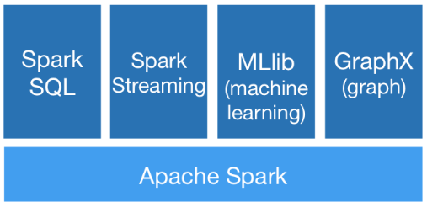
Spark
Contains
  High-level API in Java, Python, R, and Scala
  Optimized engine for general execution graph
    DAG
    MapReduce with only 2 levels
  High-level tools
    SparkSQL
    MLlib
    Spark Streaming
    GraphX

Slide 4
Spark application
Components
  Application
    Independent set of processes on a cluster (+isolation, -no shared data among applications without writing to an external storage)
    Coordinated by SparkContex object in your main program (driver program)
    Driver program must listen for incoming connections from its executors – must be network addressable from executors
    Driver schedules tasks – it should be on the same local network
    Driver program has a web UI – tasks, executors, storage
  Cluster manager
    Allocate resources across applications
  Executor
    On nodes of the cluster
    Executes computations and stores data
    Stays up for the duration of the application
    Runs task in multiple threads

Slide 5
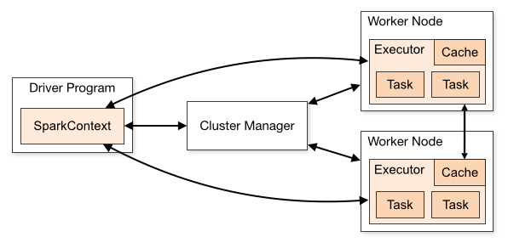
Spark application structure
App structure
  Create SparkContext object
  Connect to the cluster manager(s)
  Acquire executors from cluster manager(s)
  Send your application code to the executors
    Pass Java/Python code/files to the SparkContext
  SparkContext sends tasks to the executors to run

Slide 6
Cluster managers
Cluster managers
  Spark is agnostic to the underlying cluster manager
  Supported cluster managers
    Standalone
      Simple CM included with Spark, easy to setup a cluster
    Apache Mesos
      General CM able to run Hadoop MapReduce and service applications
    Hadoop YARN
      Resource manager in Hadoop 2
    Kubernetes
      Automated deployment, scaling, and management of containerized applications

Slide 7
Data holders
Possible data holders
  RDD
    Resilient distributed dataset
    Immutable collection of elements partitioned across the nodes that can be operated in parallel
    Possibly in-memory
    Automatically recover from node failures
    Core API, from initial release, all languages
  Dataset
    Distributed collection of data
    Since v1.6, available only for Java and Scala
    Strong typing and lambdas from RDD
    Using Spark SQL optimized execution engine
  DataFrame
    Like Dataset, organized into named columns
    Since v1.3, all languages
    Like a table in a relational DB

Slide 8
DataFrame
Construction
  Well known data file formats
    CSV, JSON, …
  Other sources
    External DB, existing RDD, tables from Hadoop, …
Transformations
  Create a new DataFrame from the existing one
  Lazily evaluated, triggered by an action
Actions
  Returns a result to the driver or writes to disk

Slide 9
DataFrame transformations and actions
Transformations (examples)
  select – select a set of columns
  join – join with another DataFrame
  groupBy – groups using specified columns
  filter – filter rows using a condition (bool or string)
Actions (examples)
  show(n) – display the first n rows
  count – number of rows in DataFrame
  collect – return data back to the driver
Example
  df.groupBy("hour").count().show(4)
  df.filter(df.age > 3).collect()

Slide 10
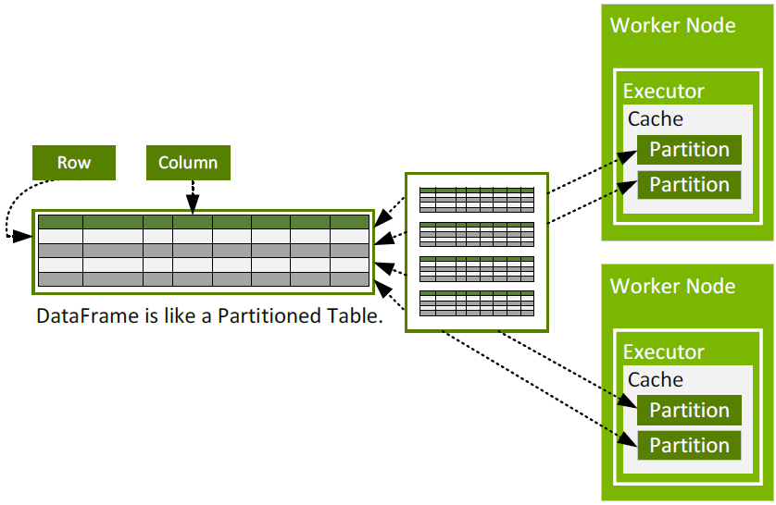
DataFrame partitioning

Slide 11
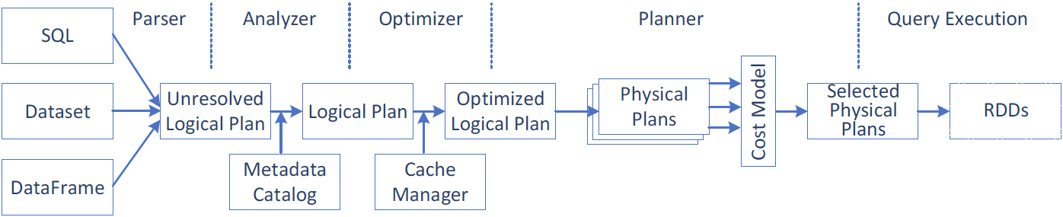
Spark query execution
Query execution steps
  Create a logical plan
  Transform the logical plan to a physical plan
  Generate code
  Execute the tasks on a cluster

Slide 12
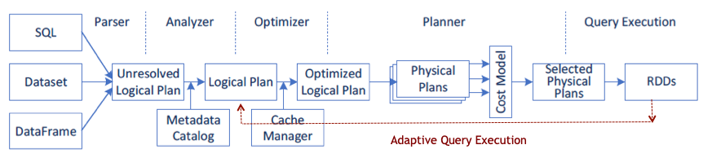
Advanced Spark 3.x features
Adaptive Query Execution (AQE)
  Runtime statistics retrieved from completed stages of the query plan are used to re-optimize the execution plan
  Dynamically coalescing shuffle partitions
    Combine adjacent small partitions into bigger partitions, reducing the number of tasks
  Dynamically switching join strategies
    Optimize join strategy at runtime based on the join relation size
  Dynamically optimizing skew joins
    Detect data skew and split skew partitions into smaller sub-partitions

Slide 13
Advanced Spark 3.x features
Dynamic partition pruning
  Data warehouse queries
    One or more fact tables referencing any number of dimensional tables
  Pruning at runtime by reusing the dimension table broadcast results in hash joins
Accelerator-aware scheduling
  GPU/CUDA with RAPIDS

Slide 14
Parallel aspects
SparkContext type
  parallelize(col, slices)
    Distribute a local collection to form an RDD
  accumulator(ival)
    Creates an Accumulator with initial value
  broadcast(ival)
    Broadcast read-only Broadcast variable to the cluster
RDD type
  aggregate(zeroval, seqop, combop)
    Aggregate elements of each partition and then the results for all partitions
  barrier
    All tasks launched together
  cache
    Partitions cached in memory
  reduce(op)

Slide 15
Shared variables
Accumulator
  Worker tasks can call add(v) operation
  Only driver can read accumulator by calling value() function
  No other operations are defined
Broadcast
  Cached read-only variable
  Tasks can read it by calling value() function

Slide 16
Launching application
Interactive shell
  Only Scala and Python
    YOUR_SPARK_HOME/bin/pyspark
Standalone applications
  Unified launcher
    YOUR_SPARK_HOME/bin/spark-submit
    Important parameters
      --master – URL of the master node for the cluster
      --class – entry point for the application
  Master URL
    local - locally with one worker thread (no para)
    local[K] – locally with K worker threads
    local[*] – locally with max number of worker threads (=cores)
    spark://HOST:PORT – standalone Spark cluster master
    CM://HOST:PORT – connect to cluster manager [mesos,yarn,k8s]

Slide 17
Launching application in SLURM environment
Use prepared environment
  Environment home
    /home/_teaching/para/04-spark
  Spark cluster startup script
    spark-slurm.sh
    Requires
      Spark Charliecloud image directory – spark
      Network interface with IP networking – eno1 for w[201-208]
      R/W directory – your home or project dir, mounted as /mnt/1
      Application – path from the container (/mnt/1/…)
  Launch the script using sbatch command

