Slide 1
Introduction, background, jargon
Jakub Yaghob

Slide 2
Literature
T.G.Mattson, B.A.Sanders, B.L.Massingill: Patterns for Parallel Programming, Addison-Wesley, 2005, ISBN 978-0-321-22811-6
M.McCool, A.D.Robinson, J.Reinders: Structured Parallel Programming, Morgan Kaufmann, 2012, ISBN 978-0-12-415993-8
Threading Building Blocks, www.threadingbuildingblocks.org
OpenMP, www.openmp.org
SPARK, https://spark.apache.org/
CUDA, https://developer.nvidia.com/cuda-zone

Slide 3
Parallel programming
Exploitable concurrency
Why?
  Solve problem in less time
  Solve bigger problem than would be possible on a single CPU
Programmer’s task
  Identify the concurrency in the problem
  Structure the algorithm so that this concurrency can be exploited
  Implement the solution using a suitable programming environment

Slide 4
Goals
Parallel programming in the real world
  Not about algorithms using 2^{n} CPUs
Practical using of different technologies for parallel programming
  TBB, OpenMP, SPARK, CUDA
Application of design patterns for parallel programming

Slide 5
Laboratory – overview
Two SLURM clusters
  parlab – parallel and distributed computing
  gpulab – parallel and GPU computing, Docker
Common homes
  NFS array mounted on /mnt/home
Available software
  CentOS 8.x
  gcc/g++ 11.x
UDSS
  Charliecloud
Info
  https://gitlab.mff.cuni.cz/ksi/clusters

Slide 6
Parlab
Internet
FDR
Infiniband
switch
FC16
SAN
Blade
chassis
parlab
10G
Ethernet
switch
phi[01-02]
w[201-208]
w[401-404]

Slide 7
Gpulab
Internet
Blade
chassis
gpulab
10G
Ethernet
switch
volta[01-05]
dw[01-05]
varjag

Slide 8
SLURM – crash course
Resource manager
  Commands from any node
  Acquire resources before use
  Cluster nodes divided to partitions
Important commands
  srun – acquire resources and immediately run a command, creates a job
  sbatch – acquire resources and run a shell script , creates a job
  scancel – cancel a job
  sinfo – get info about partitions, nodes, …
  squeue – get info about job queue

Slide 9
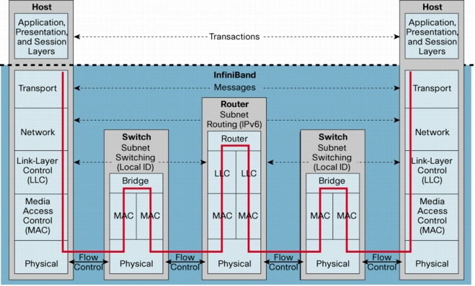
Infiniband protocol stack

Slide 10
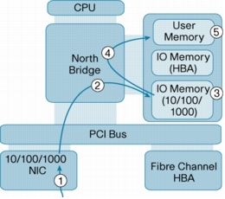
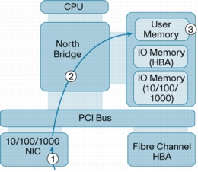
InfiniBand – RDMA (Remote DMA)
a) traditional
b) RDMA

Slide 11
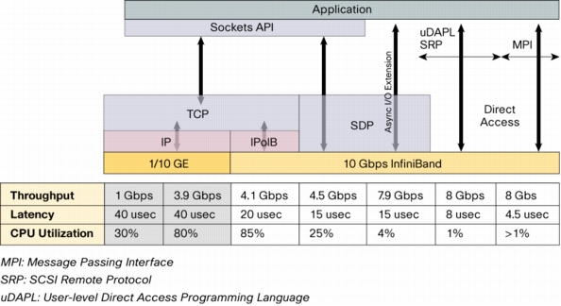
InfiniBand – latency

Slide 12
Flynn’s taxonomy
Single Instruction, Single Data (SISD)
  von Neumann
Single Instruction, Multiple Data (SIMD)
  Vector processors
Multiple Instruction, Single Data (MISD)
  No well-known systems
Multiple Instruction, Multiple Data (MIMD)
  All modern parallel systems

Slide 13
A further breakdown of MIMD – shared memory
CPU
CPU
CPU
CPU
Shared memory
  Symmetric multiprocessors (SMP)
    Easiest to program
    Do not scale well, small number of CPUs
  Nonuniform memory access (NUMA)
    Uniformly addressable from all CPUs
    Some memory blocks may be physically more closely, the access time significantly varies
    Each CPU has a cache, it mitigates the effect of NUMA – cache coherent NUMA (ccNUMA), nearly as SMP (locality issues, cache effects)
memory

Slide 14
A further breakdown of MIMD – NUMA
CPU
CPU
CPU
CPU
CPU
CPU
CPU
CPU
memory
memory
memory
memory
CPU
CPU
CPU
CPU
CPU
CPU
CPU
CPU

Slide 15
A further breakdown of MIMD – distributed memory
Distributed memory
  Own address space, message passing
  Explicitly program the communication, the distribution of data
  Massively parallel processors (MPP)
    CPUs and network tightly coupled
  Cluster
    Composed of off-the-shelf computers connected by an off-the-shelf network

Slide 16
A further breakdown of MIMD – clusters
Clusters
  Hybrid systems
    Each node several CPUs with shared memory
  Grids
    Heterogeneous resources
    Connected by Internet
    Various resources in the grid do not have a common point of administration

Slide 17
Parallel programming environments
OpenMP
  Set of language extensions implemented as compiler directives (Fortran, C, C++)
  Works well on SMP, less ideal for NUMA or distributed systems
MPI
  Set of library routines – process management, message passing, collective communication operations
  Difficult to write – explicit data distribution, interprocess communication
  Good choice of MPP
Combination for hybrid systems

Slide 18
The jargon
Task
  Sequence of instructions that operate together as a group
  Logical part of an algorithm
Unit of execution (UE)
  Process or thread
  Tasks are mapped to UEs
Processing element (PE)
  HW element that executes a stream of instructions

Slide 19
The jargon
Load balancing
  How well the work is distributed among PEs
Synchronization
  Enforcing necessary ordering constraints
Synchronous x asynchronous
  Coupling two events in time
Race condition
  Outcome of a program depends on on the scheduling of UEs
Deadlock

Slide 20
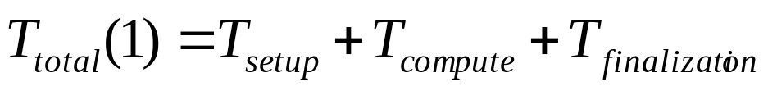
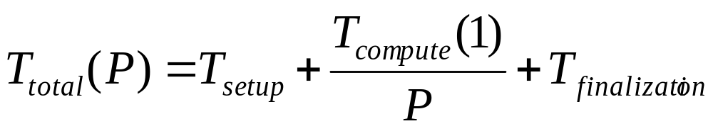
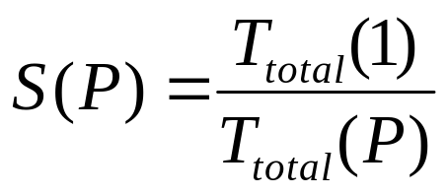
Performance modeling
Total running time on one PE
Total running time on P PEs
Speedup

Slide 21
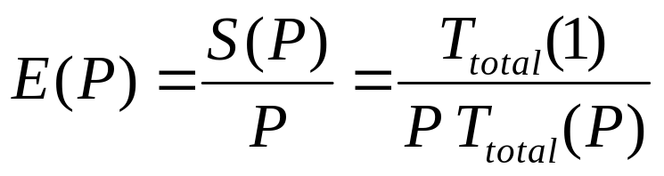
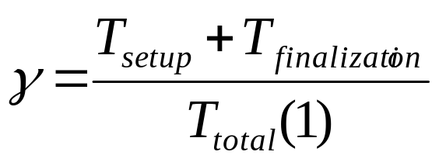
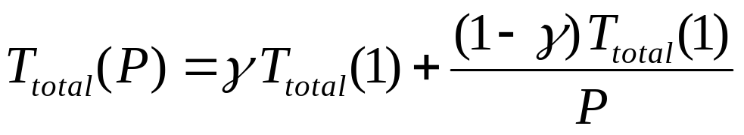
Performance modeling
Efficiency
Perfect linear speedup: S(P)=P
Serial fraction
Rewrite total running time for P PEs

Slide 22
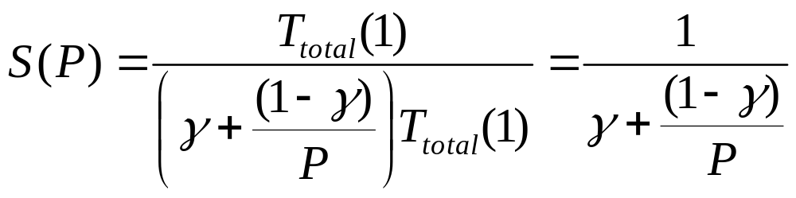
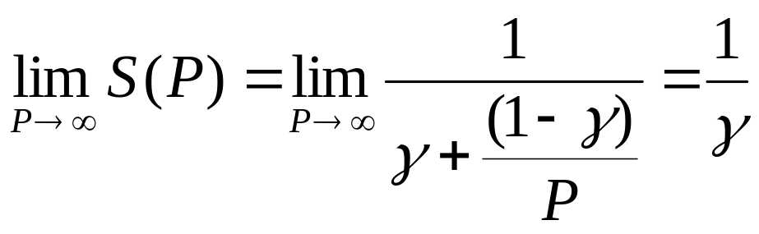
Amdahl’s law
Rewriting the speedup
No overhead in the parallel part
The same problem with varying number of CPUs
Very large number of CPUs

Slide 23
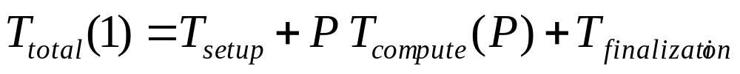
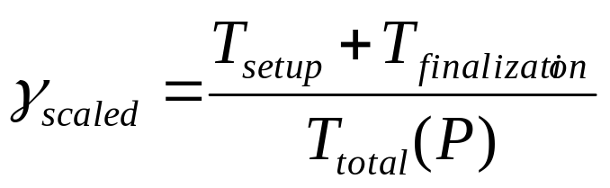
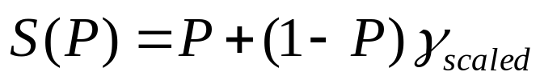
Gustafson’s law
Rewrite total running time when executed on P PEs
Scaled serial fraction
Rewrite
Rewrite speedup – scaled speedup
What happens, when the number of PEs is increased (γ_{scaled} is constant)?

Slide 24
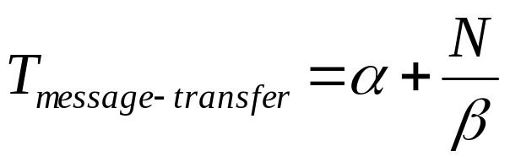
Communication
The total time for message transfer (Bandwidth β, length N)
Latency α
  Fixed cost
  The time it takes to send an empty message to the time it is received
Latency hiding
  Overlapping communication
  Mapping multiple UEs to each PE

Slide 25
Design patterns
Organized into design spaces
Guidance through the entire process of developing a parallel program
Finding Concurrency
Algorithm Structure
Supporting Structures
Implementation Mechanisms

Slide 26
Design spaces
Finding Concurrency
  Structuring the problem to expose exploitable concurrency
  High-level algorithmic issues
Algorithm Structure
  Structuring the algorithm to take advantage of potential concurrency
  How to use concurrency exposed in Finding Concurrency
  Overall strategies for exploiting concurrency

Slide 27
Design spaces
Supporting Structure
  Intermediate stage between Algorithm structure and Implementation mechanisms
  Program-structuring approaches
  Commonly used data structures
Implementation mechanisms
  How the patterns of the higher-level spaces are mapped into particular programming environments
  Not patterns

Slide 28
Design process
Design process starts in the problem domain
The ultimate aim of the design process is software
  At some point, the design elements change into ones relevant to program
  Program domain
Be careful!
  After a problem has been mapped onto the program domain too early, it can be difficult to see opportunities to exploit concurrency

